Slide 1



  Module 2: Lesson 1
  Creating a Career Pathway
U.S. Department of Labor—Employment & Training Administration| Missouri Economic Research and Information Center| Missouri Department of Economic Development
This project has been funded, either wholly or in part, with Federal funds from the Department of Labor, Employment & Training Administration under Task Order Number DOLJ061A20373; the mention of trade names, commercial products, or organizations does not imply endorsement of same by the U.S. Government.
Notes:
Hi everyone, thank you for joining us again. Today will be going over the first lesson in Module 2: Using Skill Assessments and Career Pathway Planning. In lesson one, we will be Creating a Career Pathway using some essential Labor Market Information data tools. Before we begin, please remember that you must complete Module 1:LMI Fundamentals, Lessons 1 & 2 before you can begin this lesson. It is a pre-requisite to all courses and will cover many of the Labor Market Information basics before we go in-depth throughout the module 2 lessons.

Slide 2
Today’s Lesson
Module 1: Labor Market Information Fundamentals
Module 2: Using Skill Assessments & Career Pathway Planning
  Lesson 1: Creating a Career Pathway
  Lesson 2: Skills Assessments and Career Exploration Tools
Module 3: Using Economic & Workforce Data to Drive Reemployment Strategy
Module 4: Guiding Businesses/Partners to Use Workforce System & LMI Resources to Support Human Resource Functions
Notes:
Today we are beginning module 2 with learning how to create a career pathway. We will further advance the planning in lesson 2 by incorporating more advanced LMI data tools and skills assessment programs, and by giving you a chance to walk through the LMI tools we have shown and answer questions to corresponding case studies so you have a chance to master the LMI presented in this module.

Slide 3
What’s in it for me?
After participating in this module, you will be able to:
  Identify what LMI sources will be relevant to your job seekers
  Identify Steps to Assist Job Seekers
    Gain a deeper knowledge of working with LMI data types/sources for Steps 1 & 2
  Establish a more targeted and simple approach for using LMI with your job seekers
Notes:
After this first lesson, we want you to be able to:
Identify what LMI sources will be relevant to your jobseekers
Gain a deeper knowledge of working with LMI data sources as we begin learning Steps to Assist Job Seekers and;
Establish a more targeted and simple approach for using LMI with your job seekers

Slide 4

What are your next moves?
Locate the LMI data you need
Collaborate with business representatives, managers, counselors, etc. from your area
Navigate and retrieve the LMI
Notes:
So what are your next moves now that you’ve identified the LMI data you want and where do you go to retrieve it? One of the most difficult parts of working with LMI is sorting through it all and only getting what you need. What we hope to do with this lesson is show you exactly what tools will help with these NGCC (Next Generation Career Centers) so you don’t get lost in a sea of data. The hardest part of LMI is knowing where to look. We will show you the LMI tools that are most useful to helping job seekers and help you understand who you can collaborate with for data to save you and your job seeker time in their career search.

Slide 5

The Four-Step Job Seeker Process
Identify your affected industry & job seeker
Study staffing patterns
Determine your job seekers transferable skill set
Narrow down the occupations within the industry that have similar skills for job seekers
Notes:
Setting up a series of traceable steps for workforce developers to use as they assist job seekers can make the process much simpler and consistent throughout the Next Generation Career Centers. This is our four step aid to assisting job seekers process. Not all four steps are going to be necessary in every situation, but the procedure for creating the career pathway for your job seekers will always stay the same. Let’s take a look at each step and see how it can assist your job seekers with finding their perfect career path.
Step 1 is to identify the affected job seeker and industry. This could be an industry that is experiencing mass layoffs and you know that many of those dislocated workers will be going to you for career assistance, or just an industry that a job seeker has expressed an interest in. This is the most broad and basic step of the process.
Step 2 requires that you dig deeper into your selected industry and occupations. What are the trends for growth or decline? What occupations are prevalent in the industry?
Step 3 will have you looking more in-depth into your job seeker. This step is less about LMI and more about what you do best at the NGCC’s. Have the job seekers taking their WorkKeys testing, find out their interests in the O*Net Career Interest Profiler, and any of the other tests you think necessary to find out what your job seeker is good at and what they are interested in doing.
The last step is combining all that data and looking at the new lists of occupation within their selected industry that match their skills set. We’ll show you how to identify whether a job is in-demand, what education and training they will need to acquire, and what wages they should expect if they choose a particular occupation.
In lesson 1 of Module 2, we are going to cover steps number 1 and 2. Steps 3 and 4 will be covered in Lesson 2.

Slide 6
Putting the Four-Step Process into Practice……
  Get to know your job seeker’s needs
  Look at local industry employment trends
  Look at local industry projection data
  Look at any WARN notices you have received regarding that industry
  Collaborate with local Business Reps for additional information
Step1: Identify your affected industry and job seeker.
Notes:
As you’ll recall from the previous slide, step 1 is identifying your affected job seeker and industry. The easiest way to start this task is by getting to know your job seeker and their needs. So let’s begin……..

Slide 7

Getting to know your Job Seeker
Robert Smith
  Manufacturing Supervisor at beverage manufacturing company
  Laid off due to production cutbacks
  Age 35
  Cannot complete additional training without income
  Can’t relocate due to family
Notes:
In this scenario, this is our dislocated worker: Robert Smith. He was a manufacturing supervisor at a beverage manufacturing company. Unfortunately due to cutbacks in production he was laid off. He’s coming to your Next Generation Career Center to figure out what his next steps for re-employment are and he’s not quite sure what he wants to do now.
He’s only 35 years old so starting a new career is feasible to him, but he would like to have some familiarity with either his current occupation or industry. He’s open to getting additional training if it will help him in the long run with his career, but he won’t be able to accomplish completing the training without some supplemental income to cover costs. He also can’t easily relocate from your region as his wife has a job, they own a house, and his kids are still in school and wouldn’t adjust well to moving.
How can we help Robert?

Slide 8
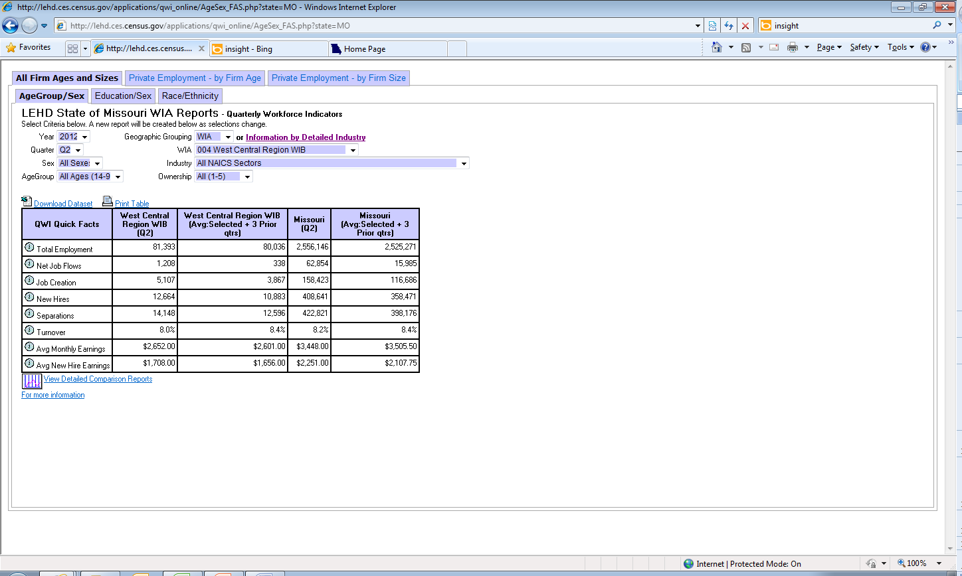
Notes:
The Longitudinal Employer Household Dynamics (LEHD) for Missouri are available on the MERIC website and can be sorted in a variety of ways. You can look at the employment by industry for a certain year and quarter. For a location search, the sort can be done by metro, county or WIA area. You can also choose to look at specific groupings of workers, like age groups or the worker’s gender. Ownership for the industry can also be determined within the page details.
Industry employment numbers are not the only information displayed for your selections. You can also retrieve data on job flow, creation, turnovers, and separations so that you can get a better insight into your industry’s outlook.
However, at its most basic level as seen here, you can only view industries at the 2-digit NAICS sector level. To view more detailed industry data, click on the Information by Detail Industry link next to the pull down menu for Geographic Grouping.

Slide 9
Putting the Four-Step Process into Practice……
  Get to know your job seeker’s needs
  Look at local industry employment trends
  Look at local industry projection data
  Look at any WARN notices you have received regarding that industry
  Collaborate with local Business Reps for additional information
Step1: Identify your affected industry and job seeker.
Notes:
Now that we have met with Robert and understand his dilemma a bit more, it is time to take a closer look at his industry to see if his company’s layoff was simply a fluke or something that was predicted by the employment trends using our labor market information. This can also help us understand his likelihood of being re-employed within the Beverage Manufacturing industry. To do this, we are going to take a closer look at his industry’s employment data through our Longitudinal Employer Household Dynamics (LEHD).

Slide 10
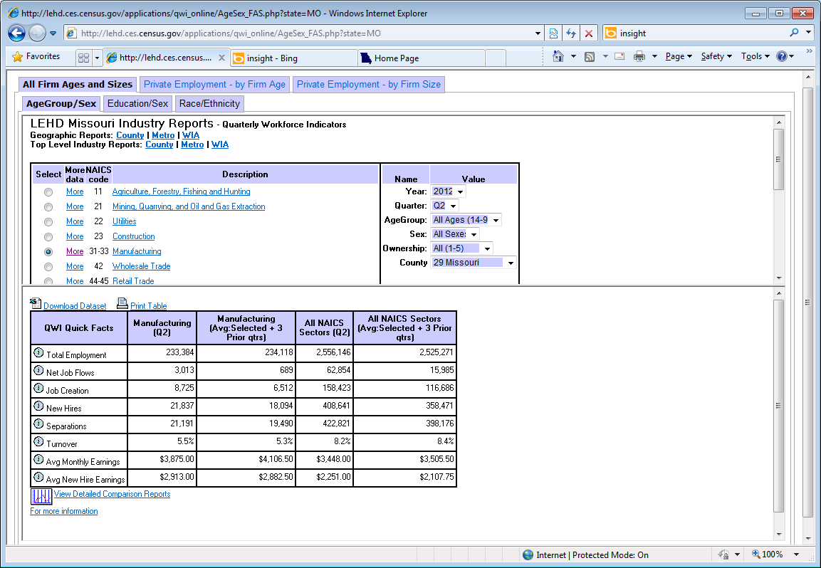
Notes:
Once again you can do all the sorting as we have mentioned previously with areas, year and quarter, as well as age or gender, but now we can see that there is more detailed industry data available for us to look through for Robert’s career path plans…….by clicking the More hyperlink next to the NAICS code you are interested in, you will have the options for even more advanced detailed NAICS industry employment data. In Robert’s case, we want to look at the Beverage Manufacturing industry in more detail.

Slide 11
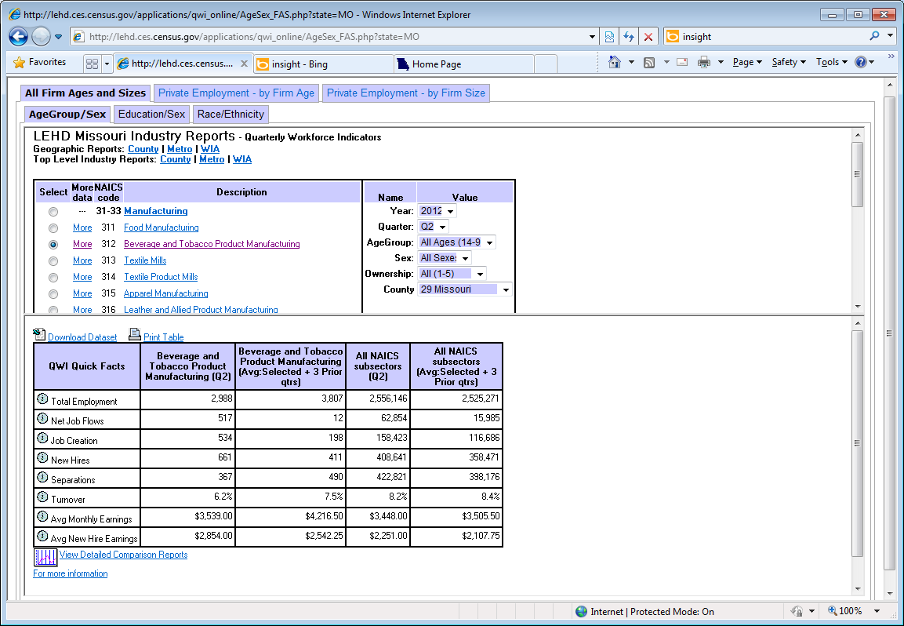
Notes:
On this page, you can see the NAICS broken down to the 3 digit level, with the continued option to choose more again if you are looking to find more specific data for the Beverage & Tobacco Product Manufacturing Industry …….as you can see the numbers filling in at the dataset below continue to become more refined with each selection we make to the Quarterly Workforce Indicators.

Slide 12
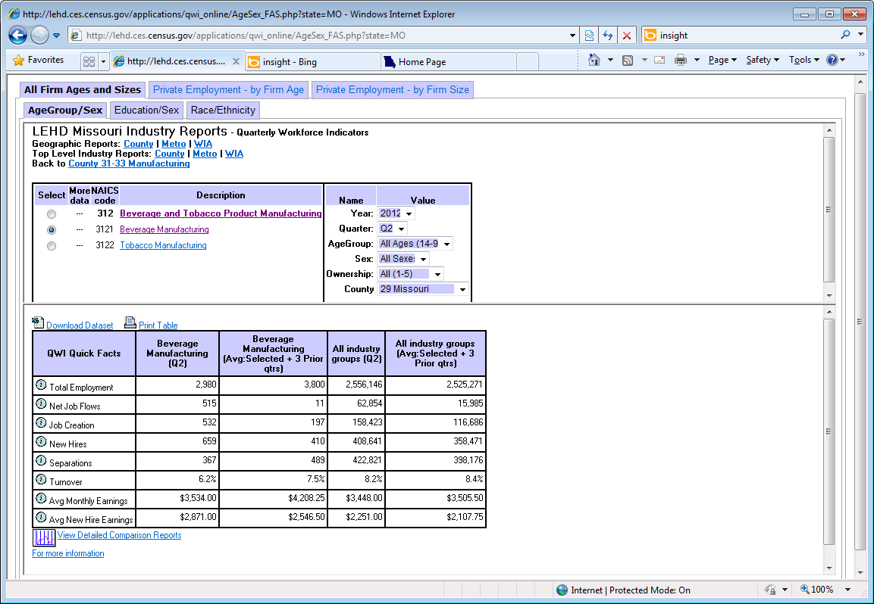
Notes:
By breaking the NAICS code down to the 4 digit level, we are able to get a much more detailed picture of what Robert’s industry is looking like now. We can specifically choose to look at Beverage Manufacturing and see what lies in store for his future in the industry.
Just by glancing at the numbers, we can see that the total employment for 2012 Quarter 2 is about 800 employees less than the average employment from the previous three quarters, New hires have increased to 659 from the previous average of 410, and the turnover rate for employees has decreased from 7.5% to 6.2%.
While the turnover rate has decreased and new hires have increased, the drop of total employees in the industry is worrisome.

Slide 13
Putting the Four-Step Process into Practice……
  Get to know your job seeker’s needs
  Look at local industry employment trends
  Look at local industry projection data
  Look at any WARN notices you have received regarding that industry
  Collaborate with local Business Reps for additional information
Step1: Identify your affected industry and job seeker.
Notes:
As we know, industry employment can change over time and it is possible that Beverage Manufacturing is simply having a rough time. Fortunately, there is an LMI tool that will allow us see what lies ahead for Robert’s industry. Let’s look at the industry projections……..

Slide 14
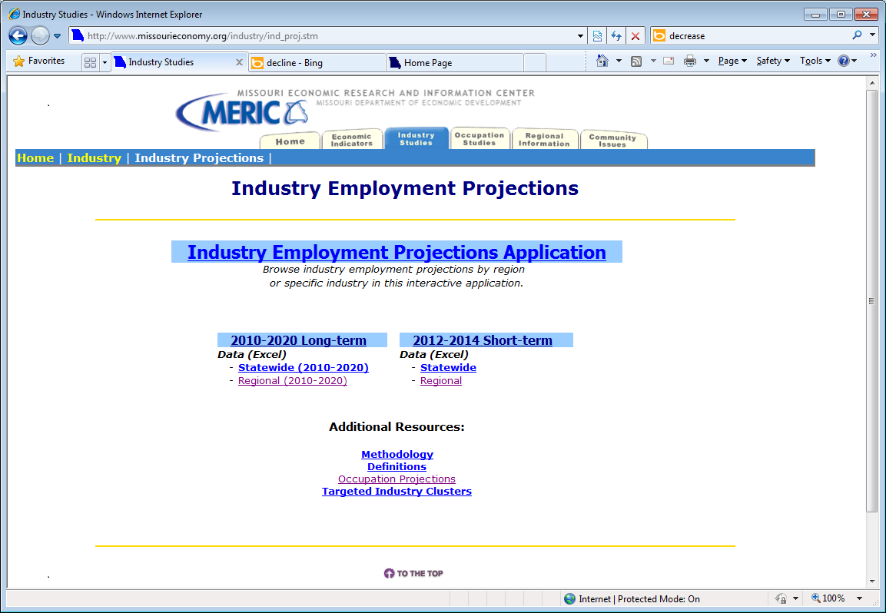
Missouri and Regional Industry Outlooks
Notes:
Industry employment projections are useful to see the projected trends in both short-term and long-term periods. The state of Missouri puts out statewide and regional industry employment projections using employment data from the Quarterly Census of Employment and Wages along with National Employment projections and other economic indicators that can be attributed to affecting employment. Short-term projections are produced annually for the state, as well as the St. Louis and Kansas City WIAs. Long-term projections are produced bi-annually for the state and all10 WIAs.
The employment projections can give career counselors and job seekers a better idea of what direction employment in their industry is headed.

Slide 15
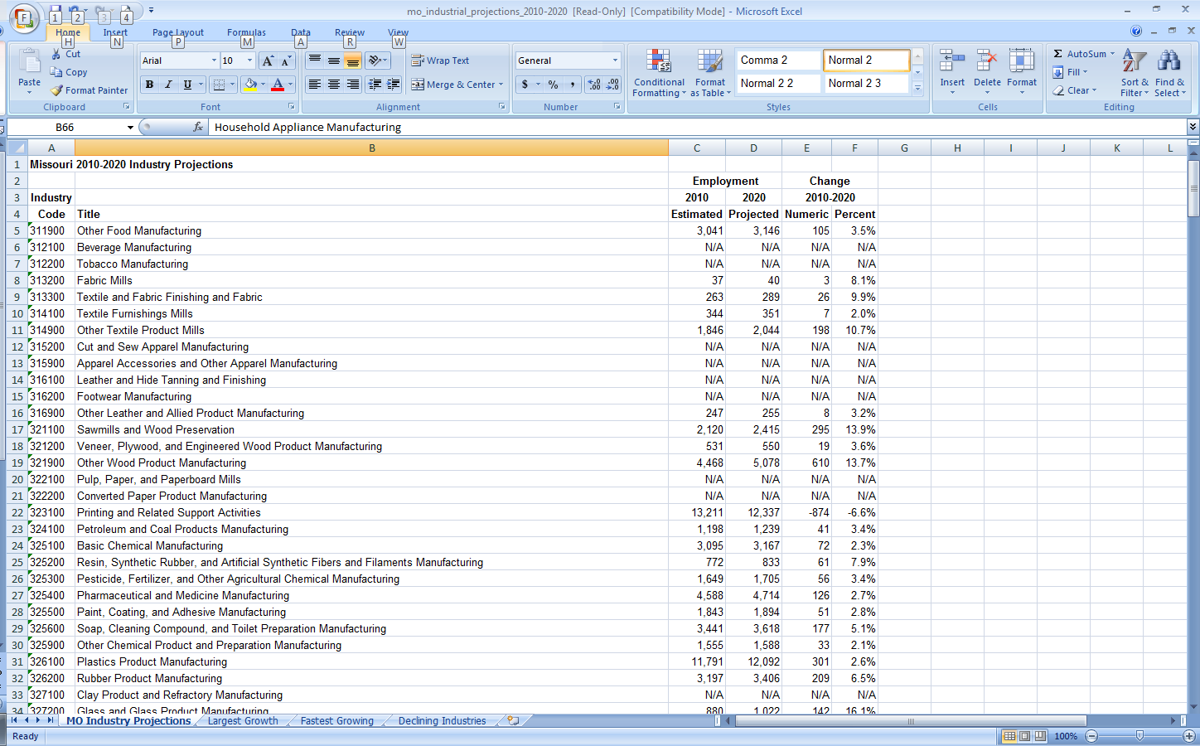
Missouri Long-term Industry Projections
Notes:
This is an example of what the Missouri Long-term Industry Employment Projections excel file looks like when you click the links on the previous slide. Here, we can look at Robert’s industry: Beverage Manufacturing and see how it is projected to change until 2020. Due to confidentiality, some of the numbers may not be available, as seen here with Beverage Manufacturing.
However, due to regional differences in economic makeup across the state, it is possible for industry data to be suppressed in one area but not all areas. Lets take a look at the Central WIA and see if we can find projections for Robert's industry there.

Slide 16
Missouri Long-term Industry Projections
Notes:
If we look at the Central WIA we see that data is available for Robert’s Industry. Beverage Manufacturing to projected to decline by .5% over the 10 year period.

Slide 17
Putting the Four-Step Process into Practice……
  Get to know your job seeker’s needs
  Look at local industry employment trends
  Look at local industry projection data
  Look at any WARN notices you have received regarding that industry
  Collaborate with local Business Reps for additional information
Step1: Identify your affected industry and job seeker.
Notes:
Some additional actions a career counselor can take to understand the affected industry is to look into any WARN notices that may have been published letting you know any future or continuing lay offs.

Slide 18
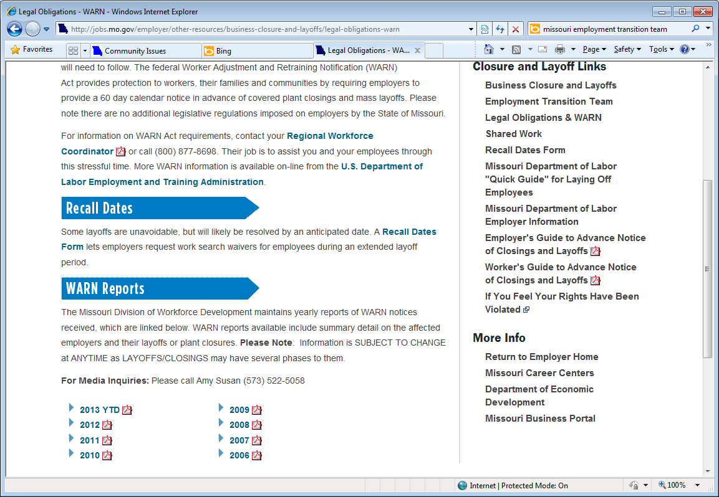
Employment Transition Team and WARN Notices
http://jobs.mo.gov/employer/other-resources/business-closure-and-layoffs/legal-obligations-warn
Notes:
A WARN notice requires employers to provide at least 60 days notice in advance of any large plant closings or mass layoffs. They’re viewable on the Missouri Employment Transition Team website and are sorted by year. You can view these notices to see if there will be any additional layoffs to the affected industry within your area or a related industry that may affect Beverage Manufacturing’s employment in the future.

Slide 19
Step 1 Website Links
Industry Projections:
http://www.missourieconomy.org/industry/ind_proj.stm
Local Employment Household Dynamics:
http://www.missourieconomy.org/indicators/lehd/index.stm
Warn Reports:
http://jobs.mo.gov/employer/other-resources/business-closure-and-layoffs/legal-obligations-warn
Notes:
Here are the website links to the LMI Data tools that we walked through in Step 1 of the Four Step Aid to Assisting Job Seekers. Please feel free to pause the webinar here and practice using these data tools yourself. Otherwise make note of them and continue on with the remainder of the lesson.

Slide 20
Putting the Four-Step Process into Practice……
Step 2: Study industry and occupational staffing patterns
BLS Industry Staffing Patterns
BLS Occupational Staffing Patterns
Occupational Projection Analysis
Notes:
Now that we have covered all the basic aspects of becoming familiar with Robert’s industry in Step 1, we can get more in-depth with his chances of re-employment in either his industry, occupation, or both. The tools that we will use for in Step 2 are nationally created within the Bureau of Labor Statistics. Due to confidentiality restrictions, Missouri cannot typically publish their industry or occupational staffing patterns, but the good news is that Missouri employment trends almost always closely mirror national trends so using the BLS data can be just as beneficial.

Slide 21
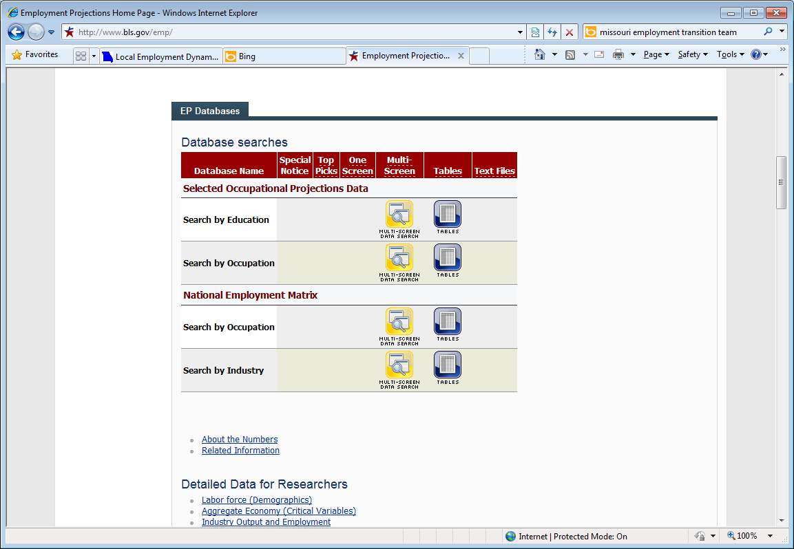
http://www.bls.gov/emp/
Notes:
Industry and Occupational Staffing patterns can be found on the BLS website within their Employment Projections data sets. Under the National Employment Matrix you can choose to either search by industry or occupation. Staffing patterns are extremely useful for job seekers looking to stay within their chosen industry or occupation. You can chose the specific industry and see which occupations are employed within it and what their projected trends will be over the long-term. Likewise with occupations, you will be able to see all the top employing industries for that occupation.
We’ll walk through both tools here, but let’s start with looking at the Beverage Manufacturing Industry since we have been discussing it up until now. It’s a relatively easy tool to walk through. To begin, click on the Multi-Screen data search next to the Search by Industry row.

Slide 22
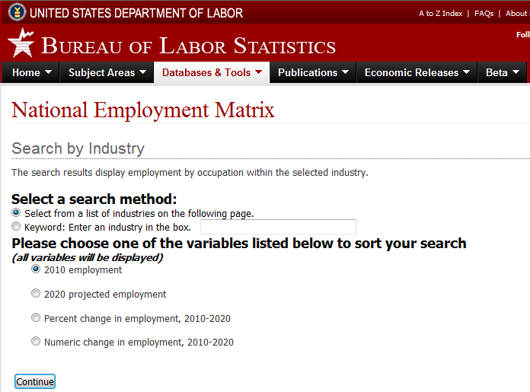
Notes:
Within this page, you can either select to choose the industry from the following page or type in the industry within the search box. We’ll choose Beverage Manufacturing from the following page so we can see what the sort looks like. You must also choose one of the four projections variables from the list that the occupations will be sorted by.

Slide 23
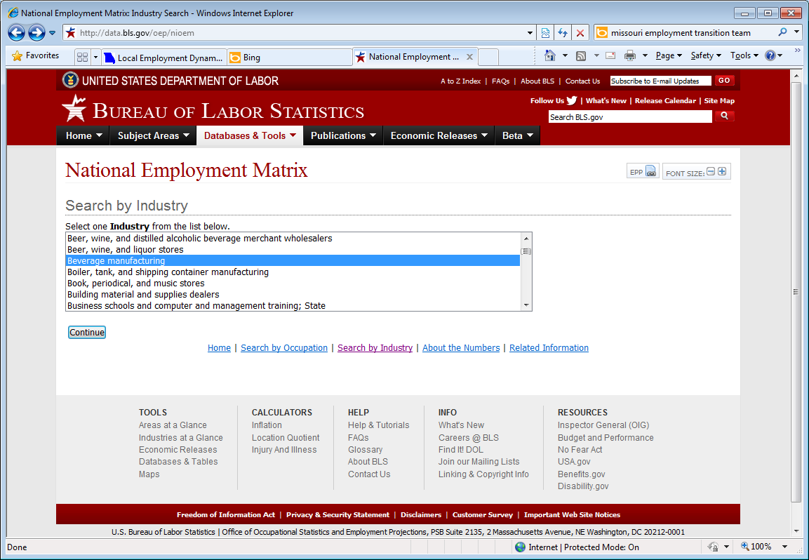
Notes:
From this drop-down list, all we have to do is select Beverage Manufacturing to see Robert’s industry’s outlook……

Slide 24
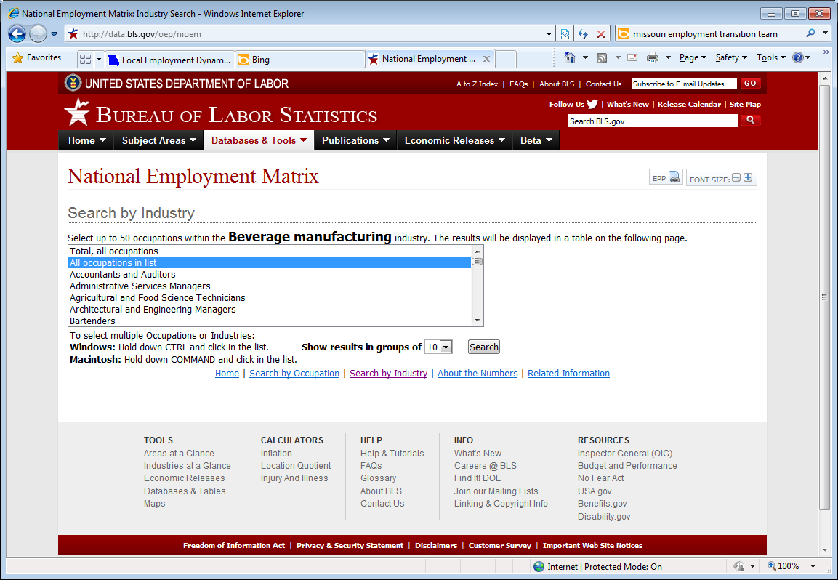
Notes:
On the final search page, we can choose to look at Robert’s previous occupation specifically, all the occupations available in the industry, or a comparison of occupations that you choose. We’ll look at all occupations in the list so Robert can see where his occupation lies in the staffing patterns and compare it with other top occupations to see if looking into a new field is necessary for him.

Slide 25
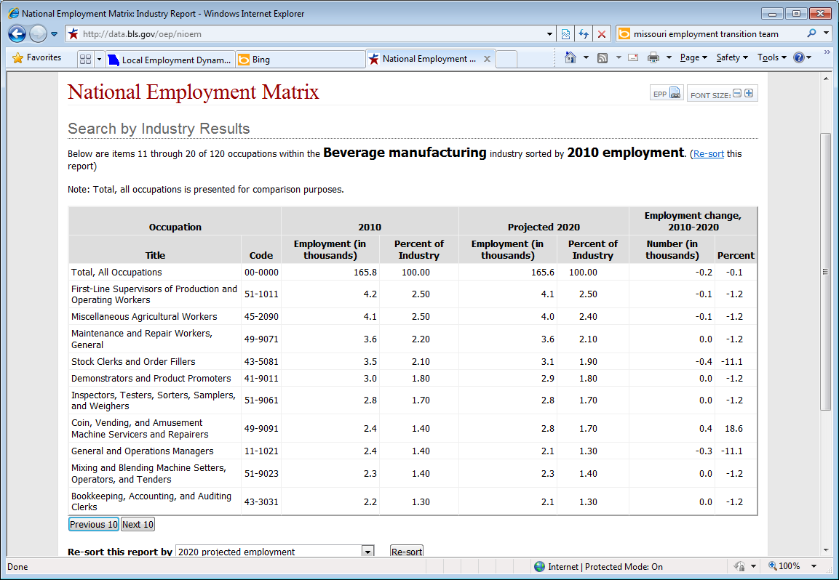
Notes:
Now, we finally get to see the staffing pattern. The Top row will always be the total of all occupations in Beverage Manufacturing so you can see how other occupations are comparing with the total average.
Robert’s SOC Code occupation, First-line supervisors/managers of production and operating workers are actually the highest employing occupation in Beverage Manufacturing. This might sounds like good news to Robert since it seems to be a popular occupation in the industry, but looking at the employment columns might start to dampen his mood a bit. From 2010 to 2020 total employment for his occupation within Beverage Manufacturing is projected to decrease by 1.2%. Robert begins to wonder if maybe he should consider staying with his occupation, but switching industries…..

Slide 26
Putting the Four-Step Process into Practice……
Step 2: Study industry and occupational staffing patterns
BLS Industry Staffing Patterns
BLS Occupational Staffing Patterns
Occupational Projection Analysis
Notes:
To look and see if Robert’s idea for switching industries is a good idea, we’ll now look at the BLS staffing patterns by occupation. It’s very similar to what we just walked through with industry staffing patterns, but it will be able to tell him if there is a closely related industry to Beverage Manufacturing that might actually be expanding and hiring in the near future.

Slide 27
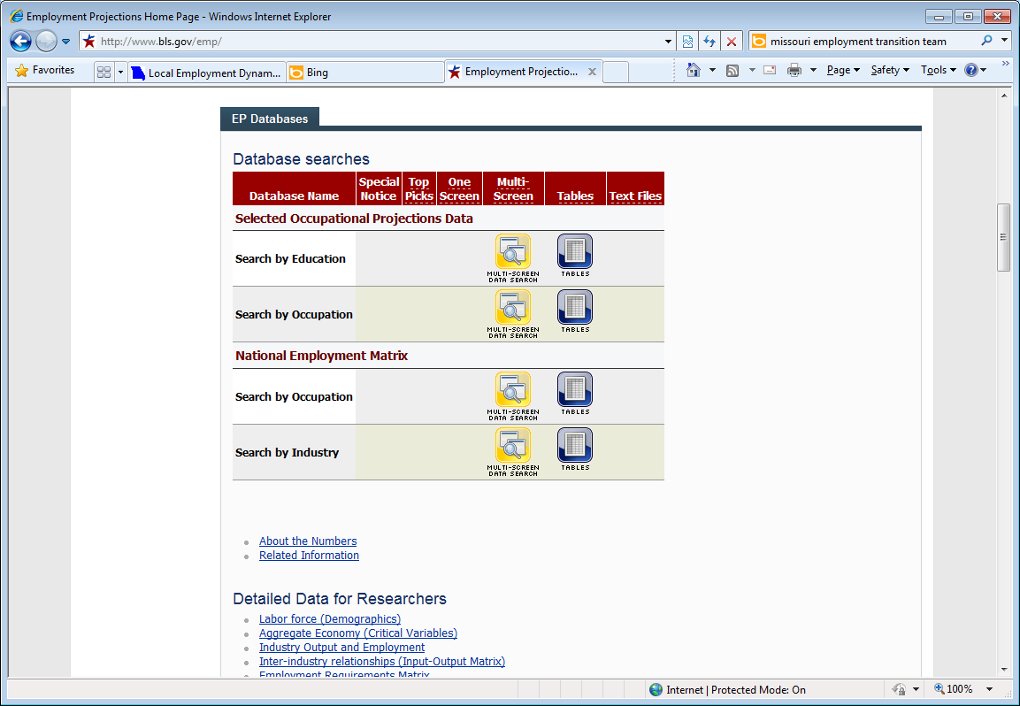
Notes:
Just like before with the industry staffing patterns only this time we will choose the Multi-Screen Data search in the Search by Occupation row.

Slide 28
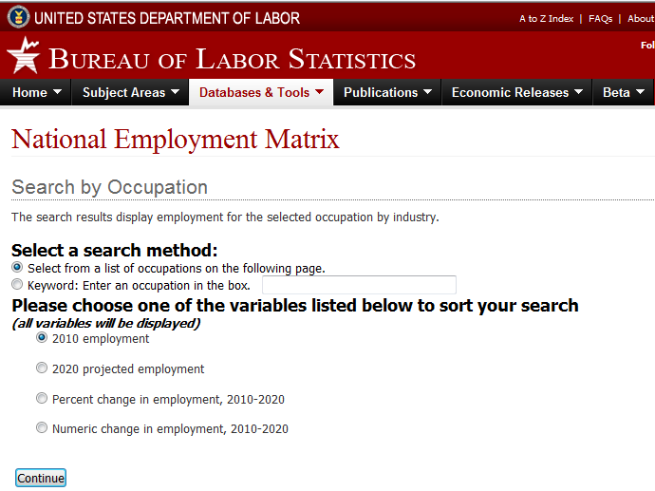
Notes:
Just as before, we can type in Robert’s occupation in the search box or choose from the following page (click), and we must choose the variable (click)we want to sort the industry’s employment by.

Slide 29
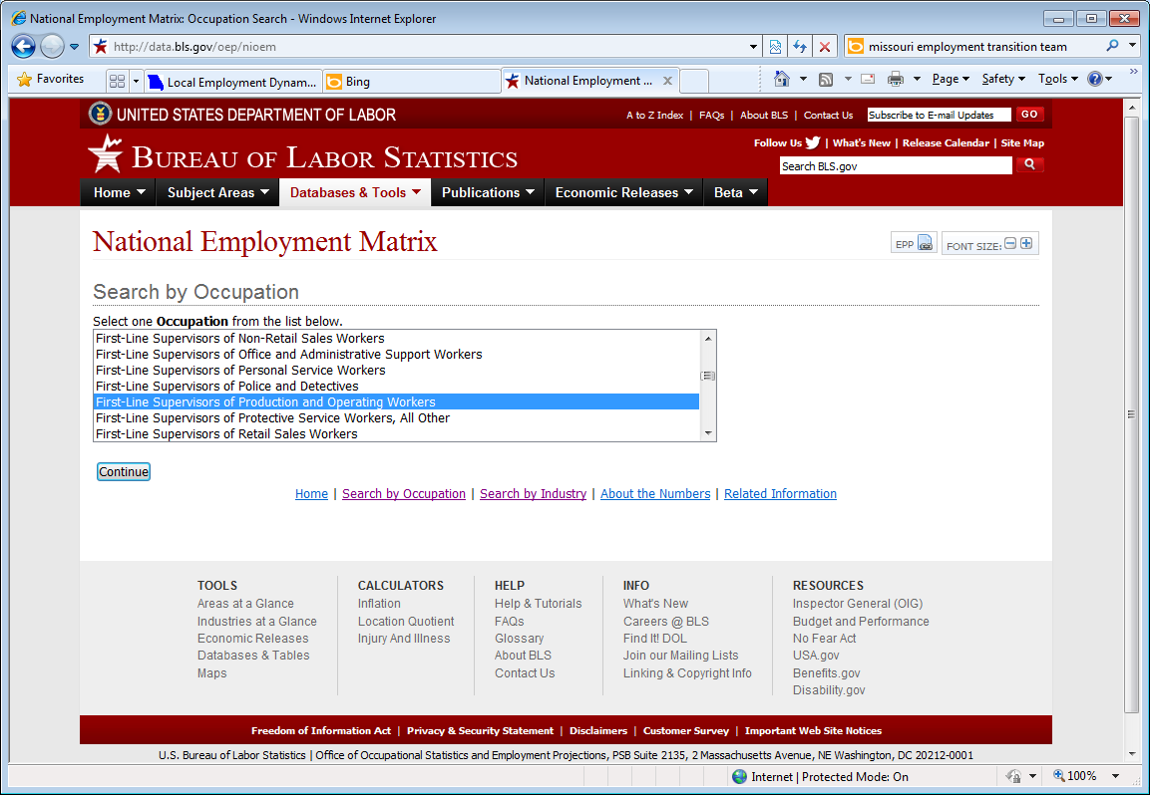
Notes:
In the Occupation search we choose First-line supervisors/managers of production and operating workers. Since his job title was Production Supervisor, it is the closest match with the BLS SOC codes.

Slide 30
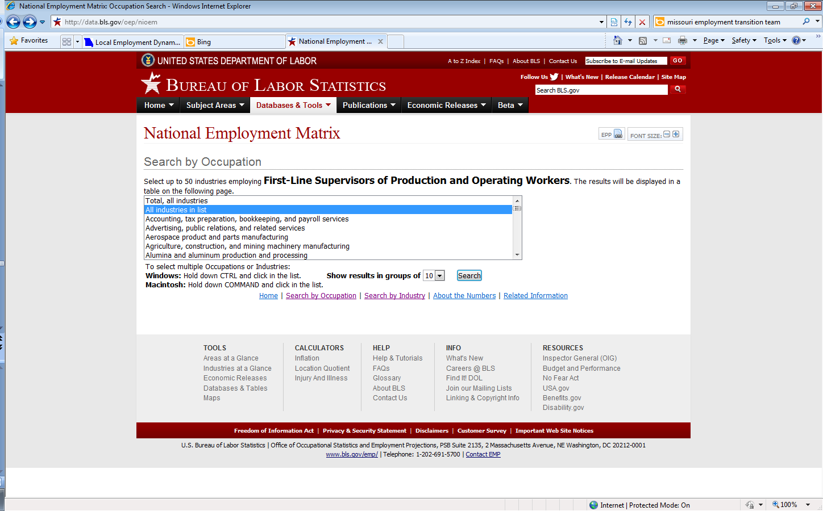
Notes:
Here again, we choose what industries we want to see employing his occupation. We are going to choose to see all industries

Slide 31
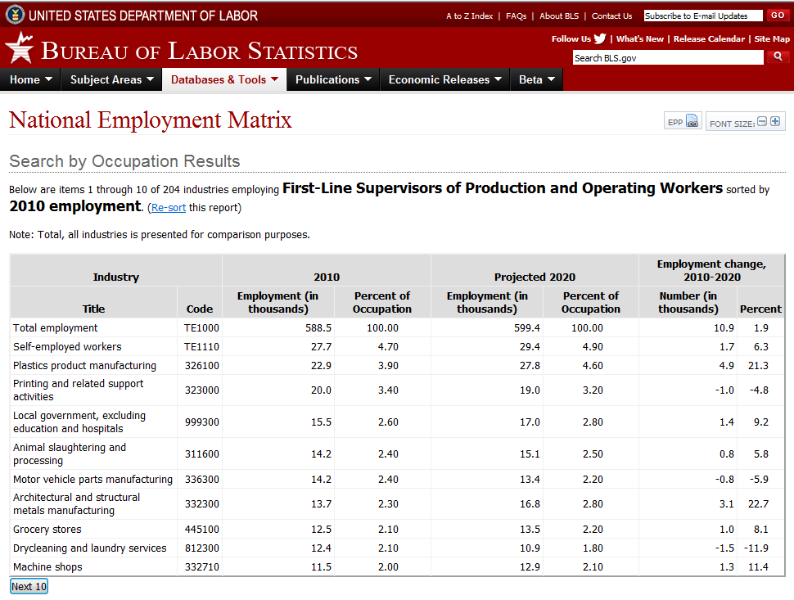
Notes:
Here is the occupational staffing pattern for First-line Supervisors/managers of Production and Operating Workers. Let’s take a closer look now.
Robert can now look through the top employing industries for his occupation and see that many of top 10 are actually growing in employment. Now he has a better idea of whether or not it is worth it to continue on with his career and simply gain additional training to meet the demands of his newly selected industry.

Slide 32
Putting the Four-Step Process into Practice……
Step 2: Study industry and occupational staffing patterns
BLS Industry Staffing Patterns
BLS Occupational Staffing Patterns
Occupational Projection Analysis
Notes:
If Robert still wants a better understanding of his occupation and would like to see more regionally specific data, you can assist him with data from the Missouri Occupational Employment Projections.
By looking into the Occupational Employment Projections, you will have gathered all the current and future employment data for First-line Supervisor/Manager of Production and Operating Workers.

Slide 33
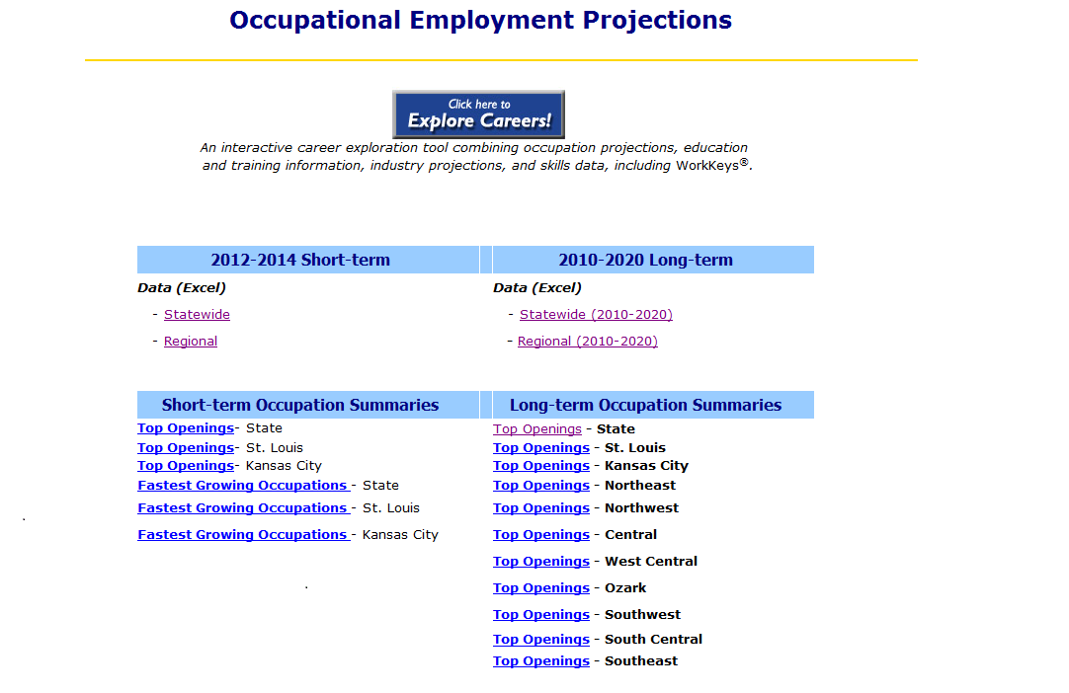
Regional Long-term Occupational Projections
Notes:
Like the Industry Employment projections, the occupational employment projections are designed to be available for both short-term and long-term periods. The same geographic restrictions apply for the available projections as they did with industry. Missouri, St. Louis, and Kansas City WIAs available for short-term, and Missouri and all 10 WIAs available for long-term. The main difference between the industry projection and occupational projections is the amount of data available. There are hundreds of occupations to look through. Besides employment data you can see wage data, typical education and training needs for occupations, and how many openings there will be within the projected time period. You can also see career grades for each occupation.
Let’s see what Robert’s occupational projection is for the long-term in the Central WIA region

Slide 34
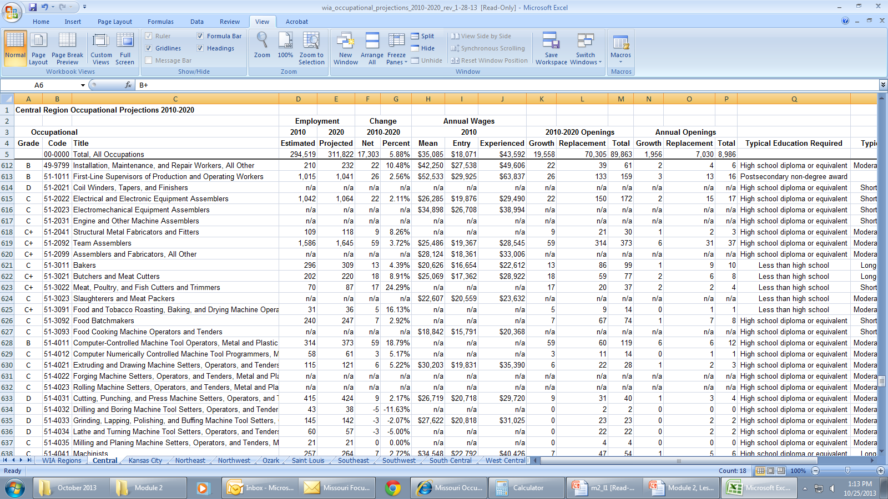
Regional Long-term Occupational Projections
Notes:
Looking at the employment data for Robert’s occupations for the Central WIA is somewhat promising. There’s projected to be an increase of 2.56% from 2010-2020. However, of the 159 projected openings over the 10 year period, only 26 are to be growth openings. Maybe a new career isn’t too far off in his future……..we’ll continue with the next step of the Job Seeker Aid and see what lies ahead for Robert.

Slide 35
Step 2 Website Links
BLS Industry Staffing Patterns:
http://www.bls.gov/emp/
BLS Occupational Staffing Patterns:
http://www.bls.gov/emp/
Occupational Projections: http://www.missourieconomy.org/occupations/occ_proj.stm
Notes:
Here are the website links to the LMI Data tools that we walked through in Step 2 of the Four Step Aid to Assisting Job Seekers. Please feel free to pause the webinar here and practice using these data tools yourself. Otherwise make note of them and continue on to finish the lesson.

Slide 36
Beverage Manufacturing Management
What We’ve Learned
What’s Next
LEHD – Statewide the industry has small employment and recent job loss
BLS – The beverage manufacturing industry has a 10-year nationally projected employment loss of 0.1% and occupation’s loss of 1.2%
Occupation Projections –In the Central Region First-line production supervisors have a 10 year projected employment increase of 2.56%
Step 3: Determine your job seeker’s transferable skill sets
Step 4: Narrow down the occupations within the industry with similar skills
Notes:
So to sum up what we learned for Robert in the first two steps of the Four Step Aid to Assisting Job Seekers:
Statewide the industry has a smaller employment base and recent job loss
Nationally Beverage manufacturing is projected to have a .1% employment loss by 2020, his occupation is expected to decrease 1.2%
However regionally his occupation is expected to increase 2.56% by 2020
In the next lesson we will finish looking at the four steps to assist Job Seekers by looking at skills assessments available within our Next Generation Career Centers. Then we will use Career Exploration tools to narrow down some occupations and industries for Robert to begin looking into for his re-employment.

Slide 37
Module 2: What’s Next?
After participating in this module, you will be able to:
  Categorize employer challenges
  Identify targeted LMI sources to address needs
  Navigate to dynamic data to provide answers
Lesson Two: Career Exploration and Assessments
  Continuing Steps 3 & 4 of the Four Step Aid to Assisting Job Seekers
    Career Assessments
    O*Net Online usage
    Missouri Education and Career Tool
Lesson Three: Practice with O*Net and Toolbox
Notes:
In Lesson 2 we look at some of the popular skills assessments that most Missouri NGCC’s are currently using including O*Net’s Career Interest Profiler and WorkKeys, before we walk through using O*Net Online and the Missouri Education and Career Tool to help job seekers narrow down their occupations list.

Slide 38

Thank you for your participation!
Contact us at:
mericdata@ded.mo.gov
Fax: (573) 751-7160
www.missourieconomy.org
Notes:
Thank you for participating in this LMI series of webinars. If you have any questions regarding this training or would like additional LMI data information, please feel free to contact by e-mail at mericdata@ded.mo.gov. You may also visit MERIC’s website at www.missourieconomy.org for additional resources and contact information for your assigned regional staff liaison.

Slide 39
Please take a moment to complete this survey, which is available online at the link below. Your input will assist us in making these webinars more effective and successful as we continue to make further improvements.
http://www.surveymonkey.com/s/M7BLRV9
Notes:
Please take a moment to complete this survey, which is available online at the link below. Your input will assist us in making these webinars more effective and successful as we continue to make further improvements.

