Slide 1



Module 3: Lesson 1
LMI and Strategic Planning
U.S. Department of Labor—Employment & Training Administration| Missouri Economic Research and Information Center| Missouri Department of Economic Development
This project has been funded, either wholly or in part, with Federal funds from the Department of Labor, Employment & Training Administration under Task Order Number DOLJ061A20373; the mention of trade names, commercial products, or organizations does not imply endorsement of same by the U.S. Government.
Notes:
Welcome to Module 3, Lesson 1: “Labor Market Information and Strategic Planning.”
Before we begin this module you should have already completed the LMI Fundamentals module before continuing on with this lesson as it is the prerequisite to all modules thereafter.

Slide 2
Today’s Lesson
Module 1: Labor Market Information Fundamentals
Module 2: Skill Assessments & Career Pathway Planning
Module 3: Using Economic & Workforce Data to Drive Reemployment Strategy
  Lesson 1: LMI and Strategic Planning
  Lesson 2: LMI and Re-Employment
Module 4: Guiding Businesses/Partners to Use Workforce System & LMI Resources to Support Human Resource Functions
Notes:
We will now be starting Module 3: Using Economic and Workforce Data to Drive Reemployment Strategy. Lesson 1 will focus more on LMI and its use in strategic planning, while Lesson 2 will cover more of the aspects of using LMI to assist with regional efforts for re-employment.

Slide 3
What’s In It For Me?
This module will enable you to:
  Identify LMI sources for the strategic planning process
  Use data to develop effective strategies for economic recovery
  Retrieve relevant data from key LMI Sources
    Local Employment Dynamics (LED), Industry Focus
    Quarterly Census of Employment and Wages
    State Industry Projections
Notes:
What we hope for you to gain out of this lesson is an ability for you to:
-Identify LMI sources for the strategic planning process,
-Use data to develop effective strategies for economic recovery, and;
-Retrieve relevant data from key LMI Sources

Slide 4
Strategic Planning
Building a dynamic Strategic Plan starts with:
Current Conditions, and
Trend Analysis.
Where are we?
Where are we going?
Can we or should we change directions?
Notes:
When one starts building a strategic plan there are many important questions that need to be answered. However, the most simplistic questions are:
(CLICK) -Where do we stand now that a new strategic plan is necessary?
(CLICK) -Where do we want to go with our plan?, and;
(CLICK) -If there are other unforeseen circumstances or problems, is it possible to alter the plan and still achieve the main goals for economic development?
The amount of data available is overwhelming. It is how you use it that determines whether your strategy will succeed or fail. One useful step to get decision makers on the same page is creating an executive summary. Having this clear representation of current data to support strategy development is key in progressive sector strategies.
It is most helpful to combine traditional (which you have seen gathered earlier) and non-traditional types of data in order to develop a strategy that addresses the big picture for your region’s growth. Traditional data is validated, historical information, such as you would get from Unemployment Statistics and Census Bureau data. Non-traditional data option include listings on job banks for obtaining real time data on employment trends, trade association reports, and data you may gather yourself from industry focus groups.
A combination of both types will allow you more backup with stating your case and can help your area win in economic recovery efforts.
Using only historical data does not allow for vital adjustments in strategic decisions, such as is necessary in a downturn situation. Whereas, using only non-traditional data runs the risk of short circuiting valuable lessons learned.

Slide 5
Data for Decision Makers
Current Conditions
Trend Analysis
Occupation Projections
Industry Projections
Workforce
Cluster Analysis
Industry
Training
Wages
Labor
Notes:
As we just discussed, the first question to address is: What are our current economic conditions and where are we headed now?
There are many LMI tools that will help to gauge current conditions of the market and workforce systems. We walked through many of these simple tools in our LMI Fundamentals module. Current labor can be easily measured using the Missouri Local Household Employment Dynamics which we will walk through shortly. It gives an overview on current industry employment and wage conditions for Missouri and specific workforce investment areas.
For trend analysis, there are always the industry and occupational projections. You can view national, state, or WIA workforce trends and where employment is projected to be heading in the next two or ten years. We will also walk through this tool later on within the module lesson.

Slide 6
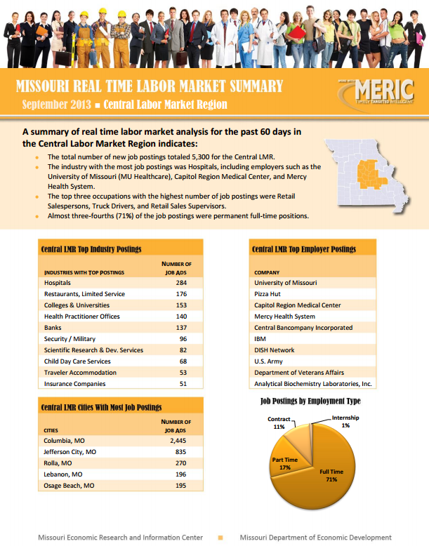
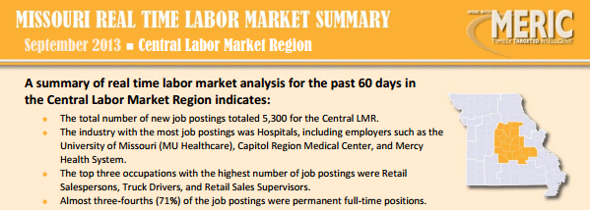
Real Time Labor Market Summaries
Notes:
Real Time Labor market Summaries show a summary of real time labor market analysis for the past 60 days. Summaries are produced for the state and for the 10 WIA regions. Information published includes the total number of new job postings, industries with the most job postings, employers with the most job postings, and the top occupations with the highest number of jobs available through online job ads.

Slide 7
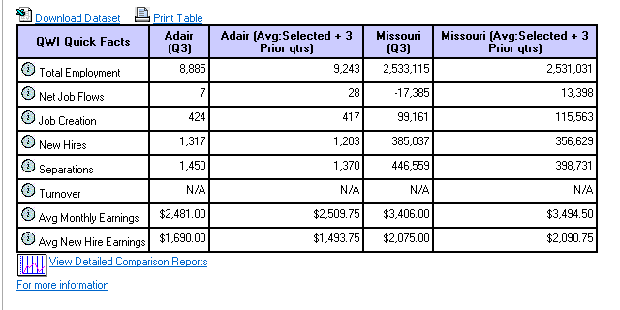
Where to Find—LEHD Data
Longitudinal Employer-Household Dynamics-LEHD
  Based on Industry Classifications – NAICS (up to 4-digit)
  Searchable by Geography and/or Industry
  Industry Employment information is inclusive of all Occupations within each Industry.
Notes:
The most basic LMI search tool for current workforce analysis will be the MERIC Longitudinal Employer-Household Dynamics tool. We briefly touched on the LEHD tool in our LMI Fundamentals modules and we will now go a bit more in depth about its functionality.
The tools allows you to view industry employment and past trends at up to a 4-digit NAICS code level for the entire state or specific regional, or WIA region data. The table allows you the opportunity to glance at your chosen industry and area for a specific quarter and compares the data with an average trend across the total year and state so you can get a better picture of not just where you are currently, but where you are coming from.

Slide 8
LED Quarterly Workforce Indicators
Customized Searches
Workforce Indicators
Quickly report activity by quarter or change over time (1995 – 2012).
Based on Worker Demographics:
  Age Group
  Gender
Organized by Geographies:
  WIA
  Metro
  County
Available to a 4-Digit NAICS Specificity
Total Employment
Net Job Flows
Job Creation
New Hires
Separations
Turnovers
Average Monthly Earnings
Average New Hire Earnings
Notes:
The Local Employment Dynamics flagship product called, Quarterly Workforce Indicators, provides information about trends in employment, hiring, job creation and separations, as well as earnings, with unprecedented details by geography, age, gender and industry going as far back as 1995.
These workforce indicators allows you to answer a multitude of questions that can be essential to creating your regional strategic plan for economic growth.

Slide 9
LED Quarterly Workforce Indicators
Workforce Indicators
Total Employment
Net Job Flows
Job Creation
New Hires
Separations
Turnovers
Average Monthly Earnings
Average New Hire Earnings
Who is filling what jobs?
What industries are the biggest employers?
What industries employ the largest number of a particular type of worker?
Notes:
Total employment can answer questions like: “Who is filling what jobs?”; “What industries are the largest employers?”; and “What industries are employing specific kinds of workers?”
These answers can tell you what training programs need to be brought into your region, where your markets may be under- or over-saturated, and what kind of workers and jobs are prevalent in your area to advertise for new business openings.

Slide 10
LED Quarterly Workforce Indicators
Workforce Indicators
Total Employment
Net Job Flows
Job Creation
New Hires
Separations
Turnovers
Average Monthly Earnings
Average New Hire Earnings
Which industries are expanding employment?
Which industries are contracting employment?
Notes:
Net Job Flows can tell you where employment is expanding or shrinking so you may have the advanced opportunity to know and help achieve continued growth or stop the leaks in the system before it becomes a problem of mass layoffs or business closures.

Slide 11
LED Quarterly Workforce Indicators
Workforce Indicators
What industries are hiring the most workers?
Which industries are hiring older workers?
Which industries are hiring women?
What geographic areas are doing the most hiring?
Total Employment
Net Job Flows
Job Creation
New Hires
Separations
Turnovers
Average Monthly Earnings
Average New Hire Earnings
Notes:
The Job Creation and New Hires indicators will be able to tell you which industries are expanding. As with other indicators, this information can help trigger the establishment of new training programs into a region to assist with the need for new employees. It also allows you to see what is thriving in your region so you can understand how to assist other industries to achieve the same.
By having the opportunity to sort through demographics you will be able to answer even more advanced staffing and hiring questions so you can guide career center staff to assist job seekers in their re-employment efforts.

Slide 12
LED Quarterly Workforce Indicators
Workforce Indicators
Total Employment
Net Job Flows
Job Creation
New Hires
Separations
Turnovers
Average Monthly Earnings
Average New Hire Earnings
What workers are leaving jobs?
What industries are workers leaving?
Notes:
The Separations and Turnovers indicators can assist with answering the questions of what is going wrong within your region’s workforce. For example, what industries are struggling? Is it because of certain demographics, like an aging population, that they are experiencing more turnover, or is it more the result of the economic climate for the region? Hopefully the answers will be useful in creating a strategic plan that will address these issues for industries in the future.

Slide 13
LED Quarterly Workforce Indicators
Workforce Indicators
Total Employment
Net Job Flows
Job Creation
New Hires
Separations
Turnovers
Average Monthly Earnings
Average New Hire Earnings
IMPORTANT NOTE
QWI measures do not include the number of hours or weeks an employee worked. This affects the interpretation of the measure of average earnings.
Similarly, high fourth quarter monthly earnings in some industries may reflect end-of-year bonuses and apparently high earnings for older workers may reflect one-time disbursements as they retire.
Notes:
Earnings data and trends are useful in understanding what it is like for employers in your region when it comes to providing competitive salaries. When comparing it with some of the other workforce indicators, are industries paying workers higher-than-average salaries experiencing more new hires because people would rather work in well-paying businesses - or are they experiencing lower job creation due to inability to keep up with operating costs because of the high salaries?
However, you may notice that QWI measures do not include the number of hours or weeks an employee has worked. This affects the interpretation of data on average earnings. High 4th quarter figures may also reflect some end-of-the-year bonuses or tips not reported until the 4th quarter of the year.

Slide 14
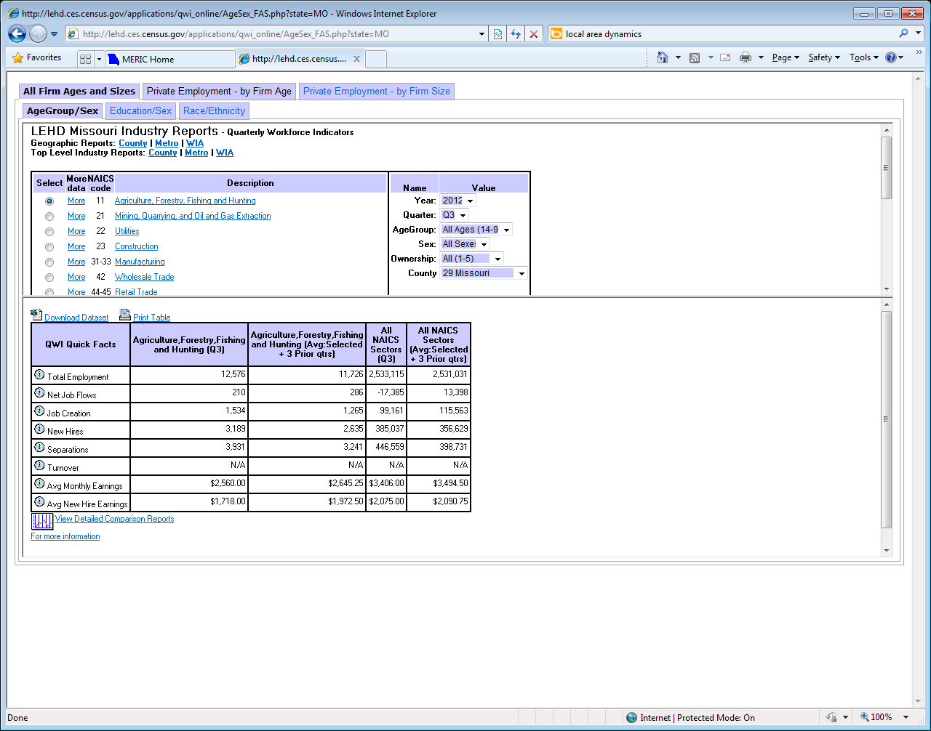
LEHD Data by Industry
Notes:
Now, let’s look at the basic functionality of the LEHD program and examine the workforce data and trends provided. This is the tool as it appears on the MERIC website. The industries are always displayed on the left-hand side at their most basic 2-digit NAICS level. On the right hand side there are options you can set, such as time frames, locations, and demographics.
We’ll begin by examining the oil and grain seed farming industry in Missouri. To see more detailed 4-digit NAICS industry, we must simply (CLICK) click on the More link next to the chosen industry.

Slide 15
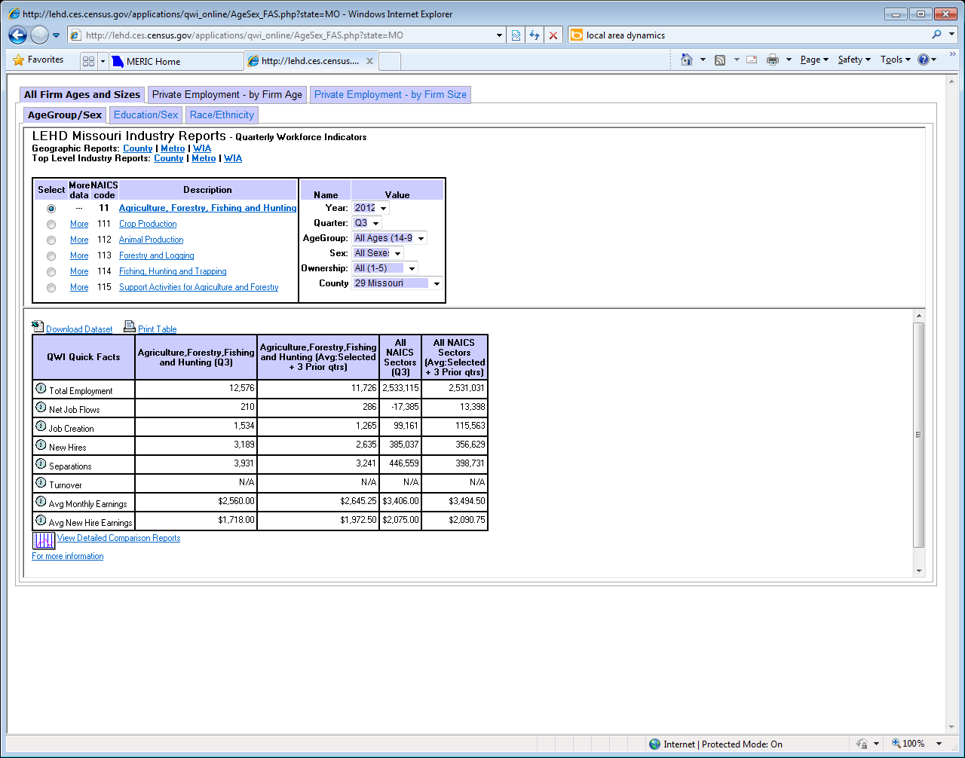
LEHD Data by Industry
Notes:
Now we have accessed the three-digit NAICS codes, but the NAICS that we wanted to look at is a 4-digit specific industry. We must once again (CLICK) click on the More link next to our desired industry which this time will be under crop production.
*Note that when you continue to go into more detail, you will have to re-select (CLICK) the time, location, and demographic variables of your choosing as they revert back to the original starting selections. It is usually best to wait to select these values until the end of the industry selection to save yourself from having to choose the same factors time and again!

Slide 16
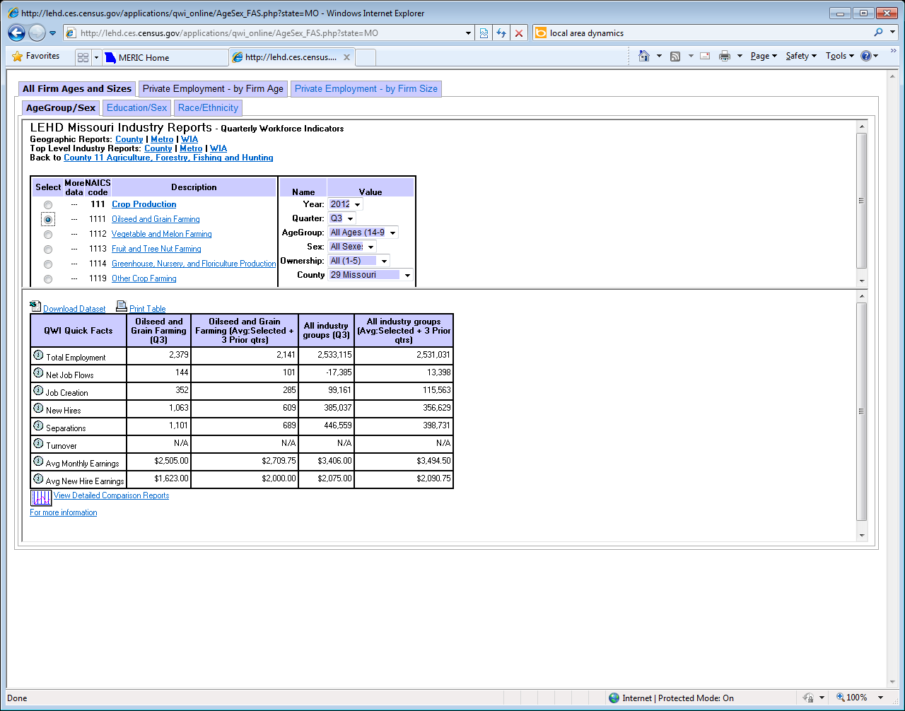
LEHD Data by Industry
Notes:
We’ve finally reached our desired industry detail and can now examine the trends for oilseed and grain farming in the state of Missouri across all workers for the third quarter of 2012.
I chose this industry and time frame for us to look at because of a very specific reason. If we just looked at the column showing a single quarter’s numbers, we might reach a wrong conclusion about including this industry in our strategic plan for growth assistance. Oilseed and grain farming is a highly seasonal industry, with high employment in the summer months and low employment in the winter months; depending on the time of year, a single quarter’s data might be misleadingly high or misleadingly low. We need to look as well at the next column to the right of the quarterly data column; this column shows averages for the previous four calendar quarters, balancing out the high-employment and low-employment quarters.
In the example shown here, Q3 is a high-employment quarter; the Q3 averages are higher than the four-quarter averages. If we were looking at the averages for Q4, a low-employment quarter, they would be lower than the four-quarter averages. It gives a little bit more incentive to look at all the columns. By comparing the four-quarter average column for the industry with the last column showing four-quarter averages for all industries in the state, you can see that the industry is neither as well or as bad off as a single quarter’s data might suggest. Remember that some industries have a high degree of seasonality.

Slide 17
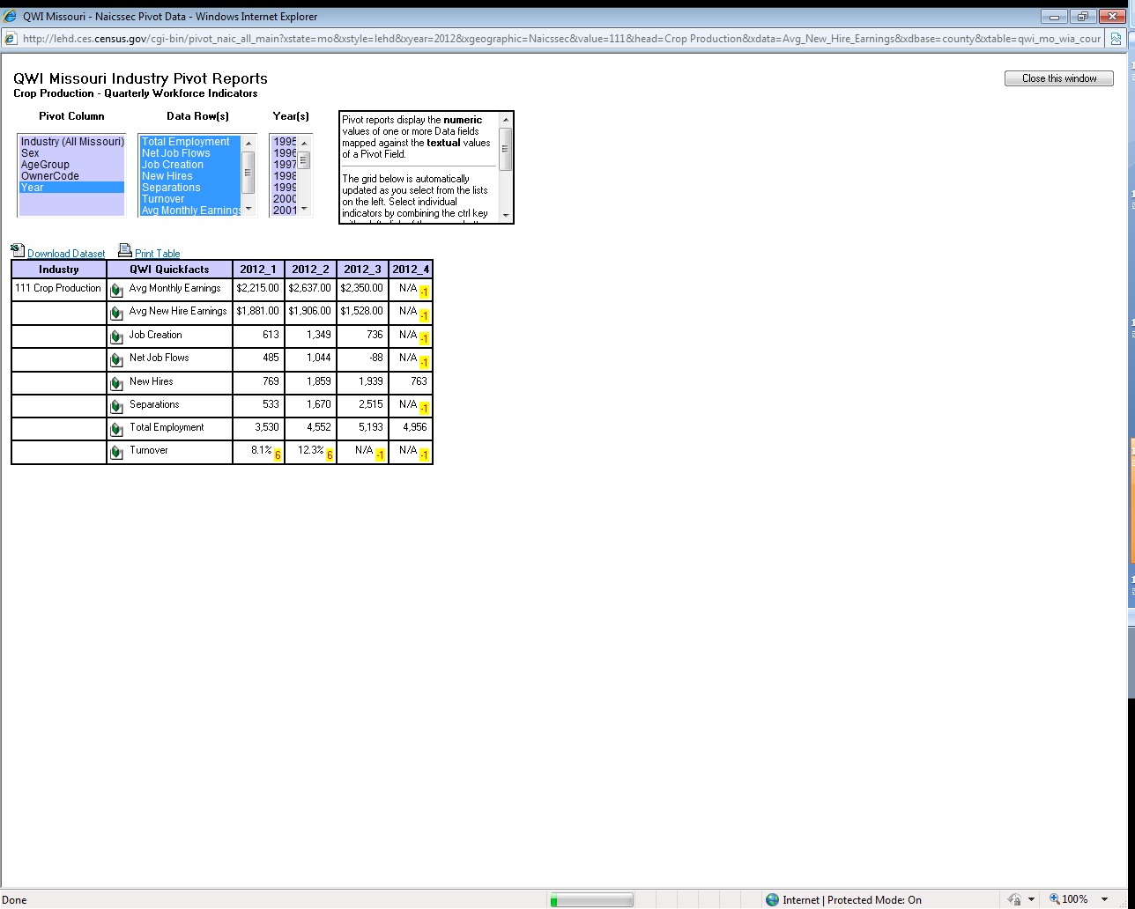
LEHD Data by Industry
Notes:
At the bottom of the table, you will see the link for View Detailed Comparison Reports. This allows you to create simple pivot charts that you can use to create a comparison across areas, industries, or demographics to see how your region compares throughout the state or over time. Great for trend analysis or combining strategic plans across areas.

Slide 18
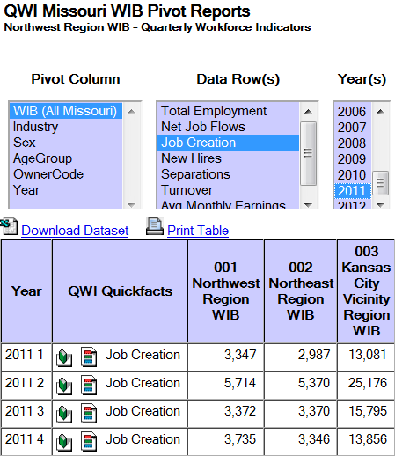
LEHD Quick Find Comparisons
Detailed Comparison Reports Available By:
  Geographies
  Industries
  Worker Classifications
  Quick Fact Categories
  Years
Visual Representation
  Graph 1 Row’s Data
  Graph All Data Rows
Notes:
This is what a pivot comparison chart will look like. You can see here that we have chosen to look at the trends for job creation in the regions of Northern Missouri and Kansas City for the year 2011.
You can go into more detail with your selections for example, by breaking this job creation by area chart down further by age group or gender to see more differences in job creation patterns.

Slide 19
LED Industry Focus
Customized Searches
Industry Indicators
Quickly report the top industries for an area.
Based on Worker Demographics:
  Age Group
  Gender
  Education
  Race/Ethnicity
Organized by Geographies:
  State
  WIA
  Metro
  County
Specific to Industry Sectors
Employment
Growth in Employment
Growth in Hiring
Number of New Hires
Firm Job Change
Average Monthly Earning for All Workers
Growth in Average Monthly Earning for All Workers
Average Monthly Earning for New Hires
Notes:
LED Industry Focus contains general employment dynamics data for each industry sector. Data can be aggregated based on worker demographics, geographies, and specific industry sectors.

Slide 20
Case Study
Industry Focus - In Action
Curious, after the state-wide commitment of $1 million to commemorate the centennial of Mark Twain’s death, what changes has the Arts, Entertainment and Recreation industry seen in the Northeast WIA region? Was it a positive impact and something that should be duplicated in the future for similar projects?
Notes:
Now that we’ve looked at some of the LMI tools that can assist with creating a strategic plan for your state, let’s try and walk through this exercise together.
Curious after the state-wide commitment of $1 million to commemorate the centennial of Mark Twain’s death, what changes has the Arts, Entertainment, and Recreation industry seen in the Northeast WIA region where Hannibal is located? Was it a positive impact and something that should be duplicated in the future for similar projects?

Slide 21
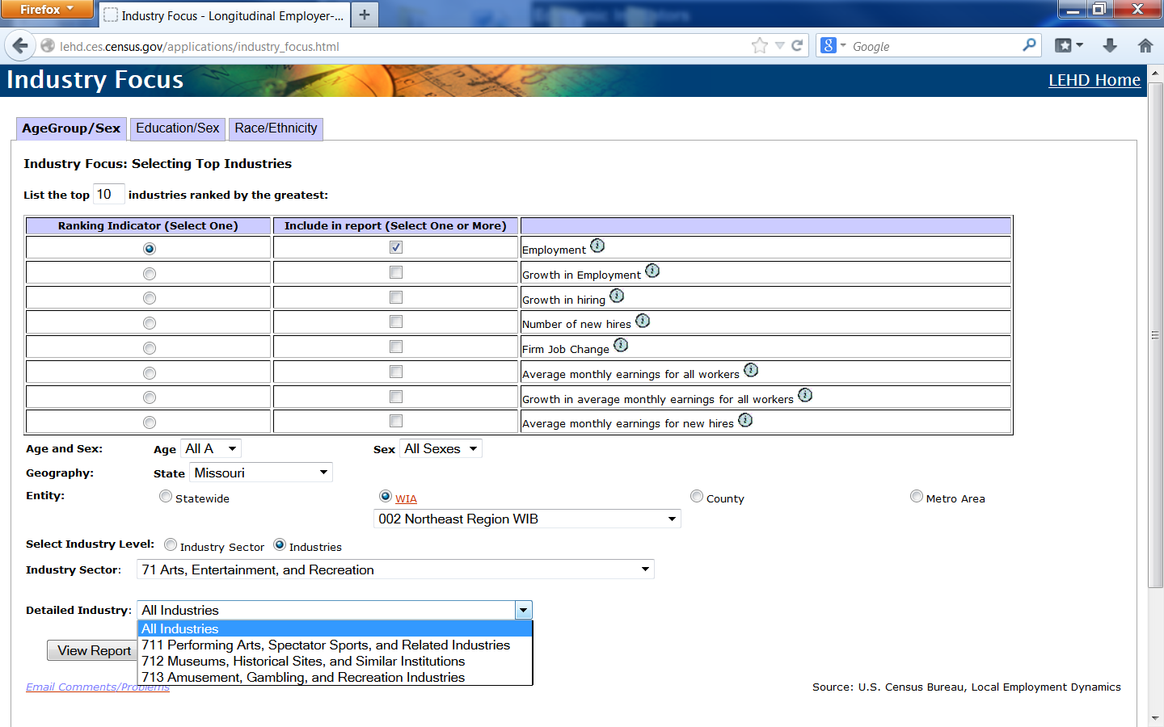
Current Conditions/Trend Analysis
Notes:
By going to the National Census Bureau’s Local Employment Dynamics page, we can sort through the similar process of Missouri’s LEHD function. We want to look for any change in employment within the Arts and Entertainment industry for the Northeast region and see how it compares across other industries for the same time frame that would not have been affected by the $1 million dollar grant.
Simply, select Missouri from the drop down, (CLICK) it will supply the WIA regions and we can choose the Northeast WIB option. Our industry sector is the (CLICK) broader Arts, Entertainment, and Recreation Industry, because the hope is that this grant did not just have an effect on the Mark Twain museum and specific sites, but also the hotels, restaurants, and other close tourist attractions that are in the region that may have been affected by the growth in tourism.

Slide 22
Focused Industry Look
Rank | NAICS subsectors | Employment
1 | 722 Food Services and Drinking Places | 5761
2 | 623 Nursing and Residential Care Facilities | 3914
3 | 561 Administrative and Support Services | 3431
4 | 621 Ambulatory Health Care Services | 2827
5 | 541 Professional, Scientific, and Technical Services | 2311
6 | 445 Food and Beverage Stores | 2284
7 | 452 General Merchandise Stores | 1878
8 | 522 Credit Intermediation and Related Activities | 1718
9 | 447 Gasoline Stations | 1698
10 | 238 Specialty Trade Contractors | 1637
11 | 311 Food Manufacturing | 1618
12 | 622 Hospitals | 1594
13 | 423 Merchant Wholesalers, Durable Goods | 1519
14 | 424 Merchant Wholesalers, Nondurable Goods | 1428
15 | 484 Truck Transportation | 1402
16 | 624 Social Assistance | 1350
17 | 336 Transportation Equipment Manufacturing | 1228
18 | 611 Educational Services | 1152
19 | 333 Machinery Manufacturing | 1115
20 | 237 Heavy and Civil Engineering Construction | 1058
21 | 454 Nonstore Retailers | 1057
22 | 441 Motor Vehicle and Parts Dealers | 1020
23 | 444 Building Material and Garden Equipment and Supplies Dealers | 987
24 | 551 Management of Companies and Enterprises | 959
25 | 713 Amusement, Gambling, and Recreation Industries | 926
Northeast WIA
  Q4 11 – Q3 12
Arts, Entertainment, Recreation
  Ranked 25th in average quarterly employment
Notes:
We see that our Arts, Entertainment, and Recreation industry ranked 25th in average quarterly employment for the year, which is very good, considering there are almost 100 industries in the region

Slide 23
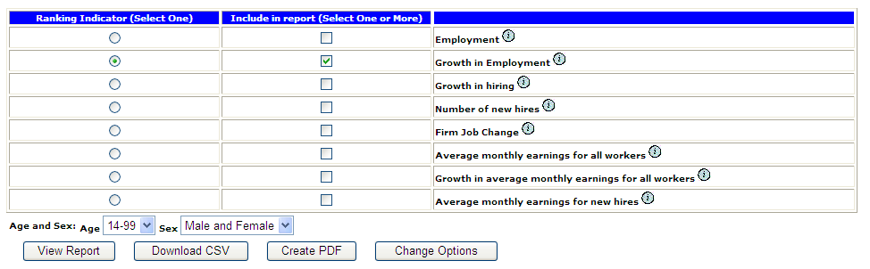
Current Conditions/Trend Analysis
Rank | NAICS subsectors | Growth in Employment
10 | 454 Nonstore Retailers | 7.0
11 | 811 Repair and Maintenance | 6.8
12 | 337 Furniture and Related Product Manufacturing | 5.9
13 | 621 Ambulatory Health Care Services | 5.6
14 | 541 Professional, Scientific, and Technical Services | 5.5
15 | 323 Printing and Related Support Activities | 5.4
16 | 322 Paper Manufacturing | 5.3
17 | 453 Miscellaneous Store Retailers | 5.0
18 | 326 Plastics and Rubber Products Manufacturing | 4.8
19 | 312 Beverage and Tobacco Product Manufacturing | 4.3
20 | 561 Administrative and Support Services | 3.8
Notes:
We can also see whether the 3 industries within the Arts, Entertainment, & Recreation industry have seen growth in employment CLICK in the top 20 industries with fastest growing employment. CLICK - This chart shows that there has been very little or no growth in the Arts, Entertainment, & Recreation Industry. If you compare these statistics with the previous year’s growth, you can see then whether it was likely due to the grant, or whether the trends have existed for quite a while, and would be expected to continue.

Slide 24
Trend Analysis – Industry
Employment_{i,r}
Employment_{i,n}
=
LQ Formula
LQ
/
Employment_{r}
Employment_{n}
Location Quotient
  An area’s distribution or concentration of employment by industry
What Does the Location Quotient (LQ) Mean?
 | Low Employment Growth | High Employment Growth
High LQ | Important industries that may require attention | Important growth industries
Low LQ | Industries with lower potential for local economy | Potential emerging industries
Notes:
Another tool that can be useful to gauge an industry’s trend in the region is the Location Quotient.
To calculate your region’s - in this case Missouri’s - industry concentration compared to the United States, or any other designated base, we use the Location Quotient formula seen here. (CLICK) Luckily for you, MERIC and BLS provide you the data already calculated so you won’t have to pull out any advanced calculus to use this information.
A Location Quotient of greater than 1 indicates an employment concentration greater than that of the comparison or base region’s average, suggesting a specialization within your target region.

Slide 25
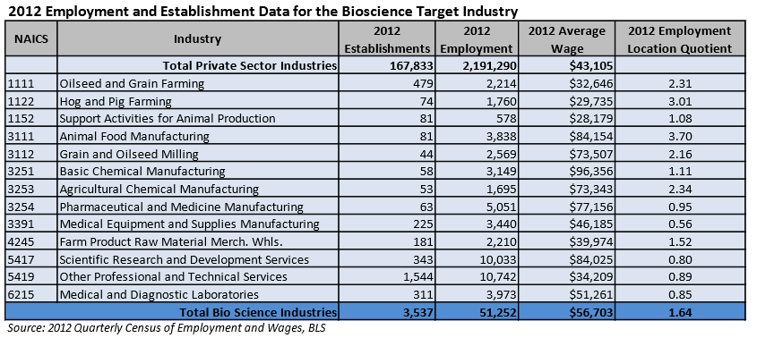
Target Industry Briefs– LQ
Bioscience Cluster of Missouri
  Compared to the United States
  Employment Concentrations
Notes:
As an example, here is the ratio of bioscience cluster employment in Missouri compared to the national concentration of employment in the identified biomedical-related industries.
Of the sectors reported, Missouri has 8 sectors that are significantly above the national concentration (LQ>1). If there is an LQ less than 0.5, that sector would be considered significantly below the national concentration (LQ<=0.5)
In context, this type of report can help your clients identify counties where a workforce may exist to staff a new site for their company, or it can help workers identify significant industries in their particular region to help with career planning.

Slide 26
State Employment Projections
Trend Analysis – Industry Employment
Project Industry Employment 2 or 10 Years Out
Analyze Staffing Patterns – Occupational Employment within Industries
Obtain Occupational Employment Projections by Applying Staffing Patterns to Base & Projected Year Industry Employment
Sample BioMedical Industry Employment Projections |  | Employment |  | Change
 |  | 2010 | 2020 | 2010-2020
NAICS | Title | Estimated | Projected | Numeric | Percent
322200 | Converted Paper Product Mfg. | N/A | N/A | N/A | N/A
325600 | Soap, Cleaning Compound, and Toilet Preparation Manufacturing | 3,441 | 3,618 | 177 | 5.1%
339100 | Medical Equipment and Supplies Manufacturing | 3,900 | 3,651 | -249 | -6.4%
541300 | Architectural, Engineering, and Related Services | 20,036 | 23,117 | 3,081 | 15.4%
541700 | Scientific Research and Development Services | 10,308 | 11,902 | 1,594 | 15.5%
Notes:
The last bit of trend analysis is the employment projections. Projections are created by gathering current employment data from the QCEW we just covered along with other economic indicators and national projections to create estimated employment numbers for either two or ten years into the future. These two year short-term projections are created annually and are only available for Missouri and the St. Louis and Kansas City WIAs. The ten-year long-term projections are created bi-annually and are available for Missouri and all 10 WIAs. *Note that some occupations will not contain employment data due to confidentiality.
These projections can then provide a rather extensive look into whichever industry or occupation your are examining for your planning.

Slide 27
Module 3 – Lesson 1 Complete
Module A: Labor Market Information Fundamentals
Module 1: Utilizing LMI to Help Job Seekers Make Career Decisions
Module 2: Using Data to Inform Skill Assessment, Competency Analysis & Career Pathway Planning
Module 3: Using Economic & Workforce Data to Drive Reemployment Strategy
  Lesson 1: LMI and Strategic Planning
  Lesson 2: LMI and Re-Employment
Module 4: Guiding Businesses/Partners to Use Workforce System & LMI Resources to Support Human Resource Functions
Notes:
Thank you for your participation in Module 3, Lesson 1: Using LMI for Strategic Planning. You may now progress into Lesson 2 of the Module: LMI and Re-employment. For your next lesson we’ll be covering:
How to Market your region to interested businesses or investments,
Using LMI to support Federal and state grant applications, and;
Identifying affected areas in need of further economic development

Slide 28

Thank you for your participation!
Contact us at:
mericdata@ded.mo.gov
Fax: (573) 751-7160
www.missourieconomy.org
Notes:
Thank you for participating in this LMI series of webinars. If you have any questions regarding this training or would like additional LMI data information, please feel free to contact by e-mail at mericdata@ded.mo.gov. You may also visit MERIC’s website at www.missourieconomy.org for additional resources and contact information for your assigned regional staff liaison.

Slide 29
Please take a moment to complete this survey, which is available online at the link below. Your input will assist us in making these webinars more effective and successful as we continue to make further improvements.
http://www.surveymonkey.com/s/M7BLRV9

