Slide 1



Module 3: Lesson 2
LMI and Re-Employment
U.S. Department of Labor—Employment & Training Administration| Missouri Economic Research and Information Center| Missouri Department of Economic Development
This project has been funded, either wholly or in part, with Federal funds from the Department of Labor, Employment & Training Administration under Task Order Number DOLJ061A20373; the mention of trade names, commercial products, or organizations does not imply endorsement of same by the U.S. Government.
Notes:
Welcome to Module 3, Lesson 2: LMI and Re-Employment. This is Lesson 2 of the Module Using Economic and Workforce Data to Drive Re-employment and Economic Recovery Strategy.
You should have already completed the LMI Fundamentals before continuing on with this lesson as it is the prerequisite before you can take any other modules.

Slide 2
Today’s Lesson
Module 1: Labor Market Information Fundamentals
Module 2: Skill Assessments & Career Pathway Planning
Module 3: Using Economic & Workforce Data to Drive Reemployment Strategy
  Lesson 1: LMI and Strategic Planning
  Lesson 2: LMI and Re-Employment
Module 4: Guiding Businesses/Partners to Use Workforce System & LMI Resources to Support Human Resource Functions
Notes:
In the previous lesson, we covered how you can use LMI to help create a strategic plan for economic recovery and investment in the region. Today we will discuss how to use LMI for re-employment purposes.

Slide 3
What’s in it for me?
This set of lessons will help strategic workforce planners use data to understand their region’s workforce & employment.
Lesson One
  Incorporating LMI into Strategic Planning for Grant Application & Recovery Efforts
Lesson Two
  Four Step Strategy to Understanding Your Workforce
  How to market your region for economic growth
Notes:
Through this lesson we hope to cover how using LMI can better help you understand your workforce and its capabilities as well as how to market it for economic growth.

Slide 4
How can you use this module lesson?
Marketing your region to interested businesses or investments
Federal and state grant applications
Identifying affected areas in need of further economic development
Disaster identification and recovery
Notes:
The LMI data tools that we will go through today will be useful in helping to understand how you can market your region to local or incoming businesses looking to expand or invest in new growth. This information is helpful in applying for federal or local grant funding which will assist in economic recovery, and assisting in disaster identification and recovery efforts.
The easiest way to approach learning these tools is to put yourself in a common scenario where we can answer the questions by using Labor Market Information.

Slide 5
Case Study
Re-Employment Data - In Action
I am a member of the Northeast’s Workforce Investment Board. The Board is currently applying for a Federal grant for Warren County which will release funds in order to recruit new companies dealing with green manufacturing to the Northeast region.
I am using national and Missouri LMI data to back up our grant application by showing the region’s capability of supporting a manufacturing industry. The Workforce Investment Board needs to show how the Northeast will differentiate itself from other regions and attract new businesses for its green manufacturing sector.
Notes:
Imagine that I am a member of the Northeast’s WIB. The board is currently looking to apply for a federal grant in Warren County that would release funding in order to recruit new companies dealing with green manufacturing into the region.
I am using national and Missouri LMI data to back up our grant application by showing the region’s capability of supporting a local manufacturing industry. The WIB needs to show how the Northeast will differentiate itself from other regions and attract new businesses for its green manufacturing sector.

Slide 6

Four Step Strategy to Understanding Your Workforce
Check current labor market performance.
Examine workforce in the region.
Examine quality and skills demanded of workforce.
Compare wages in the region.
Notes:
To walk through this scenario, the easiest method is to learn from the Four Step Strategy to Understanding Your Workforce. There may not necessarily be a need to go through each step every time, but you will gain some useful LMI knowledge by answering each step.
We will need to check on the current labor market performance and trends for the industry or employment we need, which in this case will be manufacturing. We’ll have to take a closer look at the workforce in the region and how they are capable to support the new green manufacturing industry we hope to bring in. After examining the workforce that we have available immediately, we will need to look at what skills and numbers may be required to support the industry growth and for businesses to have the incentive to move to the region we will be addressing. Lastly, we will need to be able to show industry and occupational wage data to market to green manufacturing businesses so they’ll understand their operating costs for the Northeast WIA.
Let’s start by going more in-depth with step 1: Checking the current labor market performance.

Slide 7
Step 1: Checking the Current Labor Market
MERIC Provided data
  LEHD-Longitudinal Employer Household Dynamics
  QCEW-Quarterly Census of Employment and Wages
  Industry Projections
    Missouri 2012-2014
    Northeast 2010-2020
Notes:
There are three main LMI data tools that Missouri has available to check current and trending industry employment. We’ve gone over them slightly in previous lessons, but now we will explain how they can be used for recovery efforts. The first of these tools will be the Longitudinal Employer-Household Dynamics.

Slide 8
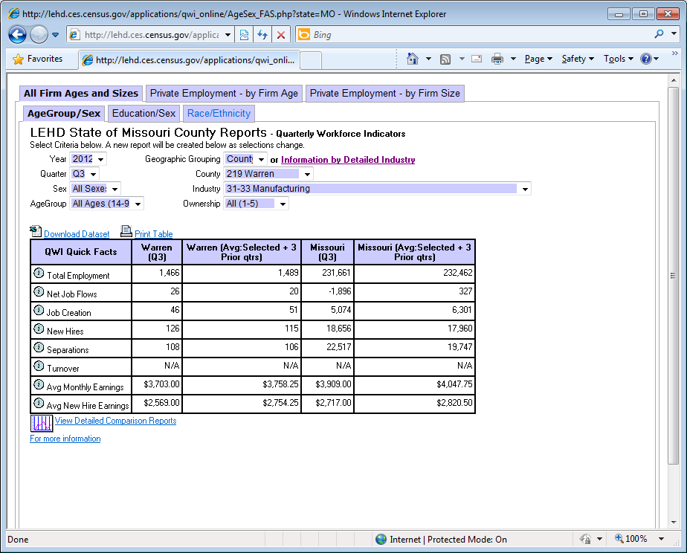
Longitudinal Employer-Household Dynamics
Notes:
The Longitudinal Employer-Household Dynamics tool allows us to look at a NAICS industry, with up to a 4-digit detail for states, WIAs, or counties and can be additionally sorted by certain demographics such as age groups and gender.
Since we are trying to look into supporting new green manufacturing business in Warren County, we will select (CLICK) the county from the drop down list first. We won’t mess with any of the demographic data since we want to see the complete picture as it is currently. Next, we will select the industry (CLICK) to look at manufacturing as a whole NAICS sector, since many sub-sectors of manufacturing can be affiliated with green.
The chart (CLICK) below automatically fills with the correct LMI data. We can see from this data that Warren County is actually doing quite well in manufacturing. Their turnover rate is less than the annual average and better than Missouri’s total numbers. Job creation is growing and separations are decreasing. This is good news for Warren County when it comes to marketing their region for manufacturing growth.

Slide 9
Step 1: Checking the Current Labor Market
MERIC Provided data
  LEHD-Local Employment Household Dynamics
  QCEW-Quarterly Census of Employment and Wages
  Industry Projections
    Missouri 2012-2014
    Northeast 2010-2020
Notes:
Now let’s take a glance at our Quarterly Census of Employment and Wage data. Since this data is collected and analyzed within the state, it is extremely up-to-date and can give us an even more recent picture of what manufacturing looks like for Warren County.

Slide 10
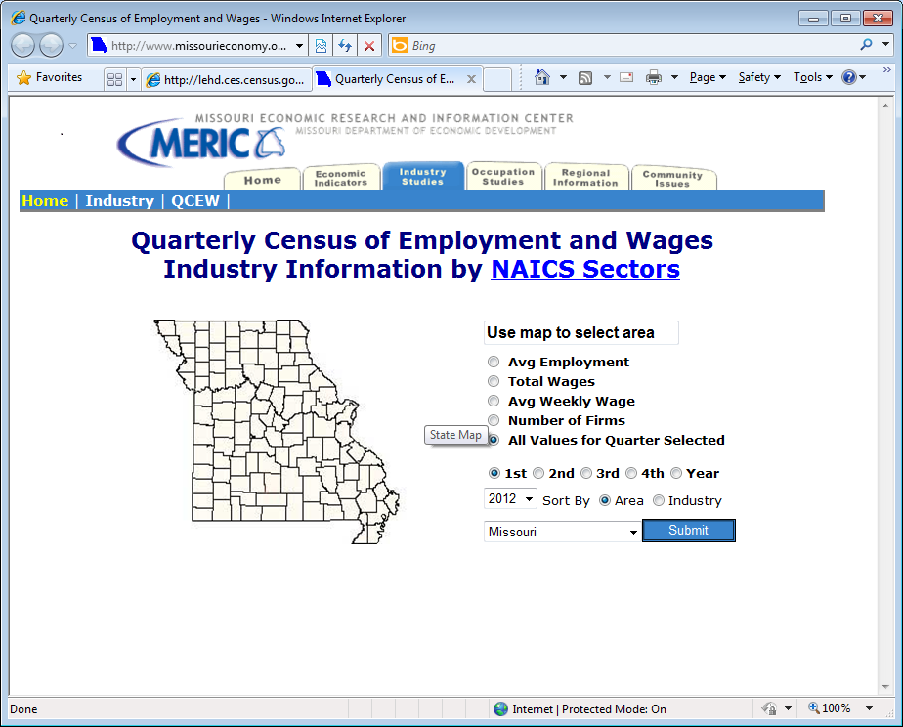
Notes:
The Quarterly Census of Employment and Wages collects businesses’ total and average weekly wages along with the number of people employed within their firms. On the MERIC site, you may choose to look at all variables, but if you are only doing a comparison of the number of manufacturing firms across the state, for example, you would click the radial for Number of Firms and Sort by Area to get the data. For our example we want to be able to see all variables, but only for Warren County.

Slide 11
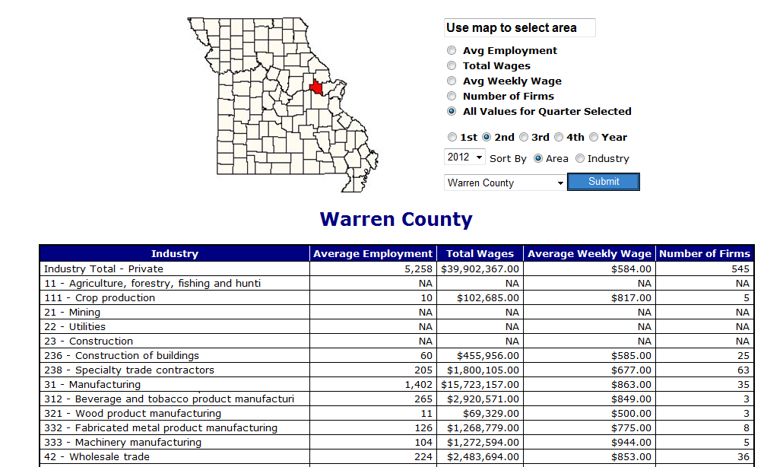
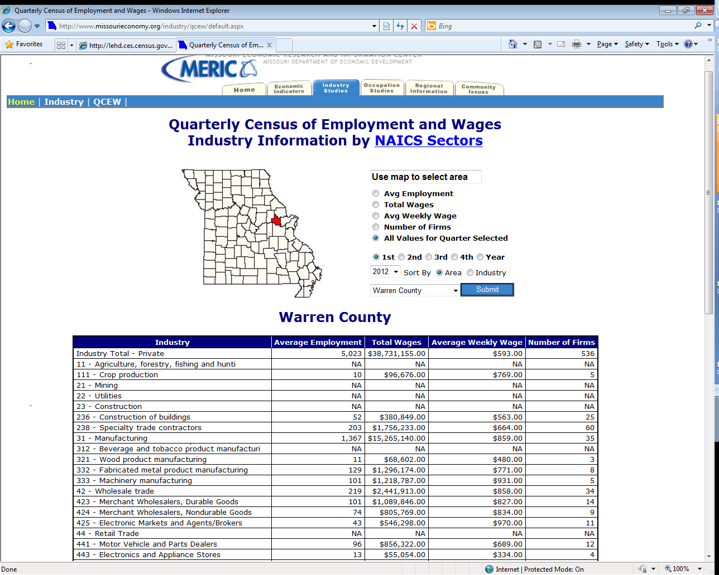
Quarterly Census of Employment & Wages
Notes:
The QCEW gives us data for 2012 on the Manufacturing industry in Warren County. (CLICK) We can see here that there are over 1,400 people employed in Warren county’s 35 manufacturing firms, with the highest number working in Beverage and Tobacco Product Manufacturing, but the greatest number of employers in Fabricated Metal Product Manufacturing. We also see that average wages in manufacturing are well above overall average wages in the county. We can use QCEW in combination with LEHD to see where some of the more recent trends for the industry are headed.

Slide 12
Step 1: Checking the Current Labor Market
MERIC Provided data
  LEHD-Local Employment Household Dynamics
  QCEW-Quarterly Census of Employment and Wages
  Industry Projections
    Missouri 2012-2014
    Northeast 2020-2020
Notes:
The last step for checking the labor market is to look at the industry projections for the state or region. This will be able to give you a glance into what the employment numbers for manufacturing are currently, but also a glimpse into how they are predicted to react to economic changes.

Slide 13
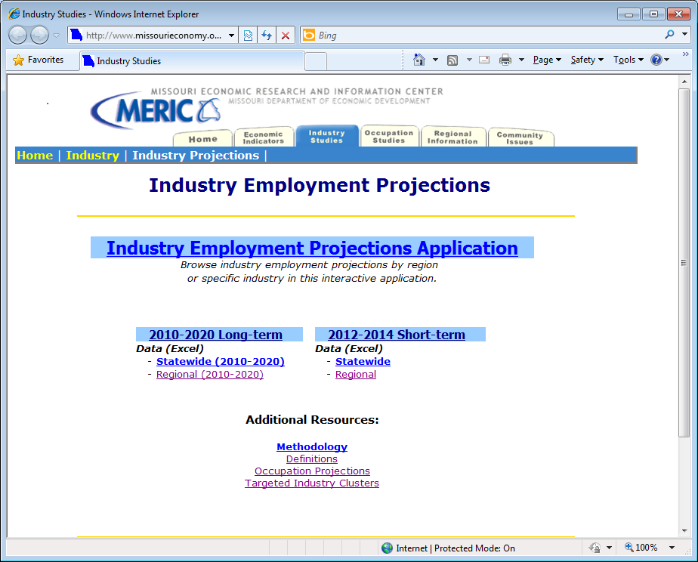
Notes:
Projections are created by gathering current employment data from the QCEW we just covered along with other economic indicators and national projections to create estimated employment numbers for either two years or ten years into the future. These two year short-term projections are created annually and are only available for Missouri and the St. Louis and Kansas City WIAs. The ten-year long-term projections are created bi-annually and are available for Missouri and all 10 WIAs. Let’s see how manufacturing is projected to go in Missouri(CLICK) for the short-term and (CLICK) take a closer look at what the Northeast’s manufacturing industry is supposed to look like by 2020.

Slide 14
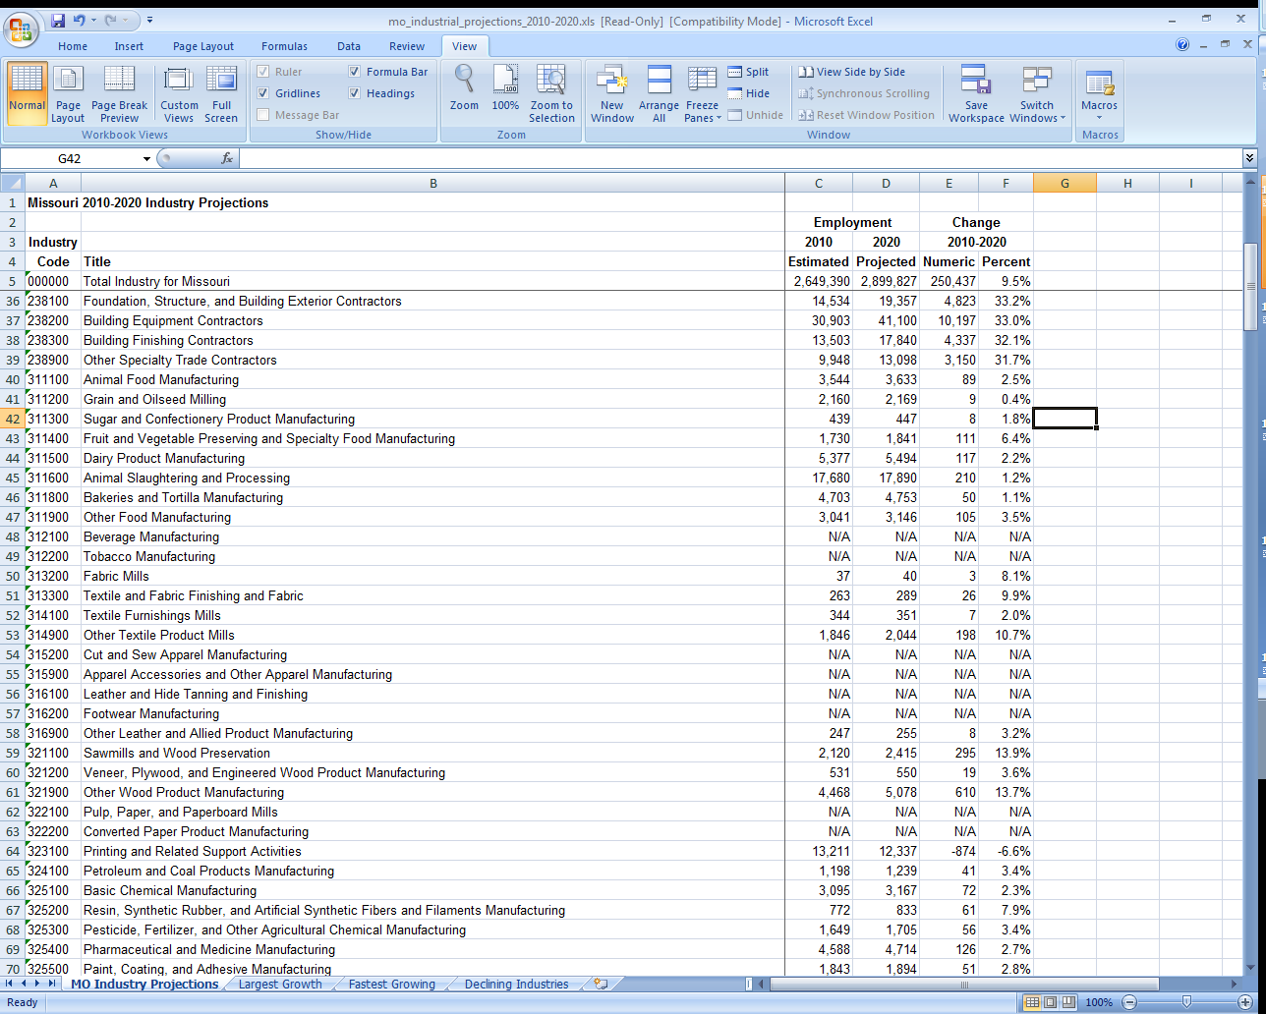
Missouri Long-term Industry Projections
Notes:
Here (CLICK) in Missouri’s long-term 2010-2020 industry projections, we can see that the manufacturing industry as a whole is recovering somewhat from the severe economic downturn of 2008-2009. Remember that we said economic indicators are included in the creation process, and when these were produced, it was immediately after the economic downturn had severely affected the manufacturing industry. However, you can use these numbers to your advantage when applying for the green grant by explaining that as a result of the downturn, there are now a large number of trained manufacturing staff who will need re-employment and already have the training necessary for the new openings generated by a recovering industry.

Slide 15
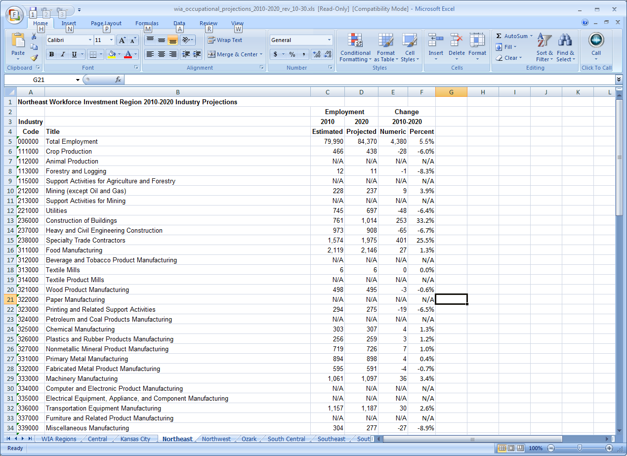
Northeast Long-term Industry Projections
Notes:
Now we can look at the Northeastern WIA specific long-term 2010-2020 industry projections. (CLICK) These numbers shown allow you to explain how the workforce is readily available and the region is showing that it is in need of manufacturing industry growth.

Slide 16
Step 1 Website Links
Local Employment Household Dynamics:
http://www.missourieconomy.org/indicators/lehd/index.stm
Quarterly Census of Employment & Wages: http://www.missourieconomy.org/industry/qcew/
Missouri & Regional Industry Projections: http://www.missourieconomy.org/industry/ind_proj.stm
Notes:
Here is a list of the websites that we covered in Step 1. Please feel free to pause the webinar where you are now and practice retrieving data on your own. If you choose not to, please continue on with the Module lesson.

Slide 17
Four Step Strategy to Understanding Your Workforce
Check current labor market performance.
Examine workforce in the region.
Examine quality and skills demanded of workforce.
Compare wages in the region.
Notes:
Now that we have examined what manufacturing looks like in Warren County, and explained our need for growth in the industry, we need to back up the claims that we have a manufacturing workforce ready and able to take on these new jobs.

Slide 18
Examining Workforce in the Region
MERIC Provided data
  LAUS-Local Area Unemployment Statistics
  Real Time Labor Market Summaries
National Provided data
  LED OnTheMap (Census Bureau)
Notes:
To examine the workforce, we will be using two LMI tools. One is Missouri provided data in our Local Area Unemployment Statistics tool while the other it the Census Bureau’s Local Employment Dynamics “OnTheMap” function. Let’s see how they can show us a little bit more about Warren County’s workforce, starting with LAUS…….

Slide 19
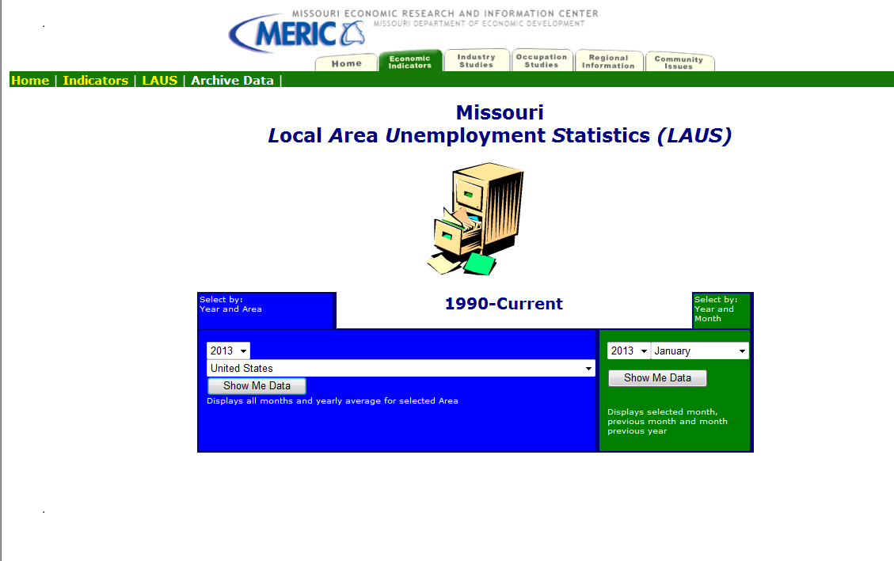
Notes:
Missouri Local Area Unemployment Statistics, or LAUS, is a very simple tool that just shows labor force data. Like QCEW data, it is also up-to-date, usually only lagging about a month in data. You can do a comparison across regions or by a particular time period. We’re just going to (CLICK) select Warren County for 2013 from the Blue selection area to see how Warren county’s labor force data has been trending in the past year.

Slide 20
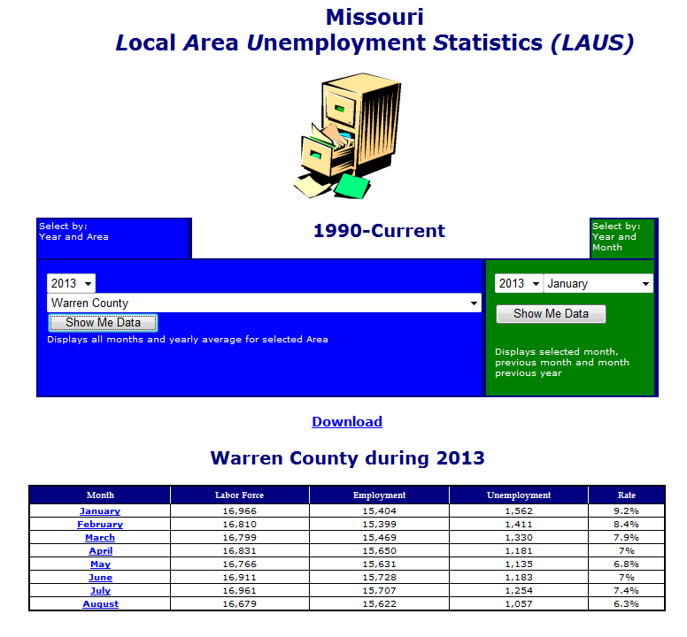
Notes:
So as we see here, (CLICK) the unemployment rate in the last column has decreased nearly 3% in the 8 months we are looking at for 2013. That is a major improvement over many of the other counties in the state - and Missouri as a whole - where unemployment has held almost steady. The labor force decreased by just under 300 people over that time period, while employment increased by more than 200. This can be a good thing to point out in our grant application, which will show that Warren county is resilient even in a rough economic climate. You can also point out that you still have over 1,000 county residents who do not have a job currently, many of whom may be interested in gaining the training required to enter into the green manufacturing field.

Slide 21
Examining Workforce in the Region
MERIC Provided data
  LAUS-Local Area Unemployment Statistics
  Real Time Labor Market Summaries
National Provided data
  LED OnTheMap (Census Bureau)
Notes:
The next tool is very advanced. It is controlled nationally by the Census Bureau and can be a very detailed LMI tool when it comes to looking into labor force demographics. You can use this tool to see in-depth commuting and labor market information for areas as small as a Census block. We will be able to look and see where the jobs are in Warren County for manufacturing or we could look to see where people working in manufacturing in the county live. You can also look at this information over a period of time in animation to see where the jobs are moving to or coming in from. Let’s look and see where the manufacturing jobs are in Warren County so you can defend why green manufacturing would work in the county.

Slide 22
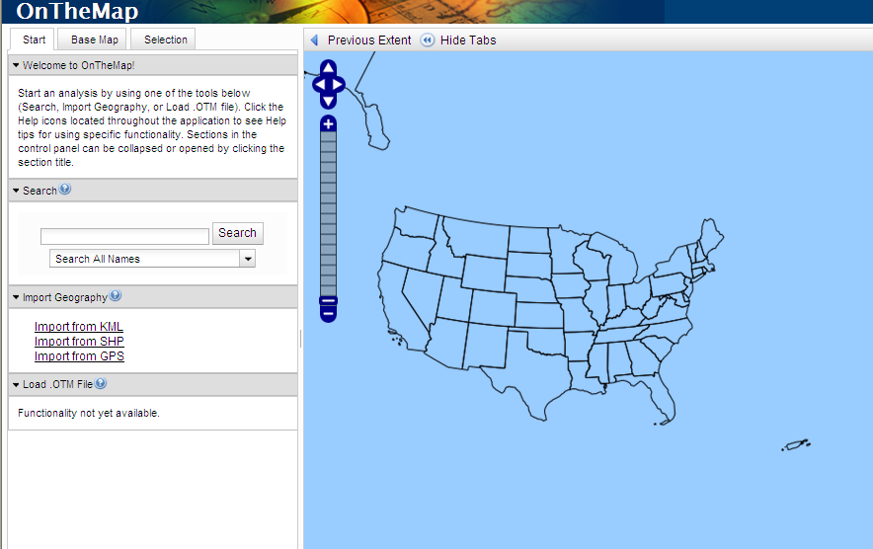
Notes:
To start OnTheMap, you can click on the map until you zoom into the area you wish to study or you may type the name (CLICK) into the search field and sort by geographic classification in the drop-down menu below. We will type Warren County in the search field and select Counties as our geographic classification. It will list all the Warren Counties in the United States and you will simply click on Warren County, Missouri to advance.
You also have the ability to choose (CLICK) the Base Map tab at the top which will allow you to choose your own geographic area to examine. You can pin point a city from the map with the tool or even draw your own area to examine.

Slide 23
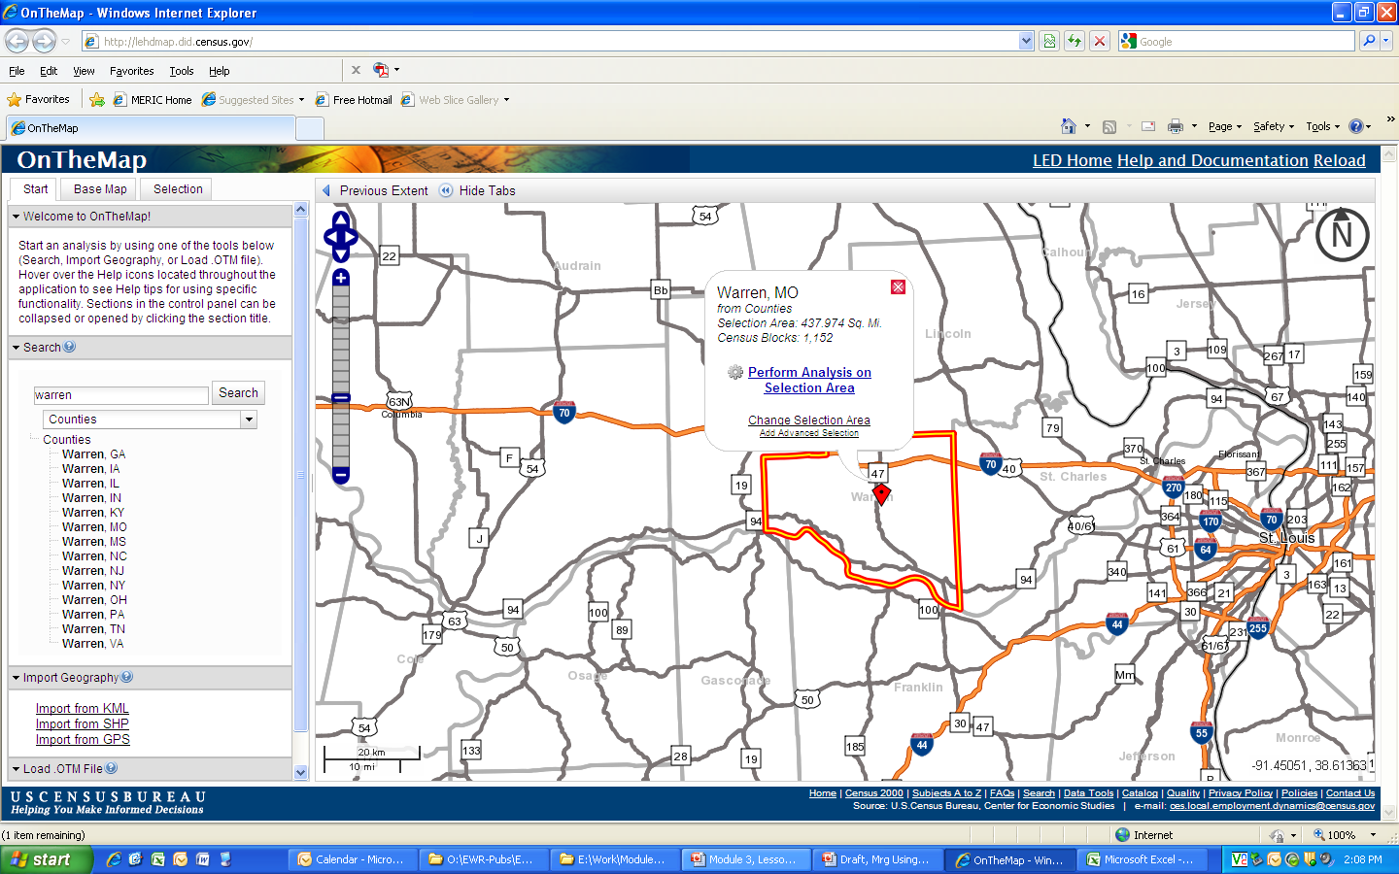
Notes:
Once our geographic area is highlighted a red pin-point will appear in the center. If you click (CLICK) on the pin-point this pop-up will appear. To advance, you need to click on the Perform Analysis on Selection Area link or if you wish to choose another area, click on the Change Selection Area link. Let’s begin our analysis of Warren County.

Slide 24
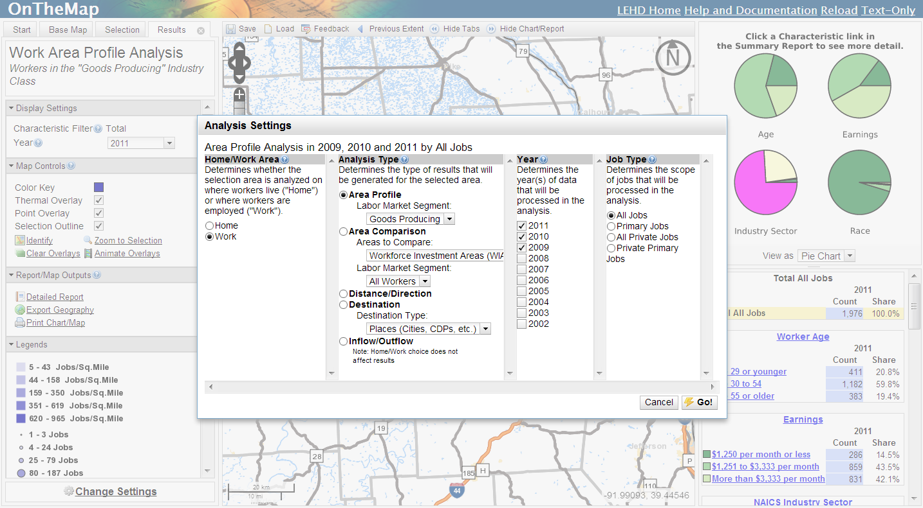
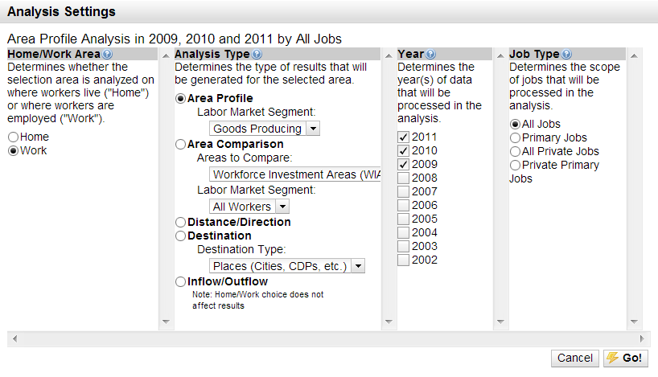
Notes:
Here are our selection choices for the analysis. The first radial we have to select is home or work. We want to see where in the county people are working so we will choose work. If you wanted to see where people in Warren county who work in Manufacturing live, you would select the home radial. The analysis type that we want to do for this round is an area profile. In the Labor Market Segment drop down menu, we can choose from a series of population demographics that we wish to look at or industry sectors. We want to see manufacturing in Warren County, so we will choose the Goods-Producing segment. Select the year or years that you want to process and whether or not you want to sort jobs by total or private and click go!

Slide 25
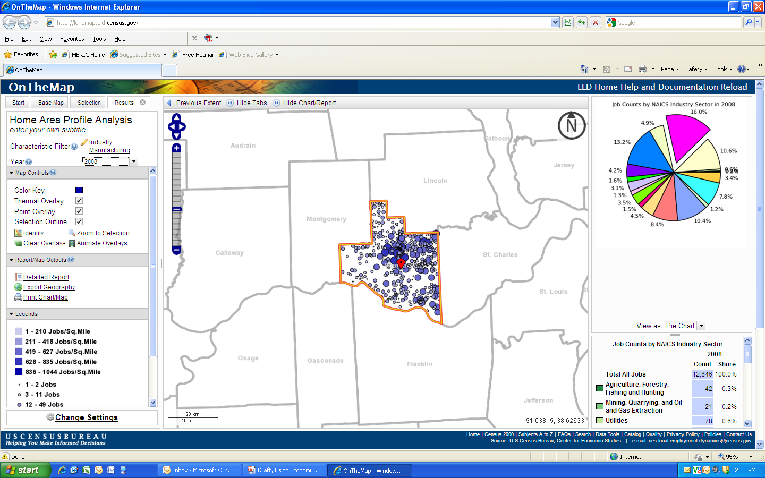
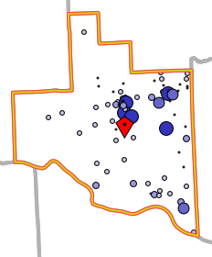
Notes:
Your results map will look similar to this. Each of those small circles represents a number of jobs. The larger the circle, the higher the number of jobs. There doesn’t seem to be a big concentration of manufacturing jobs in Warren County, other than around the I-70 corridor, which one can argue leaves the door open for a large firm to fill the employment gap. Let’s look at the detailed report link on the left-hand side and see if we can find out more from our map.

Slide 26
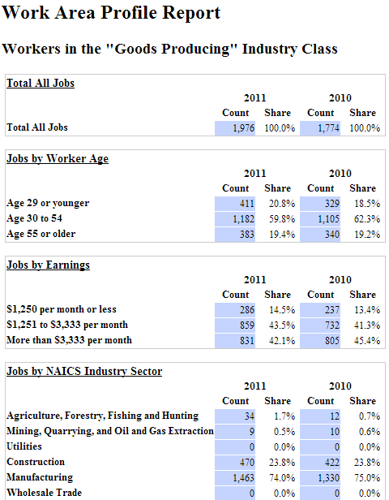
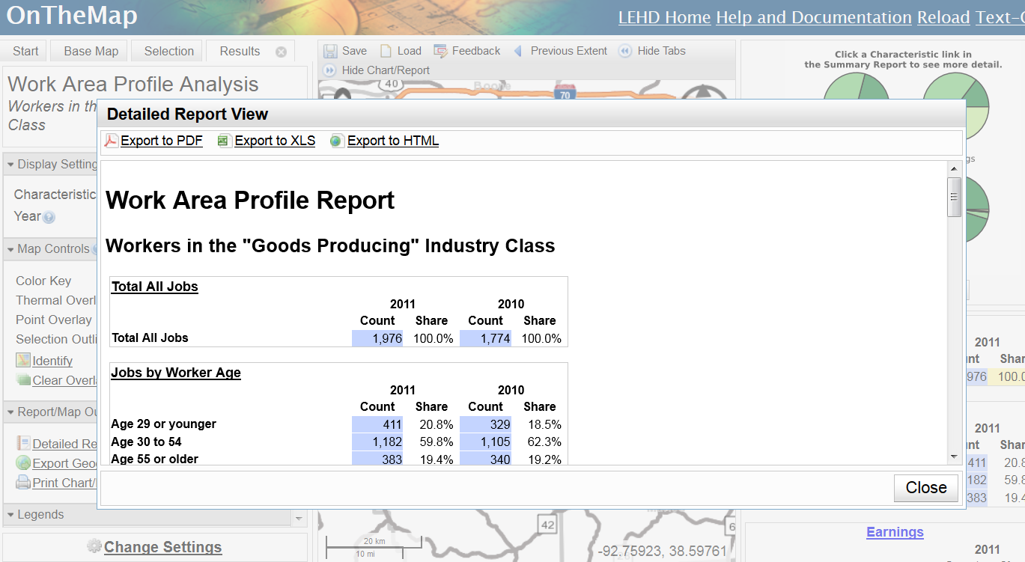
Notes:
Our detailed report can give us a bit more insight into the manufacturing industry of Warren County. One item we can use from this report is the Jobs by Worker Age chart. It looks good in a grant application if you can say that over 80% of your manufacturing employees are far from retirement age and would back up claims of a readily available workforce, as we see here in our Warren County analysis.
Let’s look at another analysis OnTheMap can do……

Slide 27
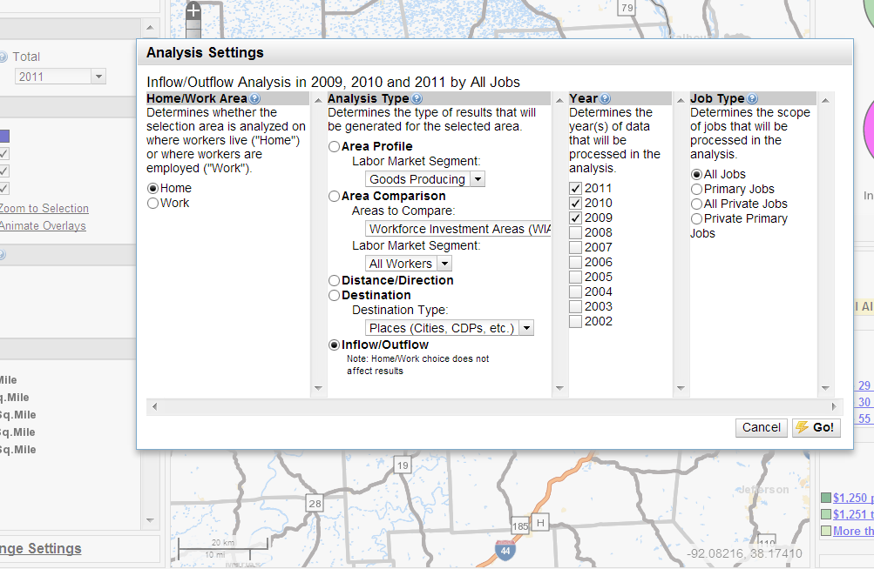
Notes:
One of the other useful analysis tools with the OnTheMap feature is the Inflow/Outflow Type. It doesn’t matter whether you choose work or home, it will give you the total number of people who both live and work in the selected region, it will tell you if they live in the county or whether they work in the county and vice versa. It can only give you the total for all industries, but is still useful if you want to have an idea of what your commute and labor shed looks like.

Slide 28
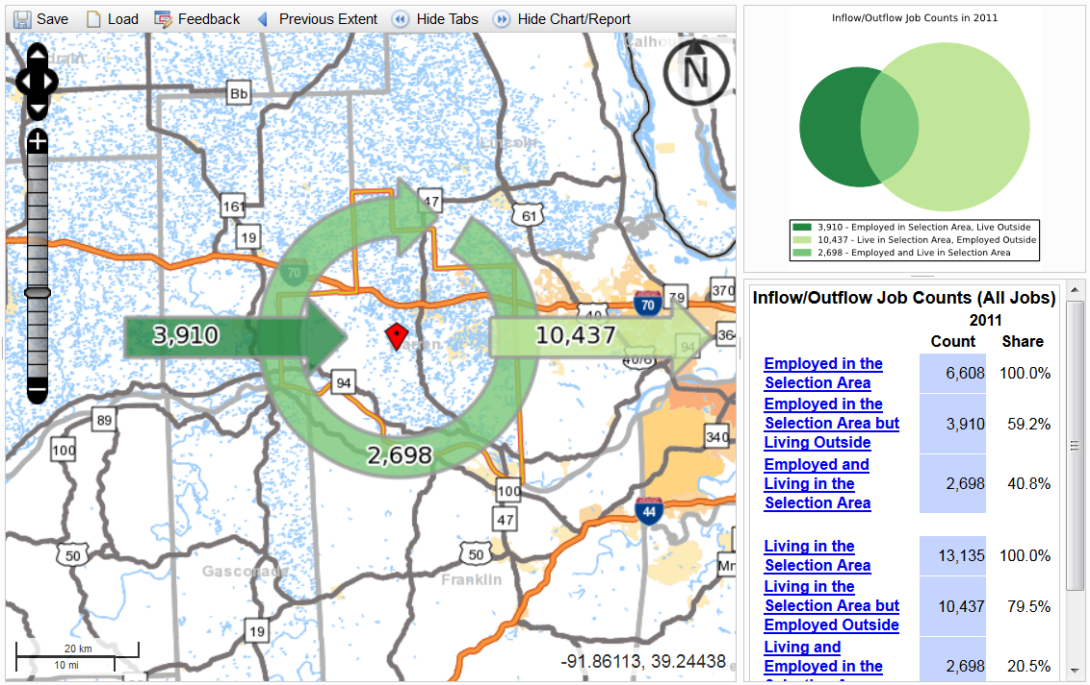
Notes:
From this map result, we can see that over 59% of the people working in Warren County do not live there and over 79% of the people living in Warren County work elsewhere. Only 2,698 of the 10,437 people living in Warren County actually work there. That means, that should the right industry come in, the number should change to a higher proportion of both living and working there as more people would prefer to work closer to home. This raises money for the region and creates more incentives for businesses to look to the county.

Slide 29
Step 2 Website Links
Local Area Unemployment Statistics: http://www.missourieconomy.org/indicators/laus/default.aspx
Census Bureau’s LED OnTheMap: http://lehdmap.did.census.gov/
Notes:
Here is a list of the websites that we covered in Step 2. Please feel free to pause the webinar where you are now and practice retrieving data on your own. If you choose not to, please continue on with the Module lesson.

Slide 30
Four Step Strategy to Understanding Your Workforce
Check current labor market performance.
Examine workforce in the region.
Examine quality and skills demanded of workforce.
Compare wages in the region.
Notes:
Now we know what the manufacturing industry and labor force looks like in our region. In order for us to be prepared, we still need to see what else may be demanded from our workforce if a green manufacturing firm should come to the region. This will always be useful because you may have a large labor force available, but if they aren’t trained for the industry that’s incoming, they will either hire elsewhere or move to a different area - and neither of those options are beneficial to our county.

Slide 31

Examining Skills of the Region’s Workforce
  American Community Survey
  Education and training programs and enrollment
    Provided by DESE or Department of Higher Ed.
Notes:
The main data set that we will examine will be the American Community Survey provided by the Census Bureau, it will let us look at the workforce’s skills and abilities. You can examine a workforce’s educational attainment levels and specific industry employment for regions to gain a better understanding of the surrounding labor pool. We’ll look at the American Community Survey now and see if there are any other questions it might be able to answer for us in regards to the region’s workforce skills…..

Slide 32
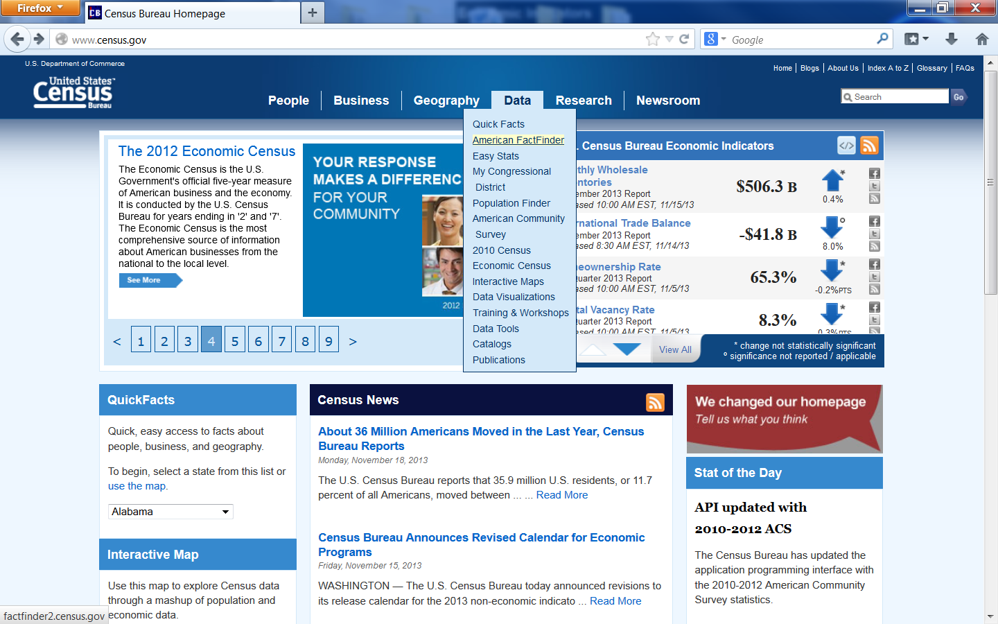
Notes:
Since the Census is only conducted every ten years, The Census Bureau developed the American Community Survey as a way to randomly survey the populace and provide knowledgeable estimates of the population between the ten-year periods. They put out annual, bi-annual, and 5-year estimates with extensive data profiles and subject tables to customize your search of the population.

Slide 33
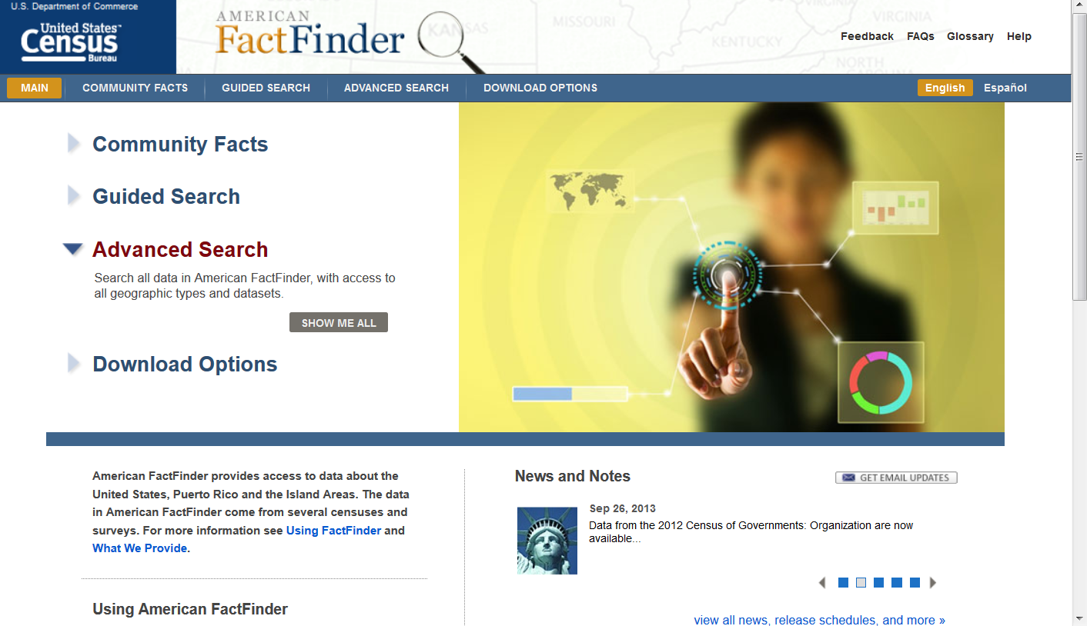
Notes:
For our search on Warren County, (CLICK) we will look at one of the 5-year estimates to see trends over time and choose to sort by subject tables.

Slide 34
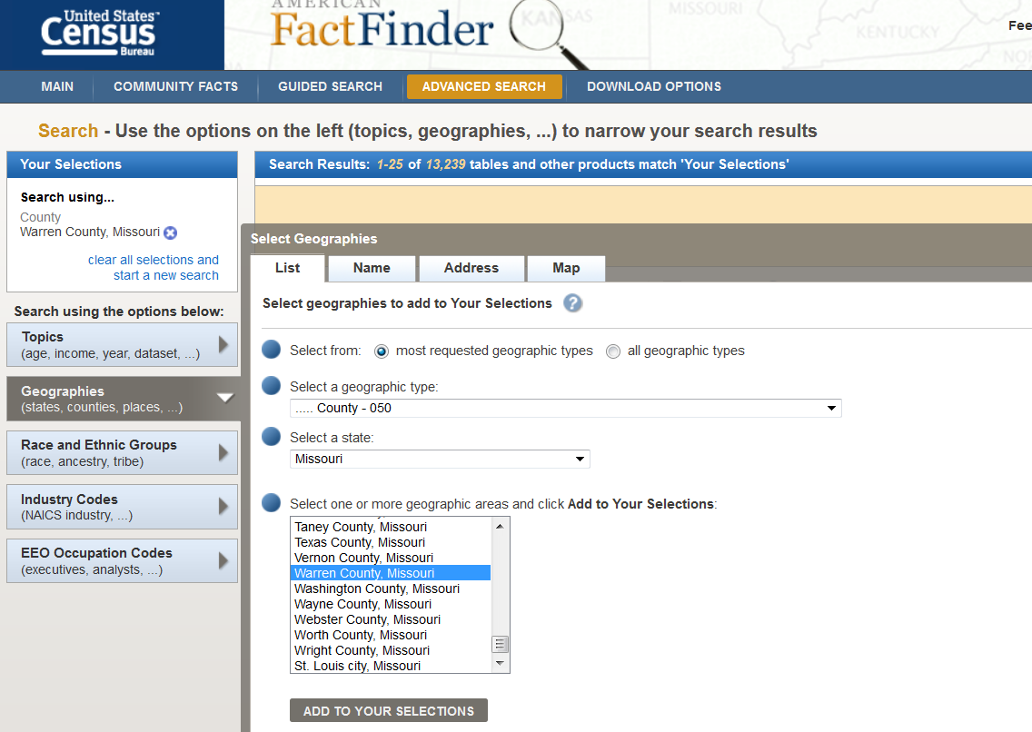
Notes:
To begin narrowing our search, we will choose the level of geography we want to examine. You can select national, statewide or even school district detail. (CLICK) We’ll choose county. We want to look at Missouri data so we choose our state from the drop-down menu, and then when populated, (CLICK) we can select Warren County and hit the Next button.

Slide 35
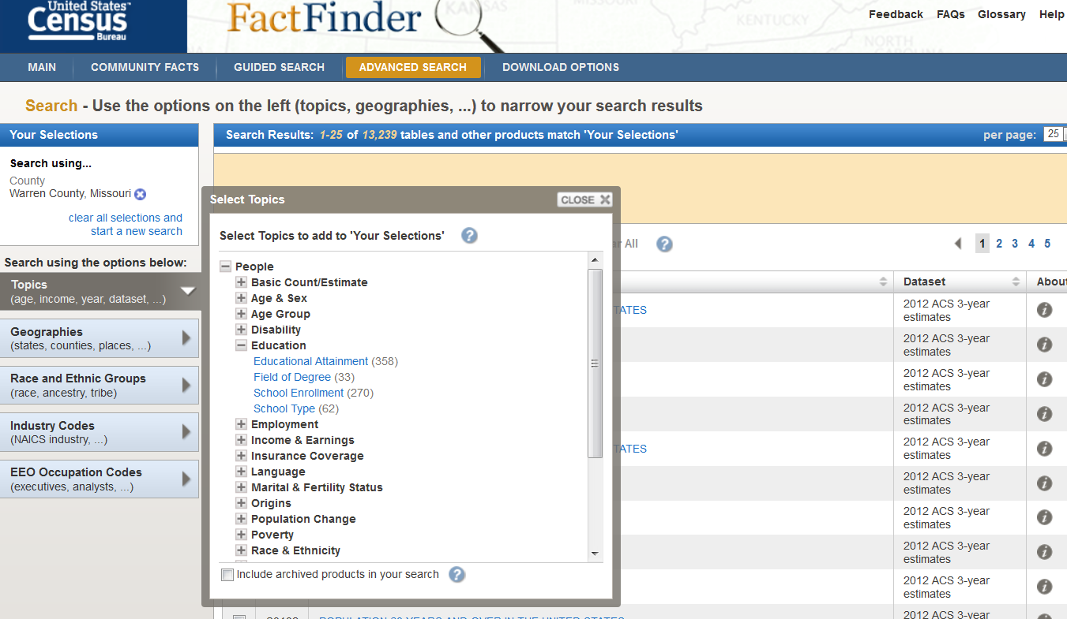
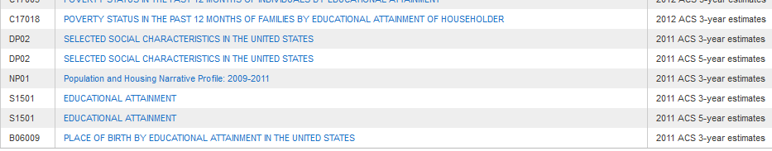
Notes:
Here you can see a small glimpse into the number of detailed subject tables that we can look up. We want to know about the skills that our workforce have so (CLICK) education is probably the most likely subject we’ll want to stay under. We can use these two tables to see both what people in the area have as their educational attainment, and with the school enrollment table, we can see the people who currently live in the area that are attempting to graduate and add to their skill sets. Let’s look and see what people in Warren County already have under their belts…..

Slide 36
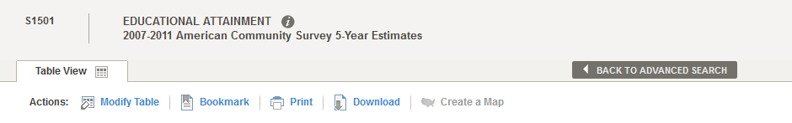
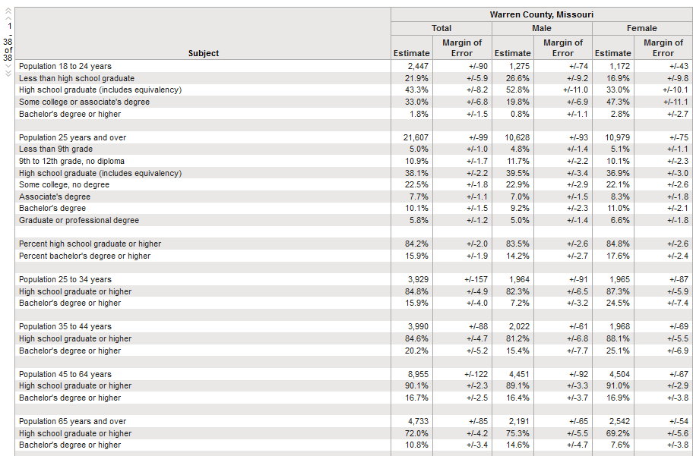
Notes:
Now we can see exactly what the residents of Warren County have for educational attainment and if it meets the standards for what the company is looking for in order for them to locate in your community. This allows you to back up claims of a readily available workforce if you do already have one. If you wanted to argue that while the workforce is almost ready to take on the task of a new green manufacturing industry, but isn’t quite there yet, this would be a good opportunity to use the school enrollment subject table we mentioned to see if the population will be completely ready in the next couple of months or years.

Slide 37
Notes:
To look more closely at the industry employment for Manufacturing in the area, we’ll do another search with the ACS.
For our search, (CLICK) we will look at one of the 5-year estimates to see trends over time and choose to sort by subject tables again.

Slide 38
Notes:
Once again we narrow our search by selecting Warren County and hit the Next button.

Slide 39
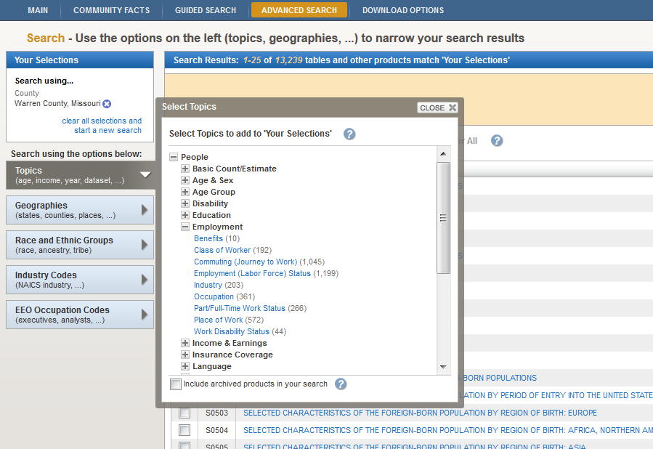
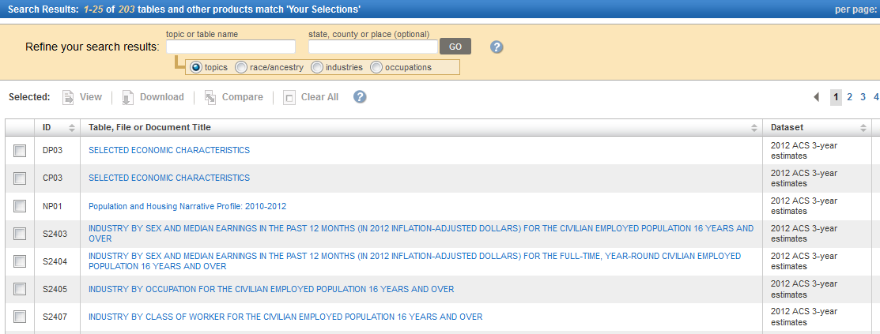
Notes:
Here you can see a small glimpse into some of the other many detailed subject tables that we can look up. We want to know about the skills that our workforce have so (CLICK) looking at where the workforce is currently employed and gaining experience is probably another great subject to examine. Let’s look and see where the people in Warren County are already working…..

Slide 40
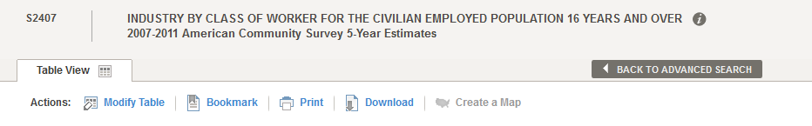
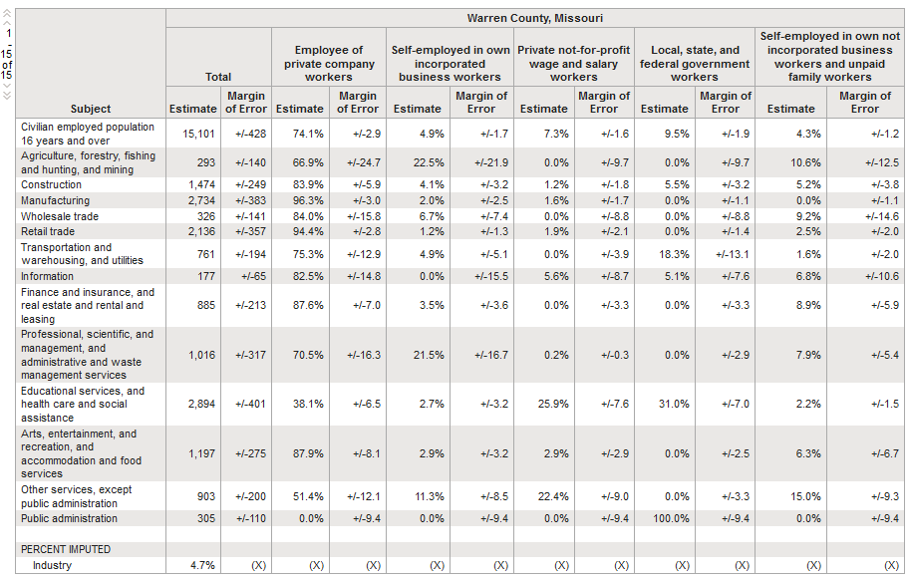
Notes:
We can see from this chart that a good portion of the workers within Warren County are employed within the Manufacturing Industry. Let’s take a closer look at our numbers. (CLICK)
For the entire county, manufacturing makes up over 18.1% of total employment. That’s a large number of workers that already have the skills and training in place to gain employment in a new manufacturing firm. You can also use this table to do a comparison across areas so you can examine counties that are in your commute shed area and see the labor force availability they have as well to contribute to your possible new firm.

Slide 41
Examining Skills of the Region’s Workforce
  American Community Survey
  Education and training programs and enrollment
    Provided by DESE or Department of Higher Ed.
Notes:
Another set of data that you may utilize is offered through the Department of Elementary and Secondary Education or the Department of Higher Education. They have data sets available to download that allow you to look at enrollment trends into institutions of learning by subject areas to see what your new highly trained labor force will excel in.

Slide 42
Step 3 Website Links
Census Bureau’s American Community Survey: http://www.census.gov/acs/www/
Missouri Department of Elementary and Secondary Education Data Portal
http://mcds.dese.mo.gov/Pages/default.aspx
Missouri Department of Higher Education Data Portal
http://www.dhe.mo.gov/data/
Notes:
Here is a list of the websites that we covered in Step 3. Please feel free to pause the webinar where you are now and practice retrieving data on your own. If you choose not to, please continue on with the Module lesson.

Slide 43
Four Step Strategy to Understanding Your Workforce
Check current labor market performance.
Examine workforce in the region.
Examine quality and skills demanded of workforce.
Compare wages in the region.
Notes:
The final step and probably one of the most important, especially for a business looking to move its bottom line, is the wage data information. In order to achieve funding for re-employment efforts, it will be necessary to explain and validate the funding requests. We’ve already seen some wage data that has appeared as a by-product of the LMI tools we were using earlier, most notably in the QCEW and LEHD. Now we will use a tool that is much more occupational and industry sector specific.

Slide 44
Comparing Regional Wages
MERIC Provided data
  OES-Occupational Employment Statistics
Other available data tools—wage data provided as a by-product
  QCEW
  LEHD
Notes:
The Occupational Employment Statistics tool allows you to sort by occupational sector and occupations alone for an area or across geographies for comparison. You can only sort by WIA region, MSA’s, or statewide, usually because confidentiality restrictions are imposed too heavily at a county level. Let’s take a look at manufacturing occupations for the Northeast region….

Slide 45
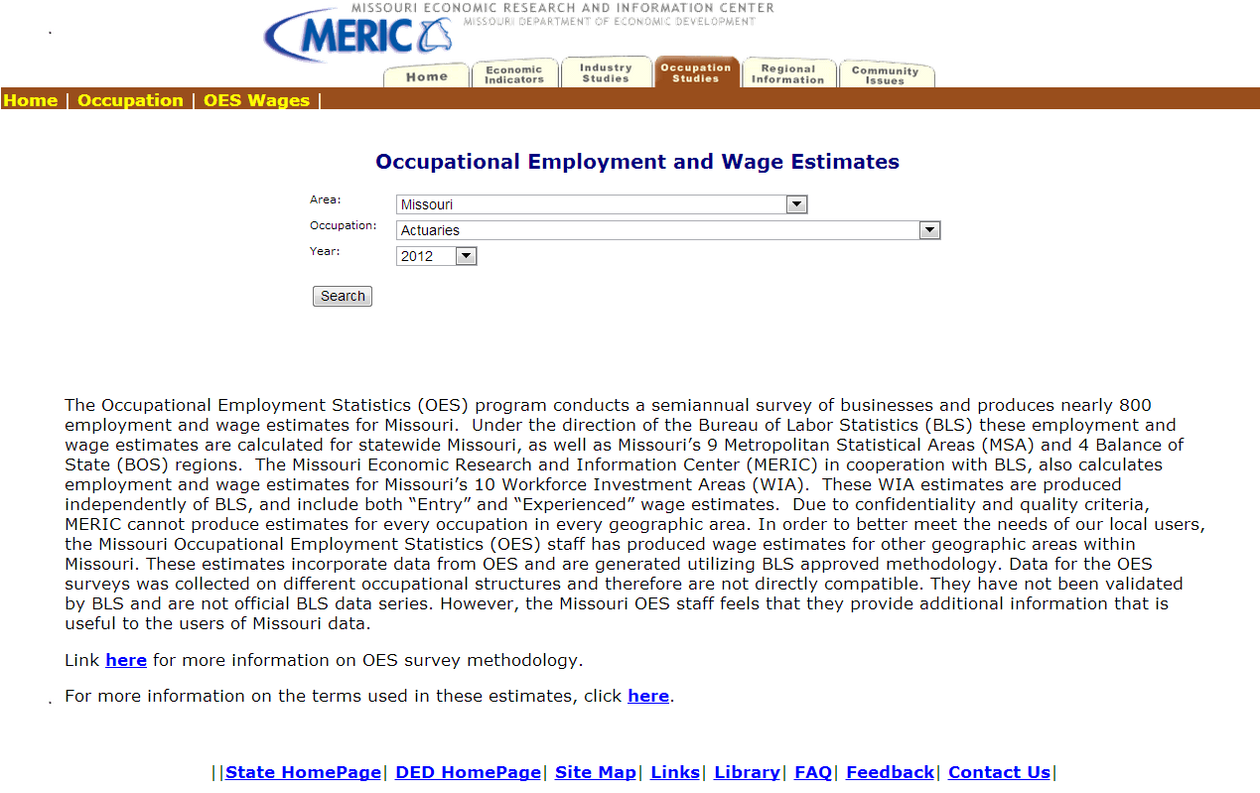
Notes:
You have the option of selecting the specific region on (CLICK) the map that you are interested in so you can view all occupations across sectors, or you can use the pull down (CLICK) to select the area and/or the occupation you wish to look at across all regions. We’ll look at the occupations within the Northeast region so we can see the occupations within the manufacturing sector, and what the average wages will be for new businesses so they will better understand their operating costs upon moving into the Warren County area.

Slide 46
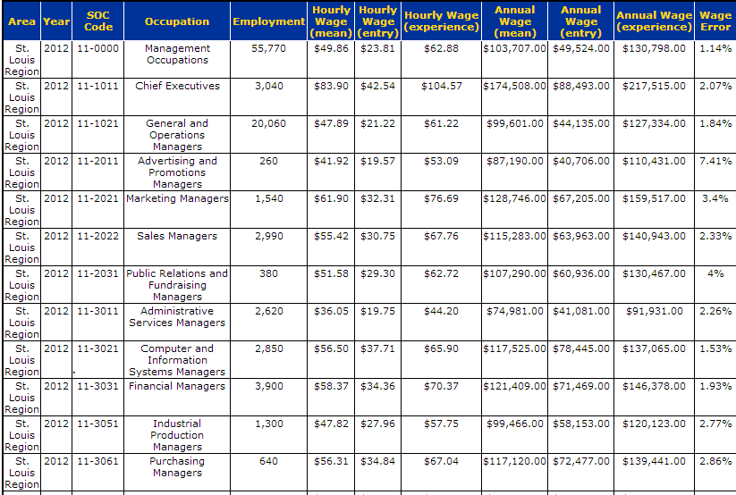
Notes:
Here are the results of the OES search. If you scroll down on the screen, we’ll find the Production Occupations and get the LMI wage data average across all occupations within this sector. If you are aware of what occupations would be needed, you can find the occupations and gather wage data as well.
The wage data is separated between hourly and annual for job announcements and for HR purposes. They also offer differentiation between Mean, Entry, and Experienced wages. Mean wages are also known as average wages, they are calculated by summing the wages of all the workers in a given occupation and then dividing the total wages by the number of workers. Entry wages are the mean of the lower third percentile of the sampled population of surveyed workers. Experienced wages are defined as the mean of the upper two-thirds percentile of the sampled population of surveyed workers. These wages are calculated by MERIC and included only in WIA & Statewide estimates.

Slide 47
Step 4 Website Links
Occupational Employment Statistics: http://www.missourieconomy.org/occupations/oeswage/
Local Employment Household Dynamics:
http://www.missourieconomy.org/indicators/lehd/index.stm
Quarterly Census of Employment & Wages: http://www.missourieconomy.org/industry/qcew/
Notes:
Here is a list of the websites that we covered in Step 4. Please feel free to pause the webinar where you are now and practice retrieving data on your own. If you choose not to, please continue on with the Module lesson.

Slide 48
Combining Data for Maximum Effect
Traditional LMI data
Non-Traditional Data
QCEW
LEHD
OnTheMap
OES
Etc…….
Local industry reports
Job openings on job boards
Unemployment Claims
Focus Groups
Training Enrollment Trends
Notes:
When you are finalizing gathering your data to put into a report, project, or in this case a grant application remember that it is most helpful to combine types of data, traditional (which you have seen gathered earlier) and non-traditional, in order to develop strategy that addresses the big picture for your region’s growth. Traditional data is validated, historical information, such as you would get from Unemployment Statistics and Census Bureau data.
Non-traditional data options include listings on job banks for obtaining real time data on employment trends, trade association reports, and data you may gather yourself from industry focus groups.
A combination of both types will allow you more backup with stating your case, and also help your area win in economic recovery efforts.

Slide 49
Module 3 - Complete
Module 1: Labor Market Information Fundamentals
Module 2: Using Data to Inform Skill Assessment, Competency Analysis & Career Pathway Planning
Module 3: Using Economic & Workforce Data to Drive Reemployment Strategy
  Lesson 1: LMI and Strategic Planning
  Lesson 2: LMI and Re-Employment
Module 4: Guiding Businesses/Partners to Use Workforce System & LMI Resources to Support Human Resource Functions
Notes:
Congratulations, you have just completed the Using Economic and Workforce Data to Drive Re-employment Strategy module. Hopefully you have been able to take away some valuable LMI data tools that will help in your drive to create economic development.

Slide 50

Thank you for your participation!
Contact us at:
mericdata@ded.mo.gov
Fax: (573) 751-7160
www.missourieconomy.org
Notes:
Thank you for participating in this LMI series of webinars. If you have any questions regarding this training or would like additional LMI data information, please feel free to contact by e-mail at mericdata@ded.mo.gov. You may also visit MERIC’s website at www.missourieconomy.org for additional resources and contact information for your assigned regional staff liaison.

Slide 51
Please take a moment to complete this survey, which is available online at the link below. Your input will assist us in making these webinars more effective and successful as we continue to make further improvements.
http://www.surveymonkey.com/s/M7BLRV9

