Slide 1



Module 4: Lesson 1 LMI and Business relations
U.S. Department of Labor—Employment & Training Administration| Missouri Economic Research and Information Center| Missouri Department of Economic Development
This project has been funded, either wholly or in part, with Federal funds from the Department of Labor, Employment & Training Administration under Task Order Number DOLJ061A20373; the mention of trade names, commercial products, or organizations does not imply endorsement of same by the U.S. Government.
Notes:
Welcome to Module 4: Lesson 1 of the LMI eLesson Catalogue. Module 4: Guiding Businesses to Use Labor Market Information Resources to Support their human resource needs is an advanced level course designed to discuss common labor and market challenges faced by employers and how DWD professionals can use LMI to serve employer needs.
(Advance Slide)

Slide 2
Today’s Lesson
✓
Module 1: Labor Market Information Fundamentals
Module 2: Skills Assessments & Career Pathway Planning
Module 3: Using Economic & Workforce Data to Drive Reemployment Strategy
Module 4: Guiding Businesses to Use LMI Resources to Support Human Resource Functions
Lesson 1: LMI and Business Relations
Lesson 2: Practicum
✓
✓
Notes:
Before participating in this lesson, you must complete:
Module 1, Lesson 1 “LMI Fundamentals”
It is recommend that you also be familiar with the content of Module 3 LMI for Strategic Planning and Reemployment
(Advance Slide)

Slide 3

What’s in it for me?
After participating in this lesson, you will be able to:
Categorize common challenges faced by businesses
Identify data types and LMI sources specific to each category of business challenge
Extract data from dynamic LMI sources
Lesson Two: Practicum
Data Extraction
Notes:
Today’s lesson will focus on common workforce challenges for businesses.
After participating in this lesson, you will be able to:
Identify common challenges faced by businesses
Identify data and LMI sources specific to each type of business challenge, and
Extract data from dynamic sources
This lesson discusses opportunities for you to build informed dialogues with businesses by highlighting how to address their common questions, challenges and needs. Today’s lesson will end with a demonstration of OnTheMap, an LMI source that locates and tracks specific labor pool segments.
(Advance Slide)

Slide 4
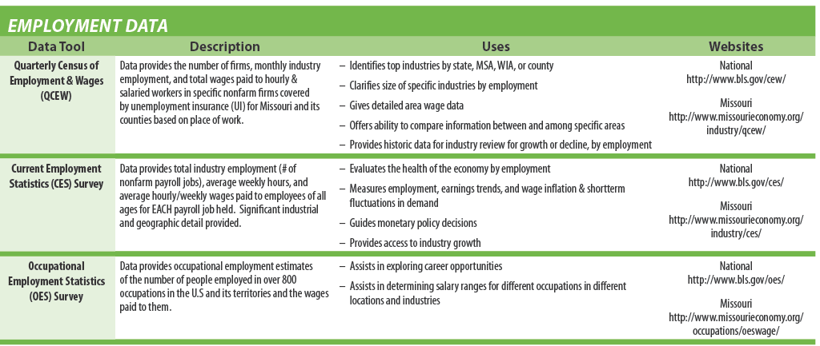
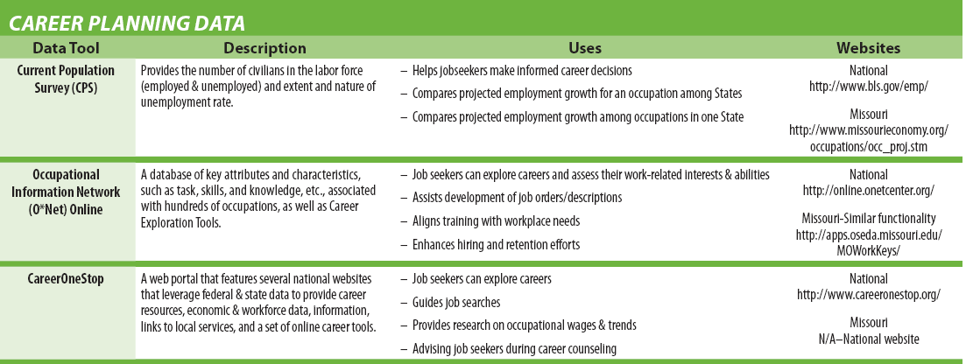
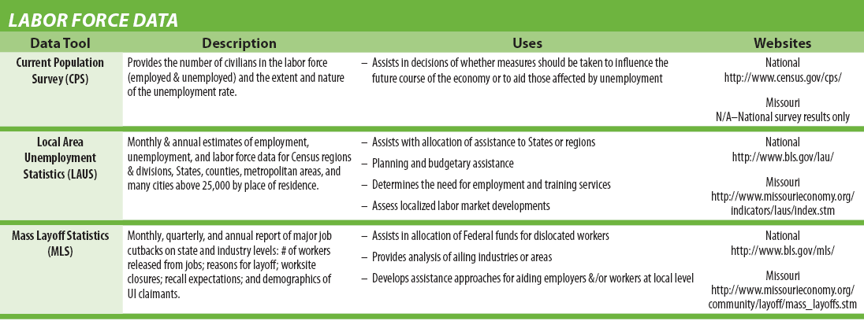
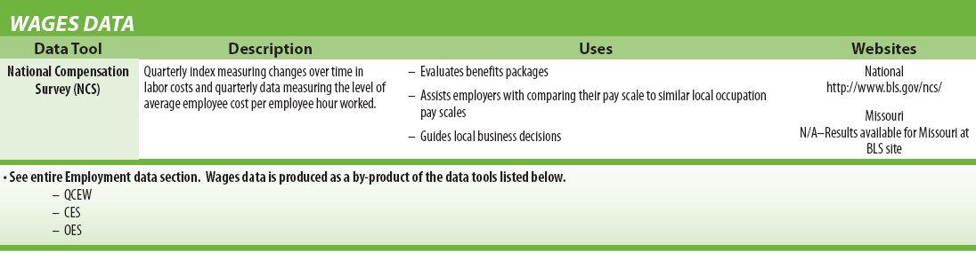
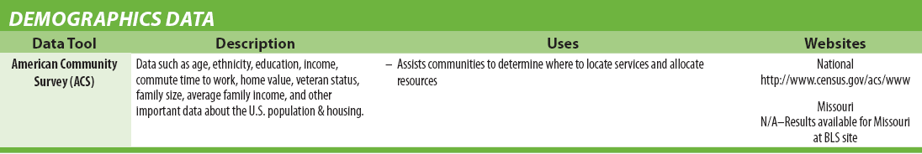
Suggested Study Aid
www.missourieconomy.org/pdfs/economic_indicator_guide.pdf
Notes:
Before we continue, please make sure you have the Module 4: Lesson 1 “Webinar Study Aid” printed and ready for use. If you don’t already have the “LMI Cheat Sheet”, please pause this webinar and visit the web address provided to print it for your reference.

Slide 5
Communication in a Common Language
Our role is to ensure the best connection between job seekers and employers.
Key Data Types:
Previous Lessons
Career Planning - O*Net Online
Employment - Occupation and Industry Projections
Demographic – U.S. Census Bureau
Today’s Lesson
Wage – Occupational Employment Statistics
Labor Force – Demographics and Labor Sheds
Notes:
Throughout this catalogue of LMI eLessons you have heard about the importance of “communication in a common language.”
As Workforce Development professionals, our mission is to ensure a mutually-beneficial connection between job seekers and employers. At our disposal are a variety of sources through which we can accesses the five different types of LMI. Today we will look at how you might use the most timely wage data available to start a conversation with local businesses about setting competitive wages for new hires and to ensure businesses can retain their expert talent.

Slide 6
How to Attract and Retain Talent?
Challenges | Labor Market Information | Data Source
Workforce Characteristics | Demographics; Educational Attainment; Skills Assessment | LED and ACS
Talent Recruitment | Labor Shed; Commute Shed | OES and LED
Competitive Compensation | Projections; Wages | OES and NCS
Training and Retraining Programs | Skills Transferability; Training Programs | O*Net Online
Services for Displaced Workers | Skills Assessment and Transferability; Projections; MO Rapid Response | O*Net Online
Notes:
One of the most common challenges businesses face is how to attract and retain talent. To help address these challenges we need to understand:
What are the characteristics of a region’s workers?
Is a region lacking specialized talent needed by particular employers?
What is a competitive wage for new and skilled workers? And
What services are available to help an employer retrain dedicated employees?
These challenges require accessing various data sets from national and state data portals like:
the Census Bureau (for demographic data),
the Bureau of Labor Statistics (for labor and workforce characteristics), and
O*Net Online (for consistent occupation information).
(Advance Slide)

Slide 7

Starting the Conversation
What is a competitive wage for my open positions?
LMI steps to an answer
Accurate occupation classifications
Regional and state occupation employment statistics
Wage data
Notes:
Let’s see how we can help businesses set a competitive wage for open positions.
To set competitive wages for occupations you must:
Ensure an occupation is accurately classified,
Examine industrial and regional-specific trends, and
Access the most timely wage data available.

Slide 8
Occupational Employment Statistics Survey
Most Timely Wage Data Available
Wage Data Applications
Based on a semi-annual mail survey of business establishments
Wage/Salary Estimates by:
Occupation
Approx. 800 SOC-coded occupations
Industry
Organized at the 3, 4 and 5-digit NAICS industry levels
Geography
To a WIA or MSA level of concentration
Employers and Job Seekers
Understand competitive pay scales
Compare occupation wages between industries & geographies
Evaluate wage trends
Workforce Professionals
Estimate labor costs
Inform occupation and industry projections
Assess need for employment and training services
Notes:
The semi-annual Occupational Employment Statistics survey designed by the BLS and administered by the state LMI shops is the least biased source of wage data and usually the most timely of all LMI sources that report wage information.
Twice a year a sample of businesses are asked to report wage or salary information for each occupation they employ. The data is then vetted and reported by occupation, industry and geography.
The level of detail informs the decisions of job seekers, employers, workforce professionals and strategic planners.

Slide 9
Things to Consider
Occupational wage data is based on the over 800 occupations classified by the Standard Occupational Classification (SOC) System.
To provide accurate wage data, the correct occupation title is crucial. To check a title’s accuracy refer to O*Net Online
For Missouri specific wage information, it is recommended you use the MERIC portal. Data available through MERIC is provided at a greater level of regional accuracy.
Notes:
However, when working with wage data, there are two key considerations one should remember….
Occupational wage data is based on the over 800 occupations classified by the Standard Occupational Classification (SOC) System.
To provide accurate wage data, the correct occupation title is crucial. To check a title’s accuracy refer to O*Net Online
For Missouri specific wage information, it is recommended you use the MERIC portal. Data available through MERIC are provided at a greater level of regional accuracy.

Slide 10
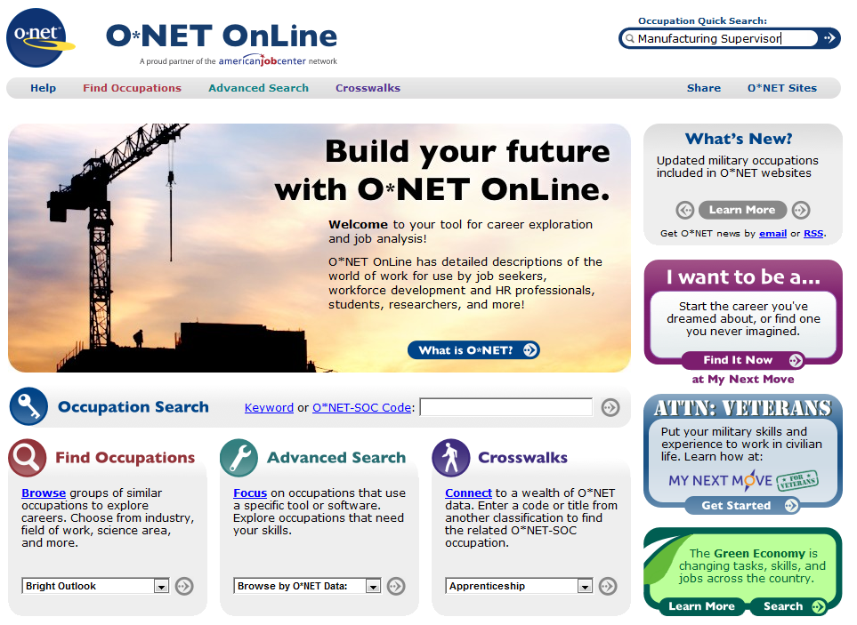
Step 1 – Check SOC Title
www.onetonline.org
Notes:
Throughout this catalogue of LMI eLessons we have demonstrated the use of O*Net Online. Please refer to Module 2 if you need additional instruction on its use.
Today O*NET Online will be used to demonstrate the importance of accurately classifying an occupation. For example if a business has a position titled “Manufacturing Supervisor,” enter the title in the “Quick Search” field to see how O*Net classifies such an occupation.

Slide 11
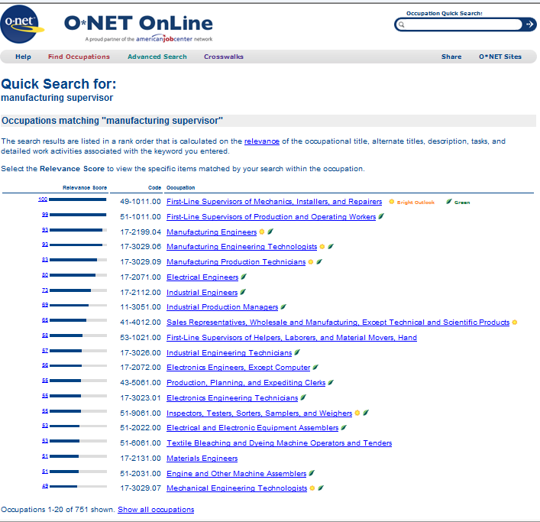
Step 2 – Explore Possible Titles
Choosing the right Occupation title makes a big difference in data accuracy.
Pairing job orders and qualified applicants,
Providing competitive compensation , and
Reporting LMI
all depend on consistent occupation titles.
Notes:
We find that O*Net Online has no such occupation classification. But the portal does return a list of over 700 occupations ranked by likelihood of relevance based on alternative titles, duty descriptions, tasks performed and associated activities.
Choosing the right Occupation title makes a big difference in data accuracy.
Pairing job orders and qualified applicants, providing competitive compensation , and reporting LMI all depend on consistent occupation titles.
To demonstrate the importance of a proper occupation classification with regards to wage data, let’s compare wage data from the MERIC OES portal for two of the returned occupations.

Slide 12
Step 3 – Compare Occupation Details
MERIC
Occupational Employment Statistics (OES):
May 2012 Occupational Employment and Wage Estimates
 |  |  |  |  | Missouri
Area | Year | SOC Code | Occupation | Employment | Hourly Wage (mean) | Hourly Wage (entry) | Hourly Wage (experience) | Annual Wage (mean) | Annual Wage (entry) | Annual Wage (experience) | Wage Error
Missouri | 2012 | 11-3051 | Industrial Production Managers | 3,090 | $43.41 | $26.25 | $52.00 | $90,300 | $54,600 | $108,150 | 1.6%
Sample of job detail |  | Plan, Direct, or coordinate the work activities and resources necessary for manufacturing products in accordance with cost, quality and quantity specifications
Area | Year | SOC Code | Occupation | Employment | Hourly Wage (mean) | Hourly Wage (entry) | Hourly Wage (experience) | Annual Wage (mean) | Annual Wage (entry) | Annual Wage (experience) | Wage Error
Missouri | 2012 | 51-1011 | First-Line Supervisors of Production and Operating Workers | 11,650 | $24.96 | $15.44 | $29.72 | $51,920 | $32,120 | $61,820 | 1.1%
Sample of job detail |  | Directly supervise and coordinate the activities of production and operating workers, such as inspectors, precision workers, machine setters and operators, assemblers, fabricators, and plant and system operators. Excludes team or work leaders.
www.missourieconomy.org/OesWage/Default.aspx
Notes:
The combined results of the two occupation searches in the MERIC OES portal are presented in this summary table. Please refer to Module 1 for additional instruction on building OES data searches.
As you can see from the results….there are clear similarities between the duties of each occupation. There is duplication in the reported job titles. However the average wages for each occupation in Missouri are very different.
You can work with an employer to analyze the job duties of their position and pair it with a SOC-Coded occupation description to ensure the occupation is being classified correctly. This will help the employer set an accurate and competitive pay scale. In turn, this should also increase the accuracy of future LMI reporting.

Slide 13

Continue the Conversation
Why are these positions unfilled?
Possible business services available to support human resource efforts
Recruit, assess and screen an applicant pool
Write and advertise job orders
Provide on-the-job training financial support
Use LMI to monitor the workforce landscape
Notes:
Once a relationship is established you might continue the conversation to explore why the employer has unfilled positions. Is there the opportunity for DWD and the Next Generation Career Centers to prepare a job order, recruit, asses or train applicants, or is there a bigger workforce landscape issue strategic planners need to be aware of?

Slide 14

Case Study
http://www.missourieconomy.org/pdfs/pattern_industry_machine_mfg.pdf
The Machine Manufacturing Pattern Industry Insight report, released by MERIC, identifies two strong machine manufacturing industry clusters in the lower West Central region. Despite short and long-term projected declines in the region’s industry, my conversations with employers suggest they have well paying jobs unfilled. In addition to offering the immediate services of the Nevada NGCC, I want to examine the landscape further to ensure a continued informed dialogue with these employers.
I need to examine the Bates, Cedar, St. Clair and Vernon 4-County region to understand:
where residents are working, and
where are the region’s Manufacturing concentrations.
Notes:
In an effort to put the workforce landscape in context, let’s look at one of the Pattern Industry Insight reports prepared by MERIC. MERIC analyzes data to examine industrial patterns by region to identify clusters. Clustered firms feed off each other and often produce a specialized labor pool specific to an industry. For example…
The Machine Manufacturing Pattern Industry Insight report, released by MERIC, identifies two strong machine manufacturing industry clusters in the lower West Central region. I want to examine the landscape further to ensure a continued informed dialogue with these employers.
I need to examine the Bates, Cedar, St. Clair and Vernon 4-County region to understand:
where residents are working, and
where are the region’s Manufacturing concentrations.

Slide 15
Where is the answer - OnTheMap?
Local Employment Dynamics
Tools for Synthesized Detailed Information
OnTheMap
By combining data from different LMI sources (Census, BLS) local employment information, once unavailable, is now easily accessible.
Quarterly Workforce Indicators (QWI)
Industry Focus
http://lehd.did.census.gov
Notes:
To work through this case study we will focus on a dynamic LMI platform. The Local Employment Dynamics platform which hosts three data tools that synthesize detailed information:
First, Quarterly Workforce Indicators (QWI) provides labor market measures
Second, OnTheMap creates customized portraits of who works where, doing what and for what compensation
Lastly, Industry Focus reports local business and workforce characteristics.
LED fills critical gaps in workforce statistics. It combines two sources collected for different reasons (state wage and unemployment records submitted each quarter combined with current demographic information from the Census Bureau) and when combined the results are very useful in seeing the workforce landscape.
Remember, the key here is to see that a combination and cross section of data is needed to really understand the big picture.
(Advance Slide)

Slide 16
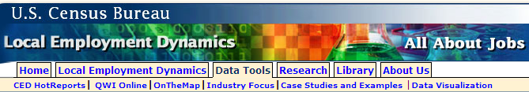
LED – Informational Maps
Regional Workforce Planning & Management
Monitor Employment Trends
Identify Workforce & Laborforce Characteristics
Identify Hotspots for Job Training Services
Business Attraction & Retention Services
Worker Concentration Maps
Age/Earnings/Industries
Commute or Labor Sheds
Where do workers live?
Where do residents work?
Notes:
Unlike the popular ArcGIS mapping software, the LED OnTheMap utility is a publically-accessible web-based mapping and reporting application that shows where workers are employed and where they live. It can be used to produce visual representations of employment and industry data since 2002.
With it one can monitor employment trends, worker demographics, track where workers of a region live and where residents of a specific geography are working.

Slide 17
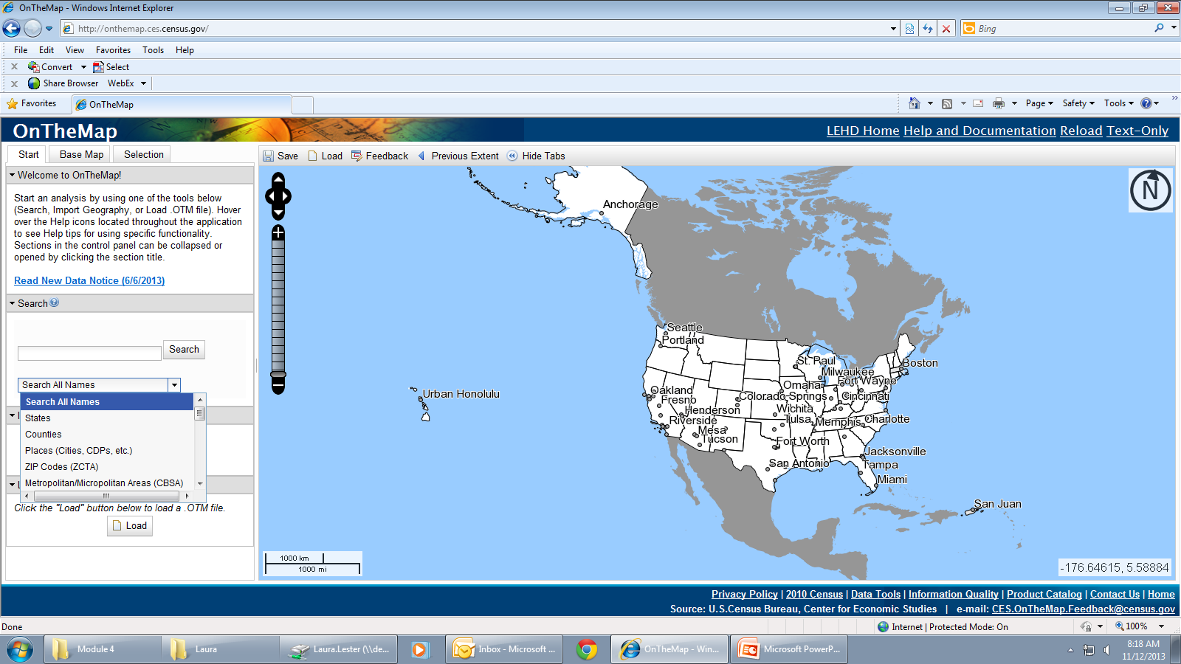
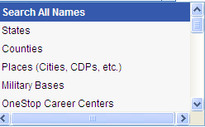
OnTheMap – Search Locations
Notes:
With very few imputes one can create a visual representation of dynamic data.
To get started…..
Select the type of geography on which you would like to focus the map. Remember we eventually need to perform a 4-county analysis but to begin with, center the map on an individual county.

Slide 18
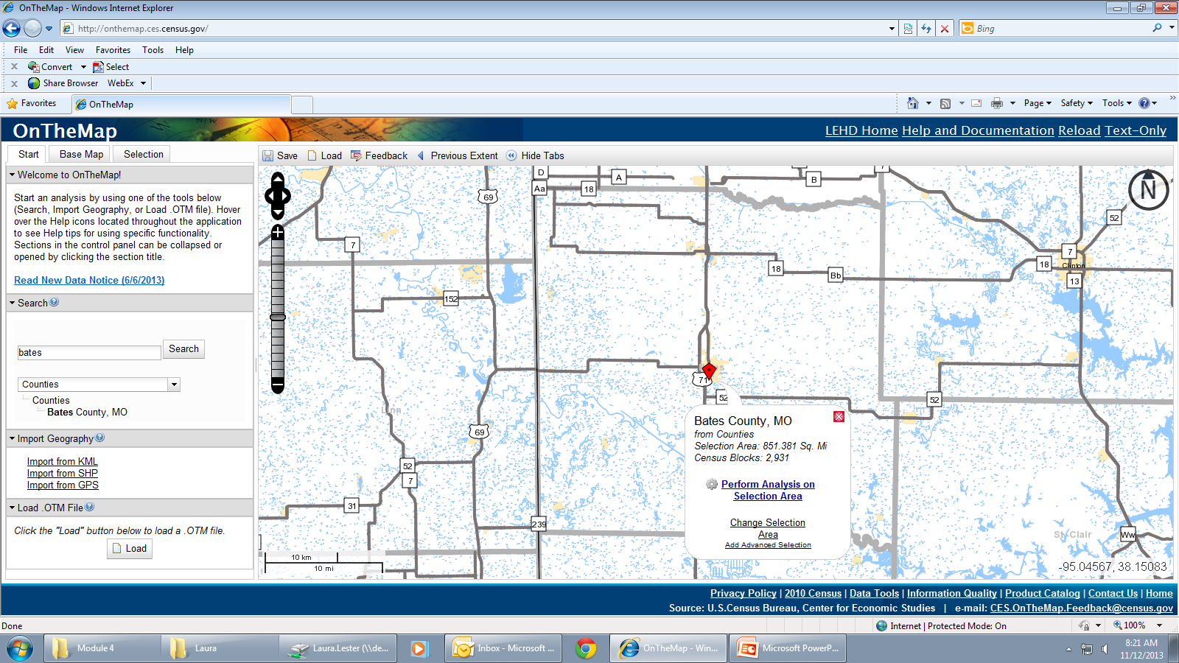
OnTheMap – Choose Location
Notes:
To get the geographic result selected from the drop down menu enter the county name in the search field.

Slide 19
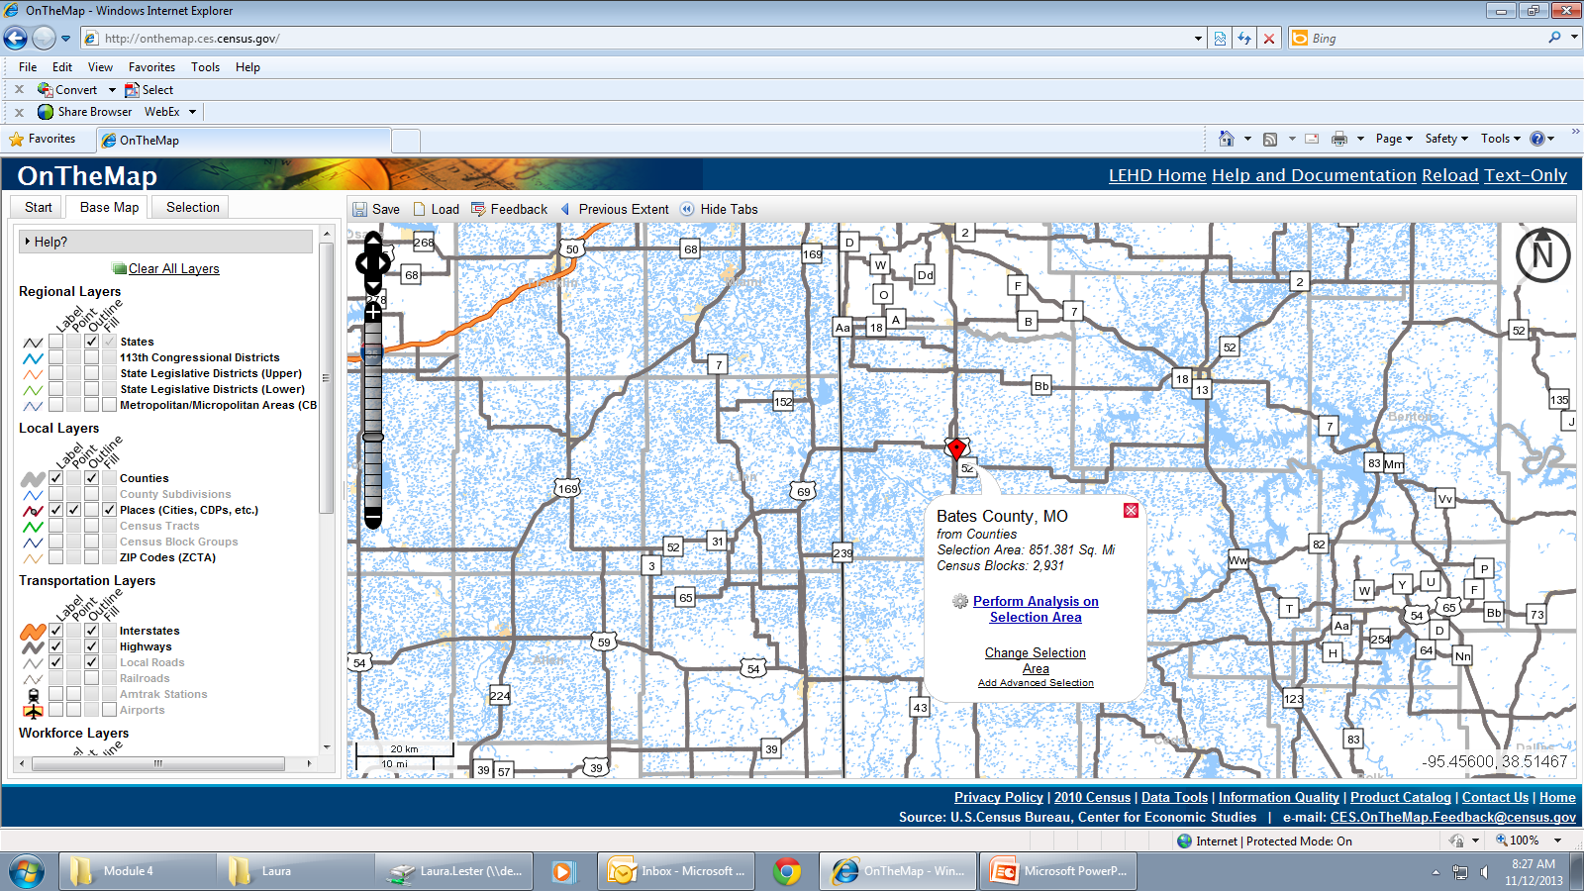
OnTheMap – Base Map Elections
Layers
Regional
Local
Transportation
Workforce
Education
Other
Background
Notes:
Now we will create the visual map with as much or as little detail as you would like.
---You can zoom in or out using the slide bar and directional arrows on the upper left-hand side of the map and
---using the “Base Map” tab you can elect what features are visible and/or labeled on the map.
The choices are organized into 7 types of visual layers: Regional, Local, Transportation, Workforce, Education, Background, and Other.

Slide 20
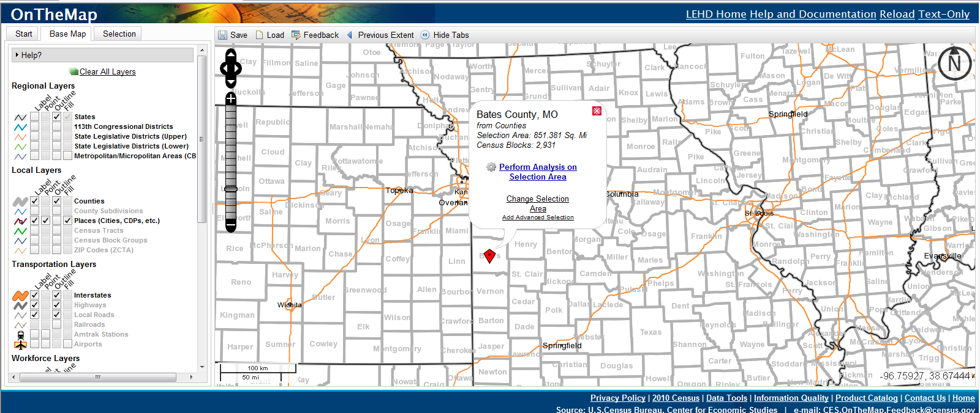
OnTheMap – Base Map Elections
Layers
Regional
Local
Transportation
Workforce
Education
Other
Background
Notes:
For the Regional layer leave the state outlined but unlabeled.

Slide 21
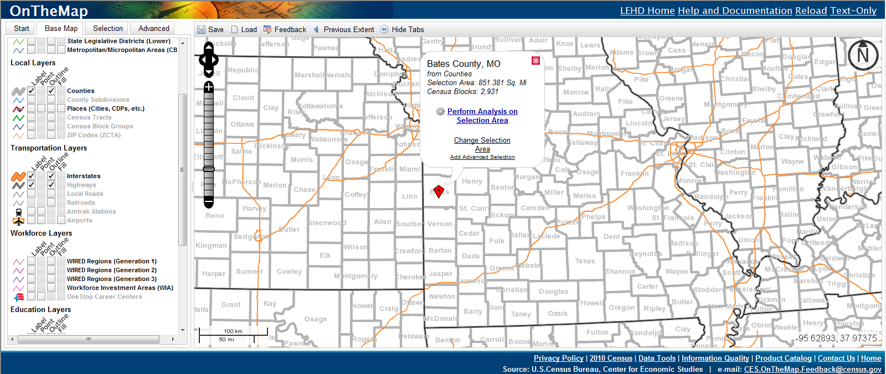
OnTheMap – Base Map Elections
Layers
Regional
Local
Transportation
Workforce
Education
Other
Background
Notes:
At the local level you might choose not to label the cities

Slide 22
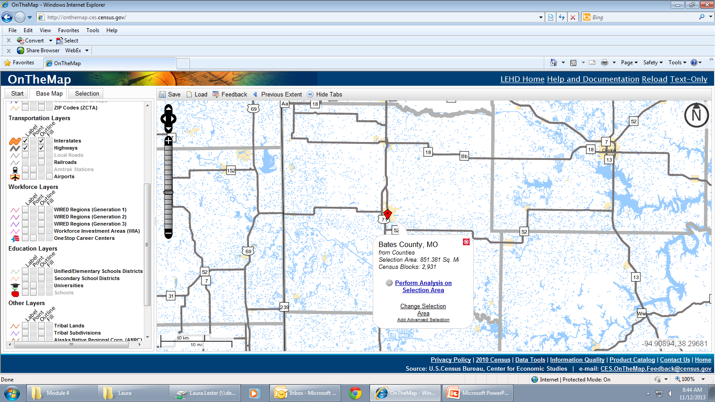
OnTheMap – Base Map Elections
Layers
Regional
Local
Transportation
Workforce
Education
Other
Background
Notes:
At a zoomed-in level you may decide the various transportation networks make the map too busy. So you can remove the local roads and only leave the higher level networks.

Slide 23
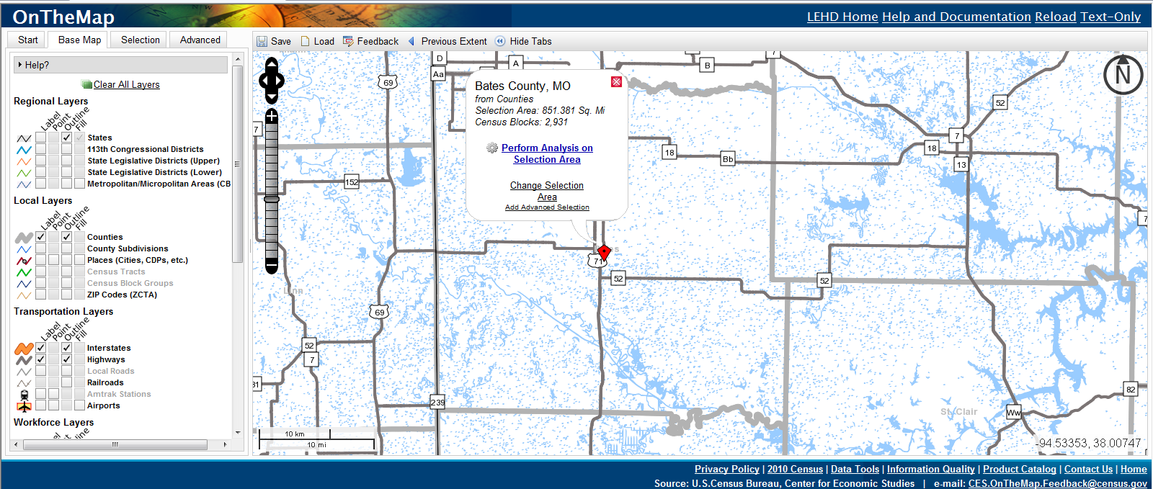
OnTheMap – Base Map Elections
Notes:
When you are comfortable with the level of detail visible on the map click on “Perform Analysis on Selection Area.”
Note that you may always return to the “Base Map” tab to change the appearance of the map.

Slide 24
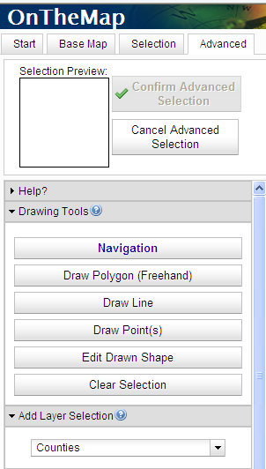
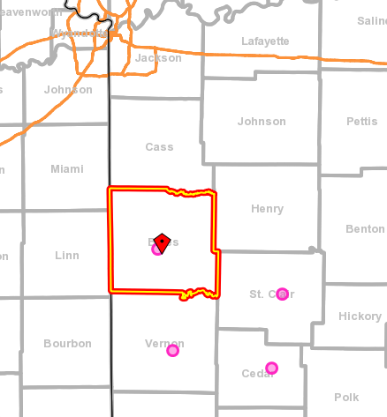

OnTheMap - Building a Map
Step 5
Step 1
Step 2
Step 4
Step 3
Notes:
For our case study we need to refocus the map to include the full 4-County region.
1) So step 1 is to choose “Add advanced selection.”
2) From the Advanced tab choose “Draw Points” which allows the user to elect additional geographies
3) by choosing the type (in this case counties) from the drop down menu in Step 3 and then in
4) Step 4: mouse over the feature you would like to add to the analysis area. In this case we want to add St. Clair, Cedar and Vernon Counties. So mouse over the outlined counties and click once in each of them. The pink circle indicates you have elected the geography.
5) Once all are chosen “confirm the selection” in Step 5.

Slide 25
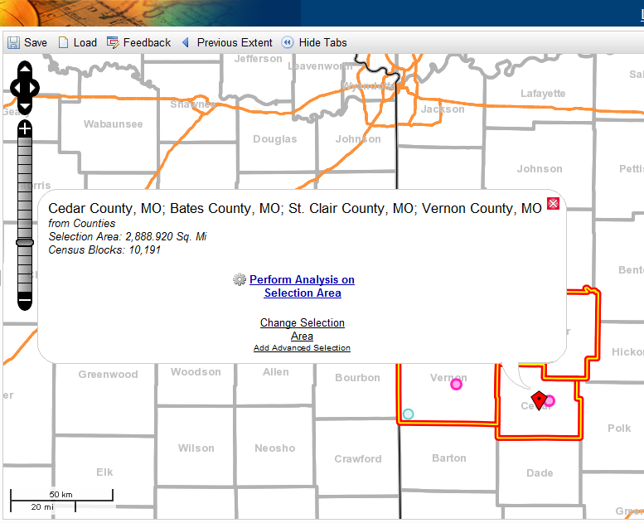
OnTheMap – Build an Area Analysis
Notes:
Once the full geography is confirmed then click “perform analysis on selection area.”

Slide 26
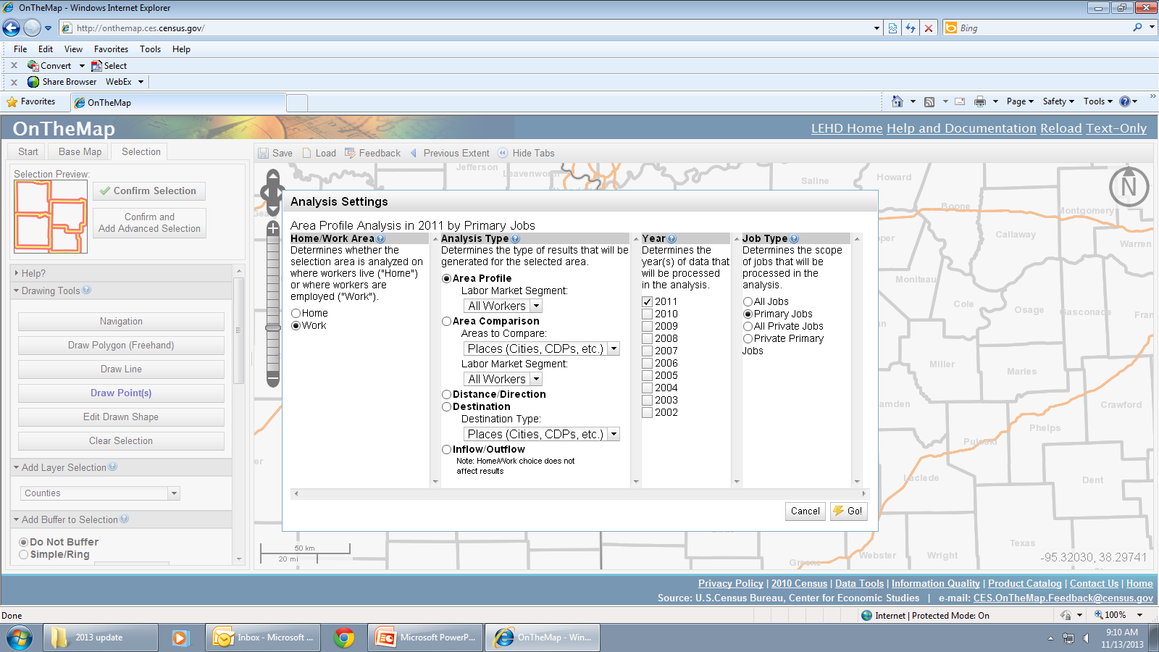
OnTheMap – Building an Analysis
Notes:
This is the basic LED OnTheMap Analysis screen from which you can build various examinations. From here you can choose your analysis settings.

Slide 27
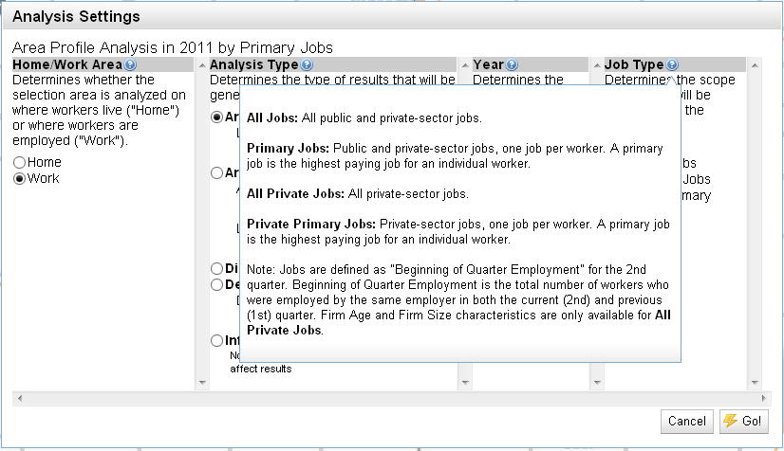
OnTheMap – Building an Analysis
Notes:
If you are unsure what analysis types you need, click on the blue question mark circles to access pop-out windows with definitions and explanations.

Slide 28
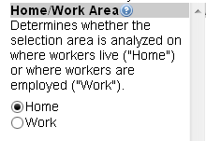
OnTheMap – Building an Analysis
Where do the residents of the 4-County region work?
HOME: Where they live
WORK: Where they work
Notes:
To answer the question – “where do the residents of the 4-County region work?” we must build a home area analysis which returns results about workers who live in the 4-county selection area.

Slide 29
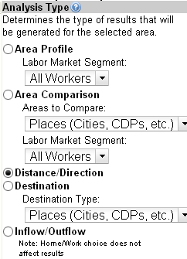
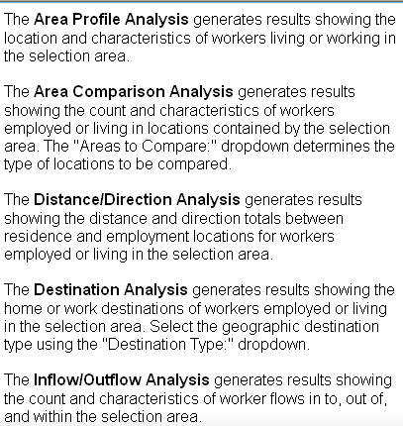
OnTheMap – Building an Analysis
Where do the residents of the 4-County region work?
Notes:
Then choose to run a “Distance/Direction” analysis that will generate results visually showing where residents of the 4-counties are working by distance from one’s residence

Slide 30
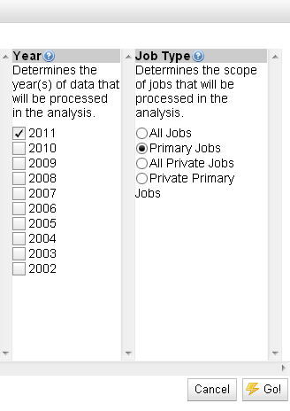
OnTheMap – Building an Analysis
Where do the residents of the 4-County region work?
PRIMARY: Highest Pay
PRIVATE:
No Government
Notes:
Choose the year and type of jobs you want. For most analysis you will usually start with the primary jobs, which is the highest paying job for an individual worker.
When you are ready to run your analysis (*) hit the “Go” button.

Slide 31
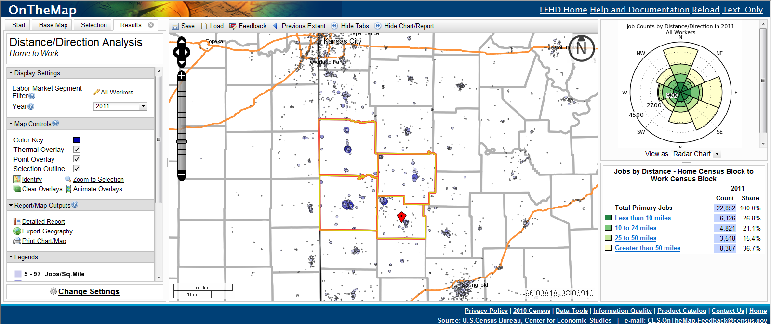
OnTheMap – Labor Force Results
Notes:
Pictured here is the basic analysis results page. The left-hand column provides additional options to simplify the map or change the search filters. The map is showing clusters of residents commuting to Kansas City and Springfield from their homes in the 4-County region.
The right-hand column reports 36.7% of the 4-counties’ 22,852 labor force is commuting over 50 miles to work.
15.4% commute 25 – 50 miles and so on.

Slide 32
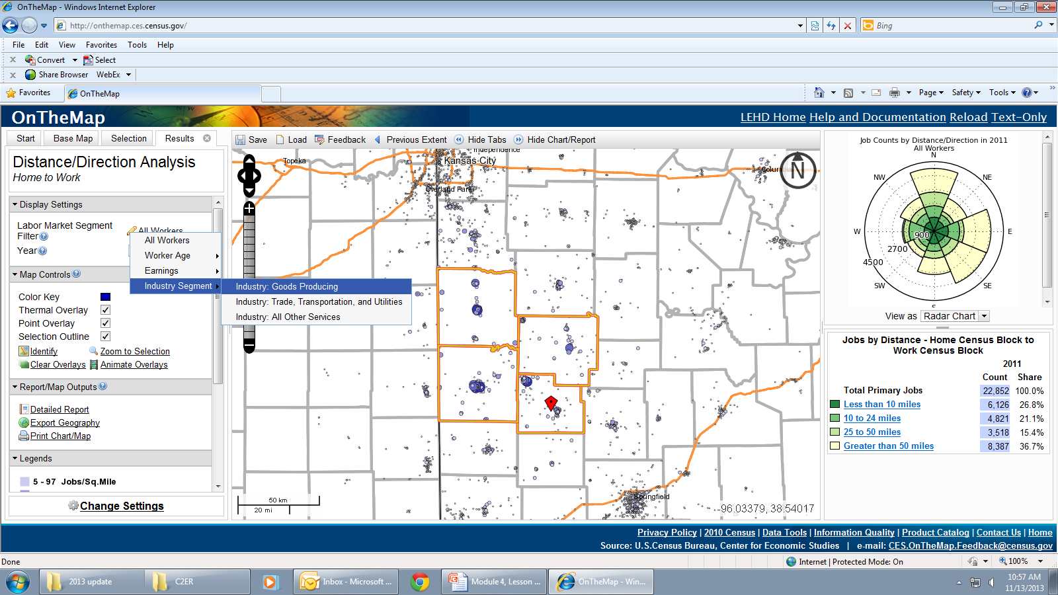
OnTheMap – Filtered Results
Distance/Direction Analysis is reporting the work locations of those who live in the 4-county region.
Characteristic Filter
Worker Age
29 or younger
30-54
55 or older
Earnings
$1,250 or less a month
$1,251 - $3,333 a month
Greater than $3,333 a month
Industry Segment
Goods Producing
Trade, Transportation and Utilities
All Other Services
Notes:
To filter your results click on the Pencil icon next to “All Workers”. You can filter by worker age, earnings or industry segment.
To learn more about the manufacturing sector we select the Goods Producing industry.

Slide 33
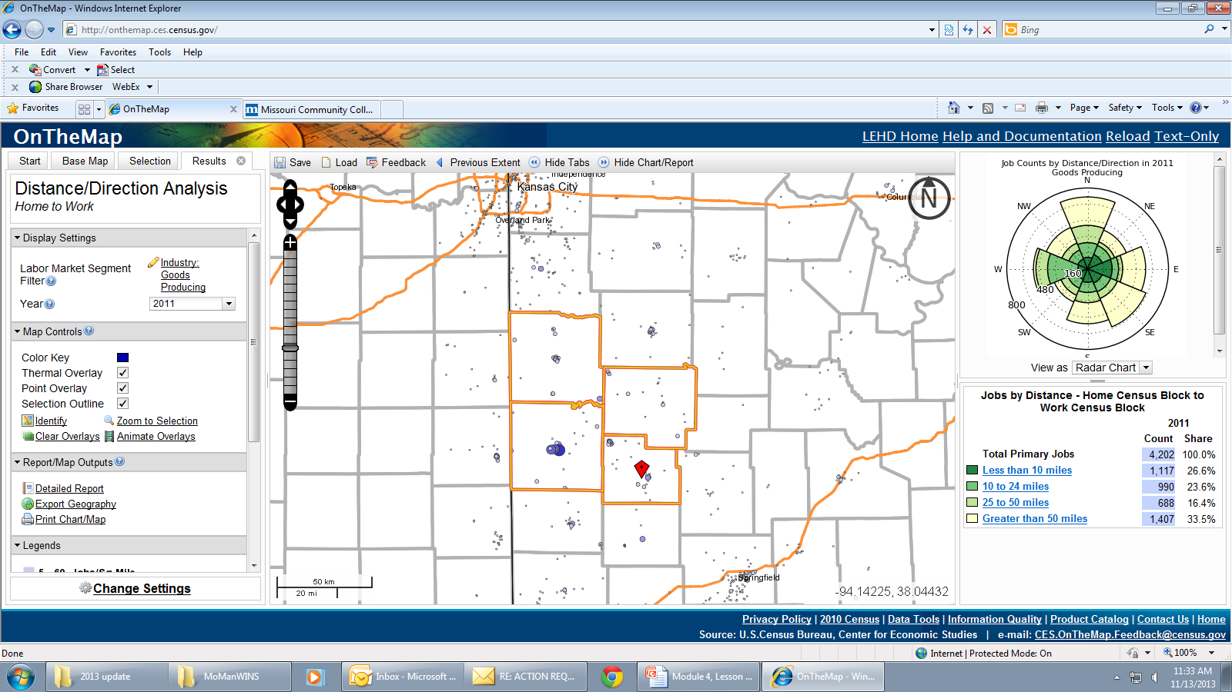
OnTheMap – Goods Producing Labor Force Results
Notes:
A significant percentage of the region’s goods producing labor force is working outside the region. This is an important marketing point for the region. With identified manufacturing industry clusters present in the region and the skilled residential labor pool, manufactures could look to the region as a place to grow, start a new plant or a supporting business.
Let’s now look at a snapshot of the region’s manufacturing workforce.

Slide 34
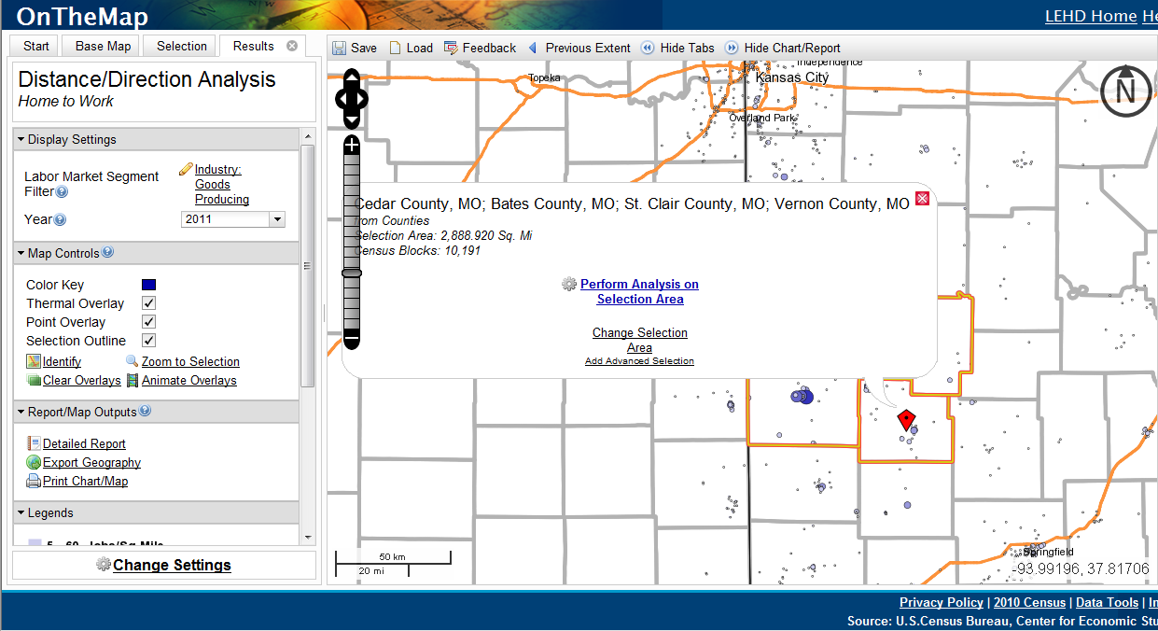
OnTheMap – Manufacturing Profile
Notes:
Where in the 4-county region are the concentrations of manufacturing activity?
First we will need to change settings so we can build a new area profile. You can either click on the “change settings” button , or click on “perform analysis on selection area” to create a new profile.

Slide 35
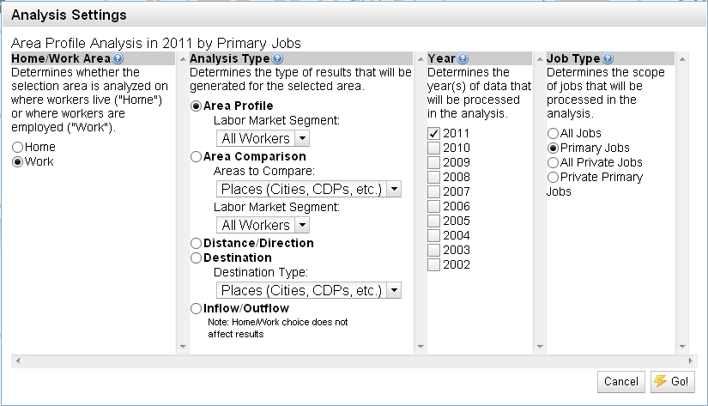
OnTheMap – Manufacturing Profile
Where are the region’s Manufacturing concentrations?
Notes:
This time we want to build the Area’s Profile Analysis which generates results showing the location and characteristics of workers living or working in the selection area. By selecting “Work” we will build an analysis of those who work in the 4-county region regardless of where they live.

Slide 36
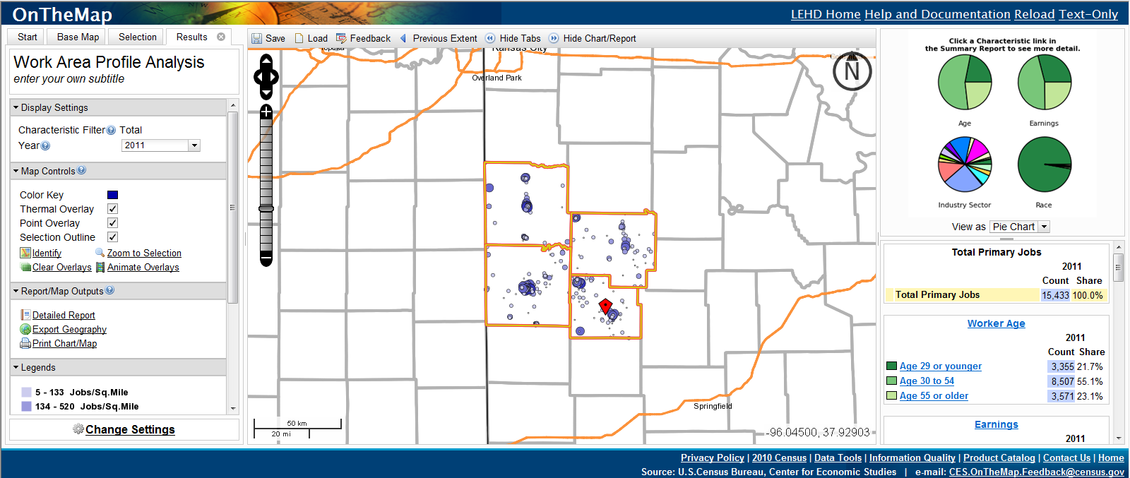
OnTheMap – Area Profile Results
Notes:
The results of our search show that in 2011 there were 15,433 people employed in the 4-counties.

Slide 37
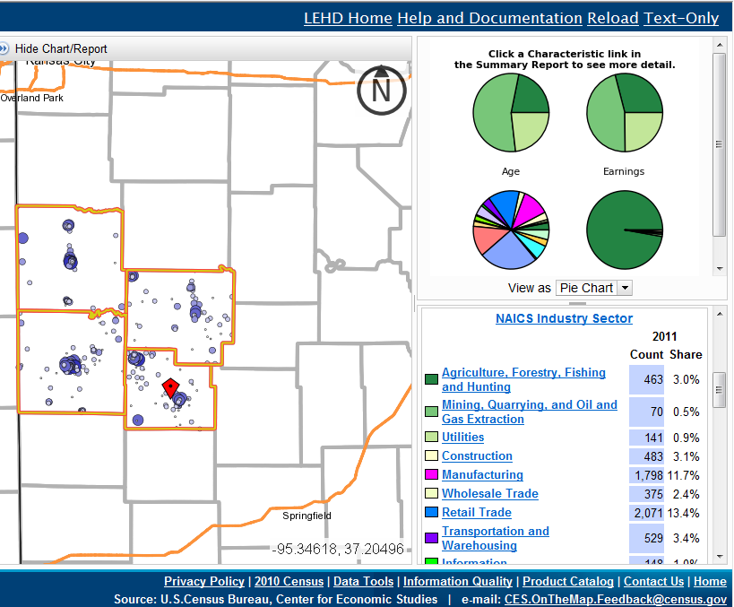
OnTheMap – Filtered Results
Work Area Profile Analyses report the characteristics of the workforce employed in the 4-County region.
Characteristic Filters
Worker Age
Earnings
Industry Segment
Worker Ethnicity
Worker Race
Worker Educational Attainment
Worker Sex
Notes:
A work area profile analysis reports the characteristics of the workforce employed in a designated geography. The results can be filtered further by clicking the characteristic link in the summary report to look at the workforce based on age cohorts, earnings, workers by industry, Ethnicity, Race, Educational Attainment, and Sex. In this case we want to look at the Manufacturing Industry.
Note: Race, Ethnicity, Educational Attainment, and Sex data are not available for years prior to 2009

Slide 38
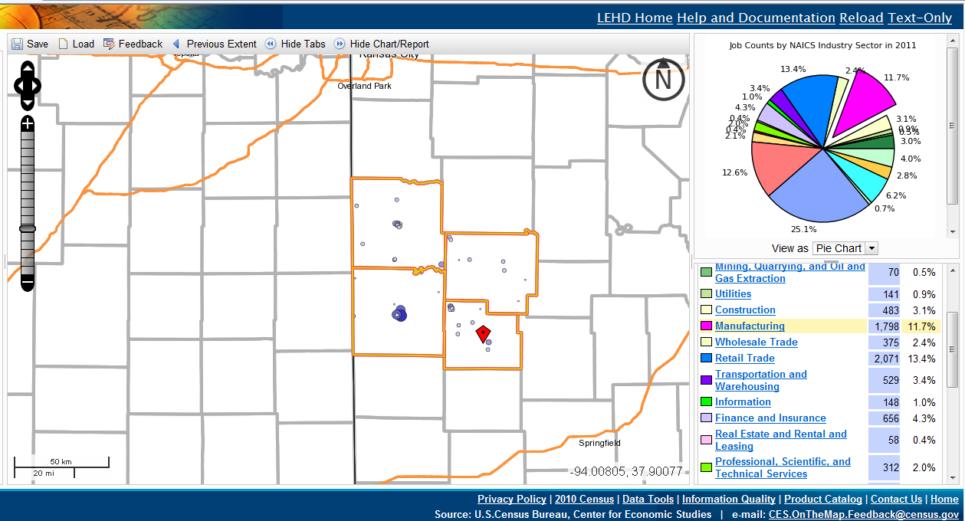
OnTheMap – Manufacturing Concentrations
Notes:
The filtered Work Area Profile results show a few heavier concentrations of activity with some additional scattered activity. The 4-county region hosted 1,798 manufacturing workers in 2011. Manufacturing made up 11.7% of the regions workforce

Slide 39
OnTheMap – Data Visualization
We looked at how LED OnTheMap can be used to:
Create Commute or Labor Shed Maps
Monitor Employment Trends
Identify Workforce & Labor Force Characteristics
Identify Hotspots for Possible Job Training Services
The Machine Manufacturing clusters are important to the region and to the state’s economic health. Ensuring a stable workforce for the companies of the lower West Central region through OTJ training or creative partnerships with Vocational Technical schools and Higher Education can help foster cooperative success and stability for years to come.
Notes:
That was a quick introductory walkthrough to demonstrate how LED OnTheMap can create a visual representation from raw data. Today…
We looked at how LED OnTheMap can be used to:
Create Commute or Labor Shed Maps
Monitor Employment Trends
Identify Workforce & Labor force Characteristics, and
Identify Hotspots for Possible Job Training Services
(Advance Slide)

Slide 40
Website Links
Missouri Economic Research and Information Center:
www.missourieconomy.org
Occupational Employment Statistics:
www.missourieconomy.org/OesWage/Default.aspx
Local Employment Dynamics:
lehd.did.census.gov
Notes:
Here are the website links to the LMI Data tools covered in Module 4 Lesson 2

Slide 41
Module 4: What’s Next?
After participating in this lesson, you will be able to:
Categorize employer challenges
Identify targeted LMI sources to address needs
Navigate to dynamic data to provide answers
Lesson Two: Practicum
Local Employment Dynamics
Notes:
Congratulations! you have completed the “LMI and Business Relations” lesson of Module 4. Next up, in the Module 4 Practicum you will be asked to apply what we discussed today to build an LED OnTheMap analysis and extract data from other LED portals.
(Advance Slide)

Slide 42

Thank you for your participation!
Contact us at:
mericdata@ded.mo.gov
Fax: (573) 751-7160
www.missourieconomy.org
Notes:
Thank you for participating in this LMI series of webinars. If you have any questions regarding this training or would like additional LMI data information, please feel free to contact us by e-mail at mericdata@ded.mo.gov. You may also visit MERIC’s website at www.missourieconomy.org for additional resources and contact information for your assigned regional staff liaison.

Slide 43
Please take a moment to complete this survey, which is available online at the link below. Your input will assist us in making these webinars more effective and successful as we continue to make further improvements.
http://www.surveymonkey.com/s/M7BLRV9
Notes:
Please take a moment to complete this survey, which is available online at the link below. Your input will assist us in making these webinars more effective and successful as we continue to make further improvements.

