Slide 1



Module 1: Lesson 1
Labor Market Information
Fundamentals
U.S. Department of Labor—Employment & Training Administration| Missouri Economic Research and Information Center| Missouri Department of Economic Development
This project has been funded, either wholly or in part, with Federal funds from the Department of Labor, Employment & Training Administration under Task Order Number DOLJ061A20373; the mention of trade names, commercial products, or organizations does not imply endorsement of same by the U.S. Government.
Notes:
Hi everyone, thank you for joining us. Today will be going over the first lesson in Module 1: LMI Fundamentals. This is the pre-requisite module that everyone must complete before they are able to progress into further module lessons.
[CLICK]

Slide 2
Today’s Lesson
Module 1: Labor Market Information Fundamentals
  Lesson 1: LMI Fundamentals
  Lesson 2: LMI and Employment Fundamentals
Module 2: Skills Assessments & Career Pathway Planning
Module 3: Using Economic & Workforce Data to Drive Reemployment Strategy
Module 4: Guiding Businesses to Use LMI Resources to Support Human Resource Functions
Notes:
Today we will be covering Lesson 1: LMI Fundamentals. We will be going over the basics of labor market information and how it can be used.
We will attempt to cover many of the fundamental LMI tools and how they can be used to extract data.
In further modules, we will go into more depth with the functions of the tools and how they can be used in certain scenarios.
[CLICK]

Slide 3
What’s in it for me?
After participating in this module, you will be able to:
  Identify Types of Basic LMI tools
  Navigate Sources of LMI
  Understand the use of LMI in Workforce/Economic Development
Notes:
After participating in this lesson you should be able to:
Identify the types of basic Labor Market Information tools
Navigate through LMI data, and
Understand the use of LMI in workforce and economic development
[CLICK]

Slide 4
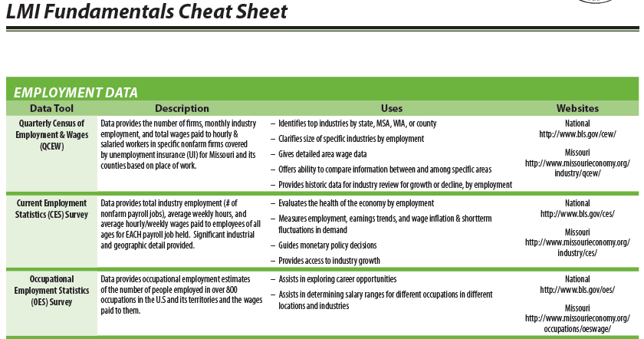
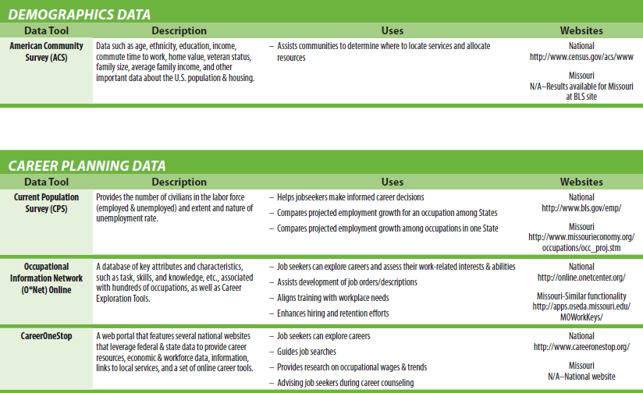
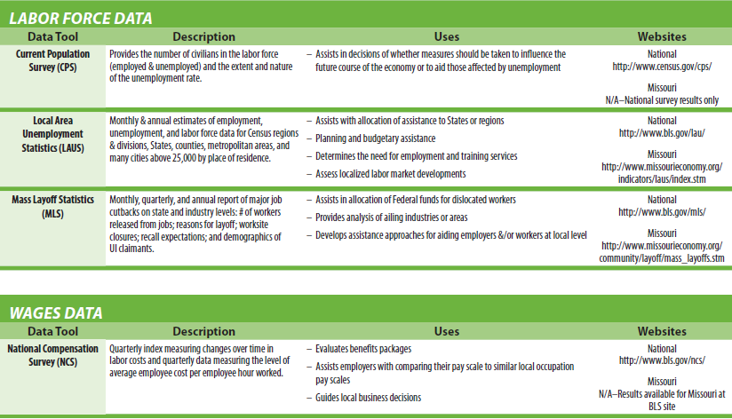
LMI Fundamentals Cheat Sheet
Notes:
If you would like, there is an “LMI Fundamentals Cheat Sheet” available to download and keep at your desk as a reference tool. It shows 5 types of LMI, giving a brief description of each, along with its uses and where to access it in national and state websites. This Economic Indicator Guide is available for download within the training site documents and within the Economic Indicators tab of the MERIC website as the “Quick Guide to Economic Indicators.”
[CLICK]

Slide 5
What is LMI?
Data
Comprehensive data related to employers and respective employees
Compiled according to standard statistical procedures governed by state and federal regulations
Collected
Describes current conditions and predicts relations between labor supply and demand
Reported
Notes:
Labor Market Information at its most basic is the systematic collection, analysis, reporting and publishing of data. It’s not just any type of data, it is data that can be used to describe the current and future conditions of the economy, to assist in creating job growth, gain funding in regions with stagnant economies, and more. We hope to teach you how to find and utilize Labor Market data throughout these series of modules.
[CLICK]

Slide 6

Common Types of LMI
Employment Data
Labor Force Data
Wage Data
Demographic Data
Career Planning
Information
Notes:
In these training modules, we classify LMI into five types: Employment, Labor Force, Wage, Demographic, and Career Planning. We’re going to break these down and go through them one at a time to explain what they are and how you can best use them in workforce and economic development planning.
[CLICK]

Slide 7
Employment Data
…is about JOBS; NOT the employees in them - includes data of actual jobs by place of work.
Provides Job Data Regarding:
  Number of Workers
  Nature of Business/Industry
  Average Wage
  Location
  Skills and Education requirements
  Projected Growth/Decline
Notes:
First up is……Employment data. This type of data is about jobs, not the employees working in them, and reports those jobs by place of work.
Employment data can answer:
How many jobs are there?
What industries employ the most workers?
What wages are they paying?
Where are jobs located?
What skills do I need to gain employment in these jobs?, and
Is employment expanding or declining in my area?
[CLICK]

Slide 8
Where to Find – Employment Data
Quarterly Census of Employment and Wages - QCEW
  Based on North American Industry Classification System - NAICS
  Searchable by
  Geography and/or
  Industry
  Industry Employment
  Information includes all
  Occupations within each
  Industry.
Example QCEW Scenario: A jobseeker enters the NGCC with a freight truck drivers’ license and is interested in finding out about the trucking industry in Jackson County where he just moved……..
Notes:
The most basic tool for finding employment data is the Quarterly Census of Employment and Wages. A state and national data source, QCEW is usually available about five months after the end of the reported quarter…a relatively timely source of data. On the MERIC website, industries are reported at a 3-digit NAICS classification that allows for most employment to be viewable without the risk of confidentiality preventing it from being published. You can use the tool to search by either industry or geography, and the data will provide you with total employment, the number of firms, and what the total and weekly wages are for the industry.
Let’s try to answer the question in the orange box using the Missouri QCEW tool: A job seeker enters the Next Generation Career Center with a freight truck drivers’ license and is interested in finding out about the trucking industry in Jackson County where he just moved…….
[CLICK]

Slide 9
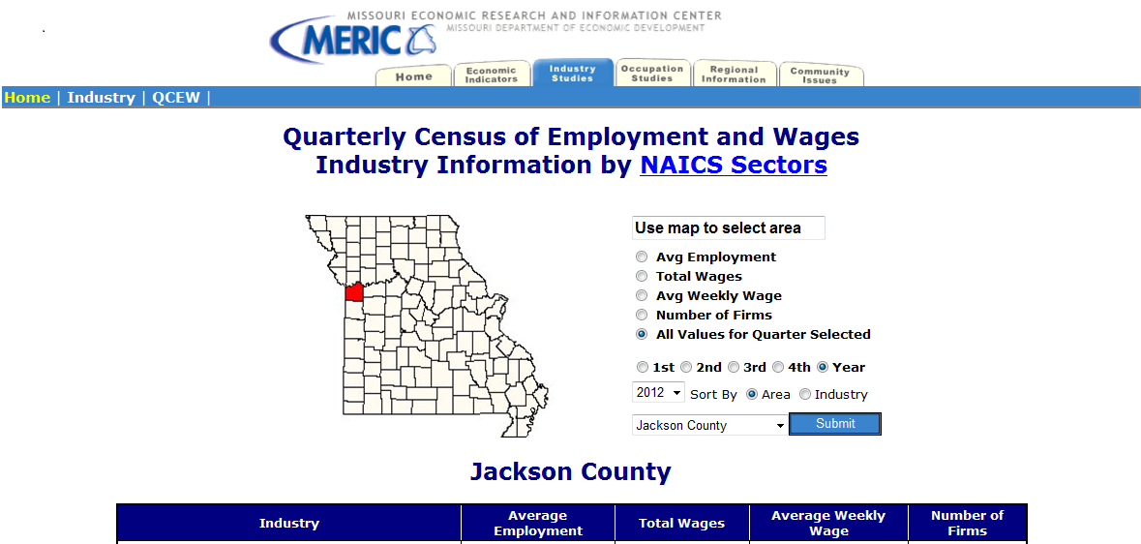
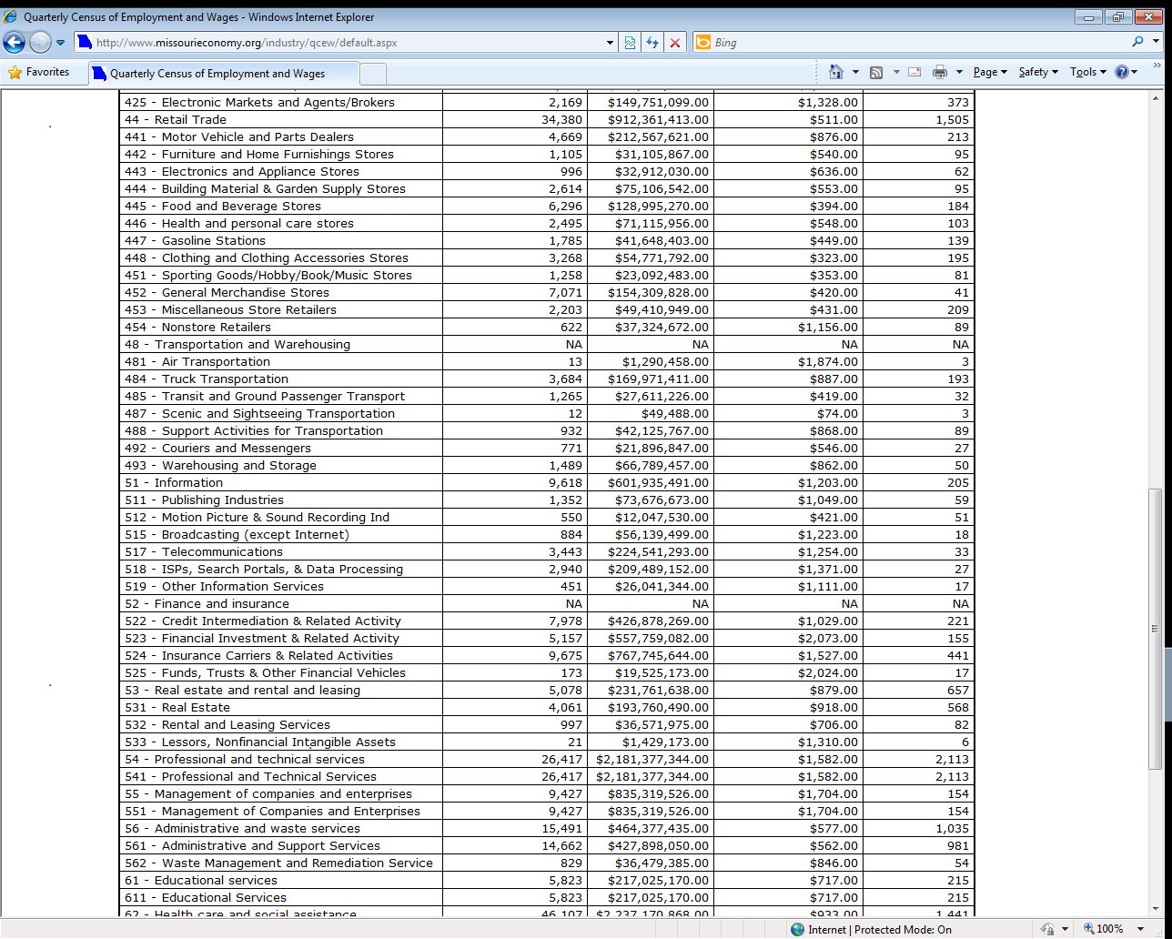
Employment Data - QCEW
www.missourieconomy.org/industry/qcew/
Notes:
With the tool, you can select the county you wish to view by clicking it on the map [CLICK] or by choosing it from the drop-down menu on the right. Select the year and quarter you wish to see and then choose the values to display. [CLICK]
We’ve selected Jackson county on the map and we want to look at the most recent data that’s available for the entire year. We can now scroll down the table until we get to truck transportation and provide our freight truck driver with the employment information shown here [CLICK] . He can now see that there are 193 truck transportation firms operating in the county and that wages in that industry are relatively high. It’s a nice place for him to start when looking at employment data.
If you wanted to compare one industry across all areas, simply click on the industry radio button and select trucking transportation. It will show the employment data for that particular industry across all counties and statewide for Missouri.
[CLICK]

Slide 10
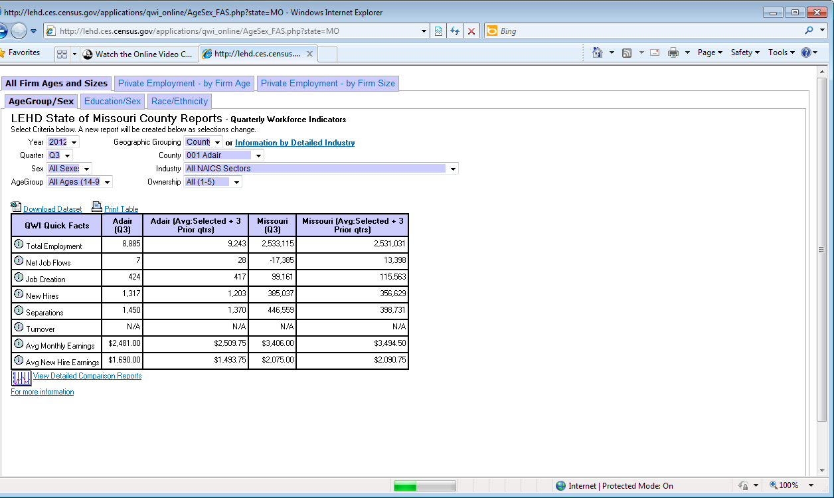
Where to Find—Employment Data
http://www.missourieconomy.org/indicators/lehd/index.stm
Longitudinal Employer-Household Dynamics-LEHD
  Based on Industry Classifications – NAICS (North American Industry Classification System (up to 4-digit)
  Searchable by Geography and/or Industry
  Industry Employment information is inclusive of all Occupations within each Industry.
Notes:
For more detailed employment data by industry, we can also use the Longitudinal Employer-Household Dynamics tool. LEHD data for Missouri are available on the MERIC website and can be sorted in a variety of ways. You can look at the employment by industry for a certain year and quarter. Area wise, the sort can be done by metro, county or Workforce Investment area. You can also choose to look at specific groupings of workers, like age groups or gender. The view can also focus by ownership (private or the three levels of government) by selecting within the page details.
[CLICK]
Industry employment numbers are not the only information displayed for your choices. You will also get data on job flow, job creation, turnovers, or separations so that you can get better insight into an industry’s trends and outlook.

Slide 11
Employment Data-LEHD
Notes:
Here is the tool as it appears on the MERIC website. You must select the time frame, demographic group, geography, industry, and ownership of your employment query from [CLICK] the drop-down menus here.
The LEHD data has more of a lag than the QCEW employment information, but there are types of data here that are not available in the QCEW tool. You can also view industries up to a 4-Digit NAICS code with this tool. At its most basic level as seen here, you can only view industries at the 2-digit NAICS sector level. To view more detailed industry data, all you must do is [CLICK] simply click on the “Information by Detailed Industry” link next to the pull down menu for Geographic Grouping.
Let’s see what more we can find out about the truck transportation industry for Missouri statewide.
[CLICK]

Slide 12
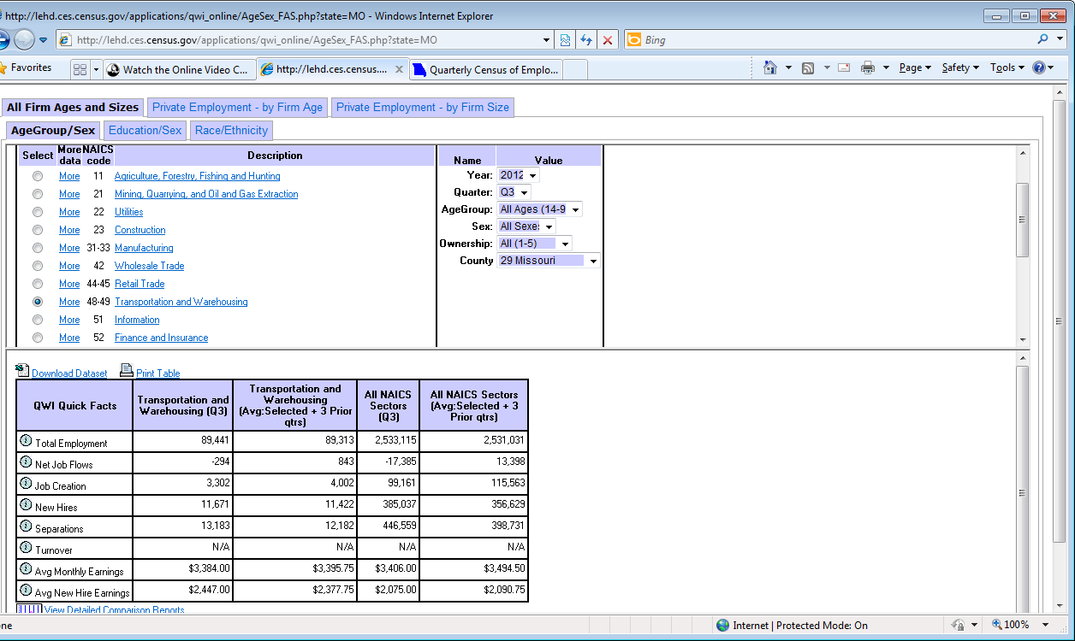
Employment Data-LEHD
Notes:
After clicking the Information by Detailed Industry link, the page will move into this format. You can look at [CLICK] the total transportation and warehousing industry located here at the basic two-digit level, but since we want to see trucking transportation in particular, we will need to [CLICK] select the “More” hyperlink next to our chosen industry.
[CLICK]

Slide 13
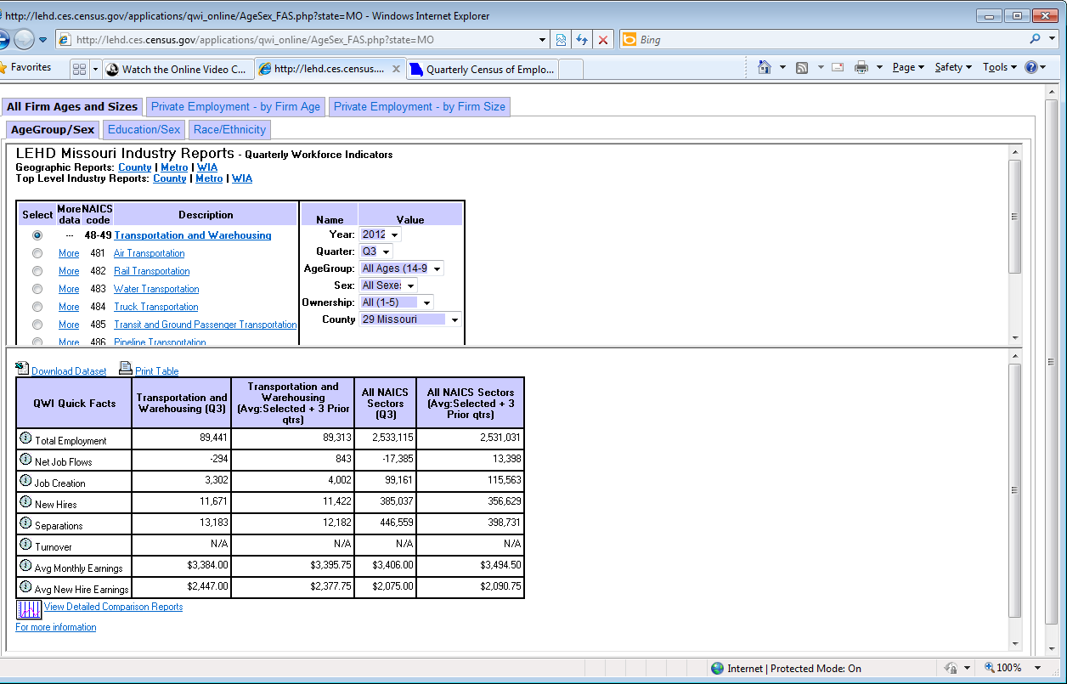
Employment Data-LEHD
Notes:
Now we can see the [CLICK] employment data for our specific industry. For our job seeker, this information could tell him more about separation rates and other information specifically for truck transportation .
Another useful feature of this tool is the demographic sorter. If a student is about to enter a program to gain certification for employment, you can filter the age group to a similar age bracket [CLICK] and see more specifically what employment chances look like within an industry.
[CLICK]

Slide 14
Employment Data Website Links
Quarterly Census of Employment & Wages: http://www.missourieconomy.org/industry/qcew/
Longitudinal Employer-Household Dynamics:
http://www.missourieconomy.org/indicators/lehd/index.stm
Notes:
Here is a list of the websites that we covered in the Employment Data. Please feel free to pause the webinar where you are now and practice retrieving data on your own. If you choose not to, please continue on with the Module lesson.
[CLICK]

Slide 15
Labor Force Data
…is about PEOPLE and where they reside, not the jobs they do! – Includes data on people by place of residence, regardless of where they work.
Provides Data Regarding:
  The Employed and Unemployed
  Where Residents Work
  What Residents Earn
  Educational Attainment/Skills
Notes:
The second type of Labor Market Information is Labor Force Data. This data offers a different view than the employment data we just looked at. The labor force data views employment by people’s place of residence, regardless of where they work.
Labor force data provides more insight into topics like:
Employment and unemployment rates
Where residents of an area are working
What the labor force is earning, and;
What skills our regional labor force has to secure employment.
[CLICK]

Slide 16
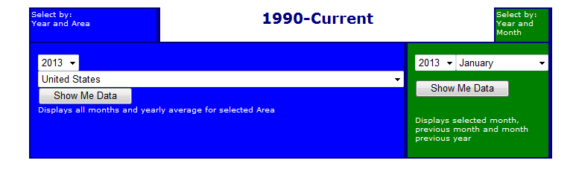
Where to Find – Labor Force Data
http://www.missourieconomy.org/indicators/laus/default.aspx
Local Area Unemployment Statistics (LAUS)
  Monthly
  Employed and Unemployed
MERIC Option
  State, County, Metropolitan and Micropolitan Statistical Area (MSA), and City Options
Notes:
The Local Area Unemployment Statistics tool provides the broadest scope of labor force data. It estimates the number of people within the labor force, showing how many are employed or how many unemployed. The unemployment rate is a very frequently used type of data. Monthly data can be examined at various geographic levels including the U.S., states, counties, and metropolitan areas.
This data is usually up-to-date, being reported only a few weeks after the reference period.
Let’s look at an example of this tool using Cape Girardeau County. We want to see how this county has been faring in terms of unemployment.
[CLICK]

Slide 17
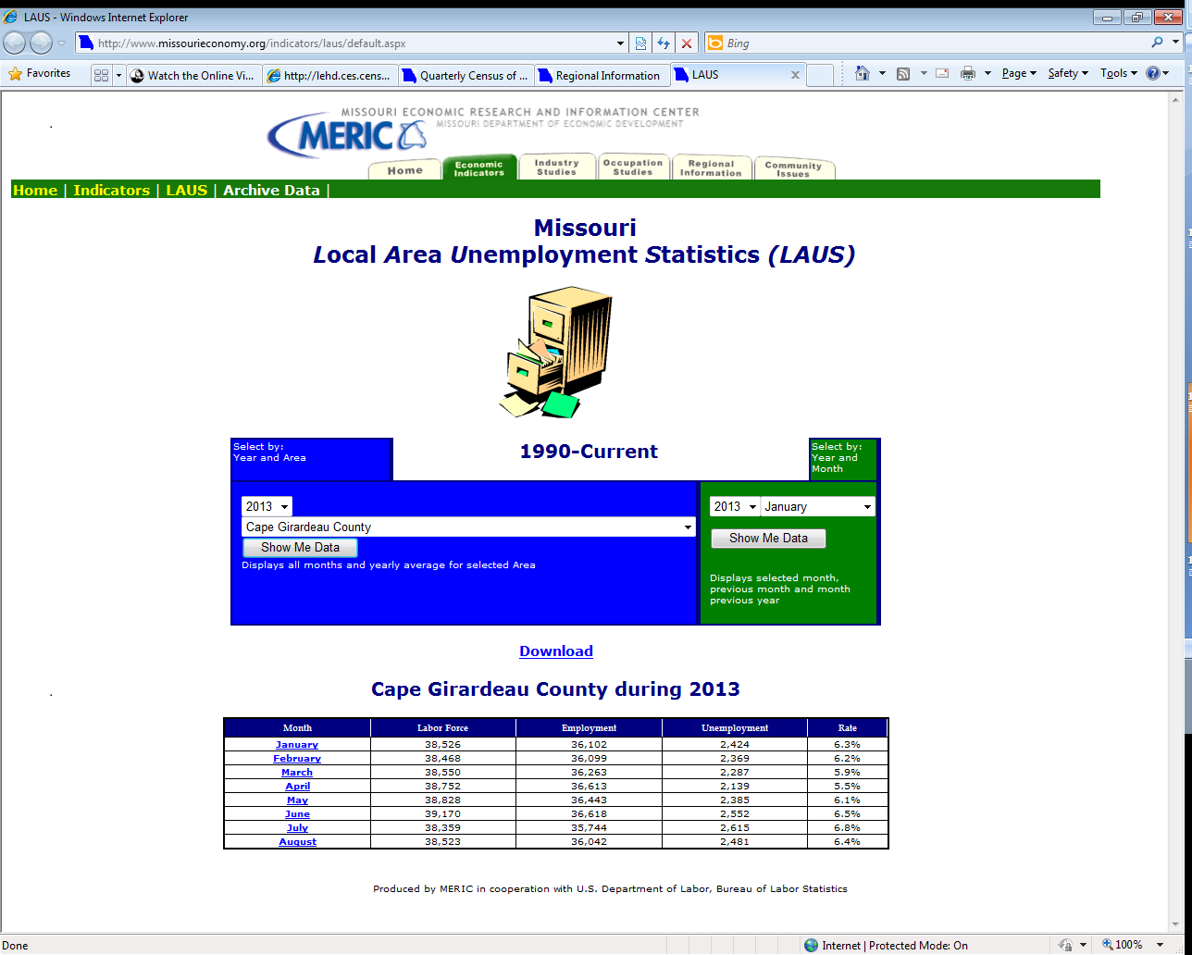
Notes:
To extract data, we must select [CLICK] Cape Girardeau County from our pull-down menu and the year we wish to view in the blue shaded area. If you want to do a comparison across areas for a particular time frame, you can just select a year and month from within the green shaded area and the labor force data for that month will appear in a table showing all geographic areas.
From our selection of Cape Girardeau County from the blue area we now have a populated chart with our labor force data that we can use to examine how the labor force and unemployment have performed during the current year. By selecting other years we can view a longer time period, for example seeing how well an area has recovered from the recession.
[CLICK]

Slide 18
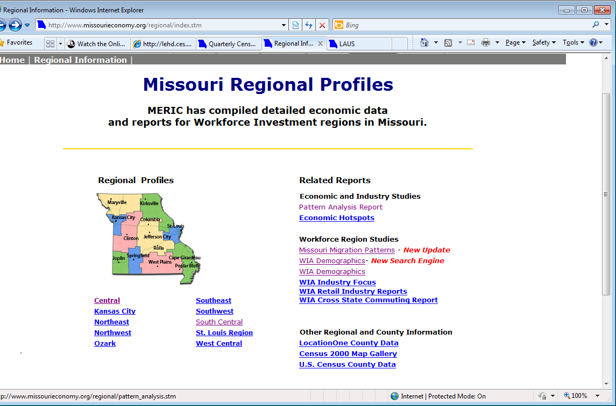
Quick Find – Labor Force Data
http://www.missourieconomy.org/regional/index.stm
Regional Profiles
  Snapshot Summary
  Population
  Income
  Educational Attainment
Notes:
Regional profiles, a labor force tool for WIA regions, is compiled using different types of LMI. They’ll have much of the data you just looked up in our LAUS tool, but some data may appear with a longer lag. However, these summaries include a lot more information about our labor force. They’ll have population and income data, as well as information by industry and occupation. Let’s take a quick look at the Southeast region’s demographic summary and see if there is anything we can learn……
[CLICK]

Slide 19
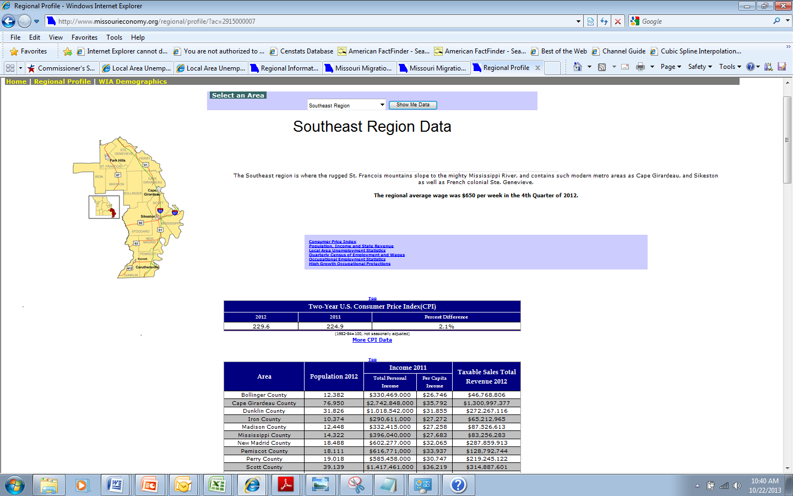
Notes:
We can use the information on this page in conjunction with the LEHD tool and others presented in this lesson to better understand where many of our future openings may exist and what we will need to do to start addressing skill gaps now.
[CLICK]

Slide 20
Other Tools – Labor Force Data
Commuting Data
  Shows place-of-work/place-of-residence relationship
    ACS
    LED On the Map
Migration Data
  Shows movements into and out of area
    ACS
    IRS
Notes:
There are other tools that may help you understand your labor force. Commuting data – sometimes called journey to work or inflow/outflow data – show the relationship between where people live and where they work. Some areas with employment centers have net “in-commuting”… more people come from other areas to work there than leave that area to work elsewhere. Other areas have more out-commuting, where a substantial number of residents commute to other areas.
Migration data show permanent relocations…the number of people who’ve moved from you area to other areas or who have moved into your area from elsewhere.
Both types of data can help you understand labor availability and other questions that affect labor market and economic conditions in your area.
Let’s look at commuting using LED On-the-Map.
[CLICK]

Slide 21
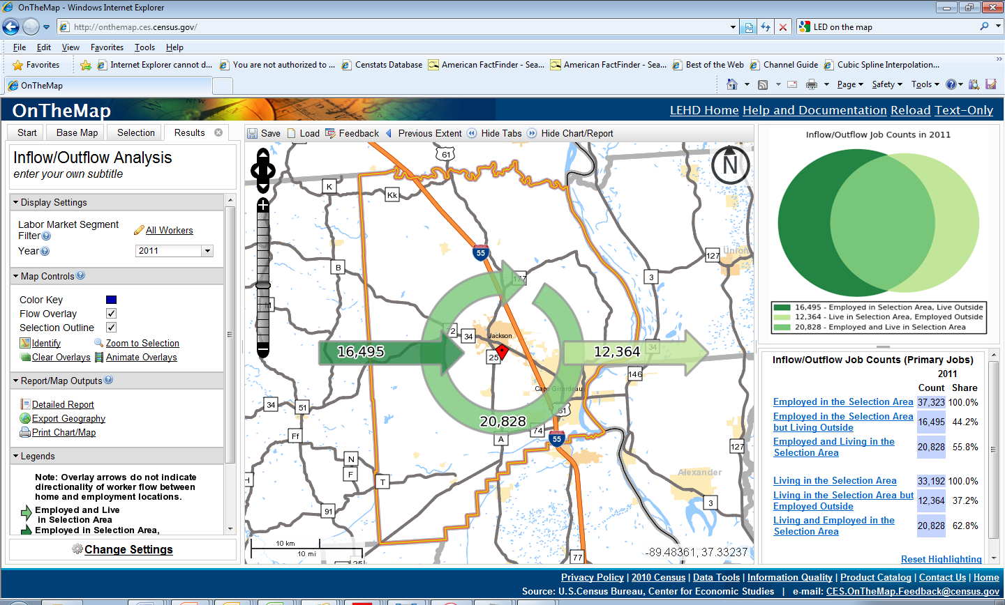
Notes:
Once again using Cape Girardeau County, we see a graphic summary of worker inflows and outflows. 20,828 Cape Girardeau County residents work in the county. An additional 12,364 residents work in other counties. This is more than offset by the 16,495 residents of other counties who come to Cape Girardeau County to work.
You can find more information by selecting “Detailed Report.” [CLICK]
[CLICK]

Slide 22
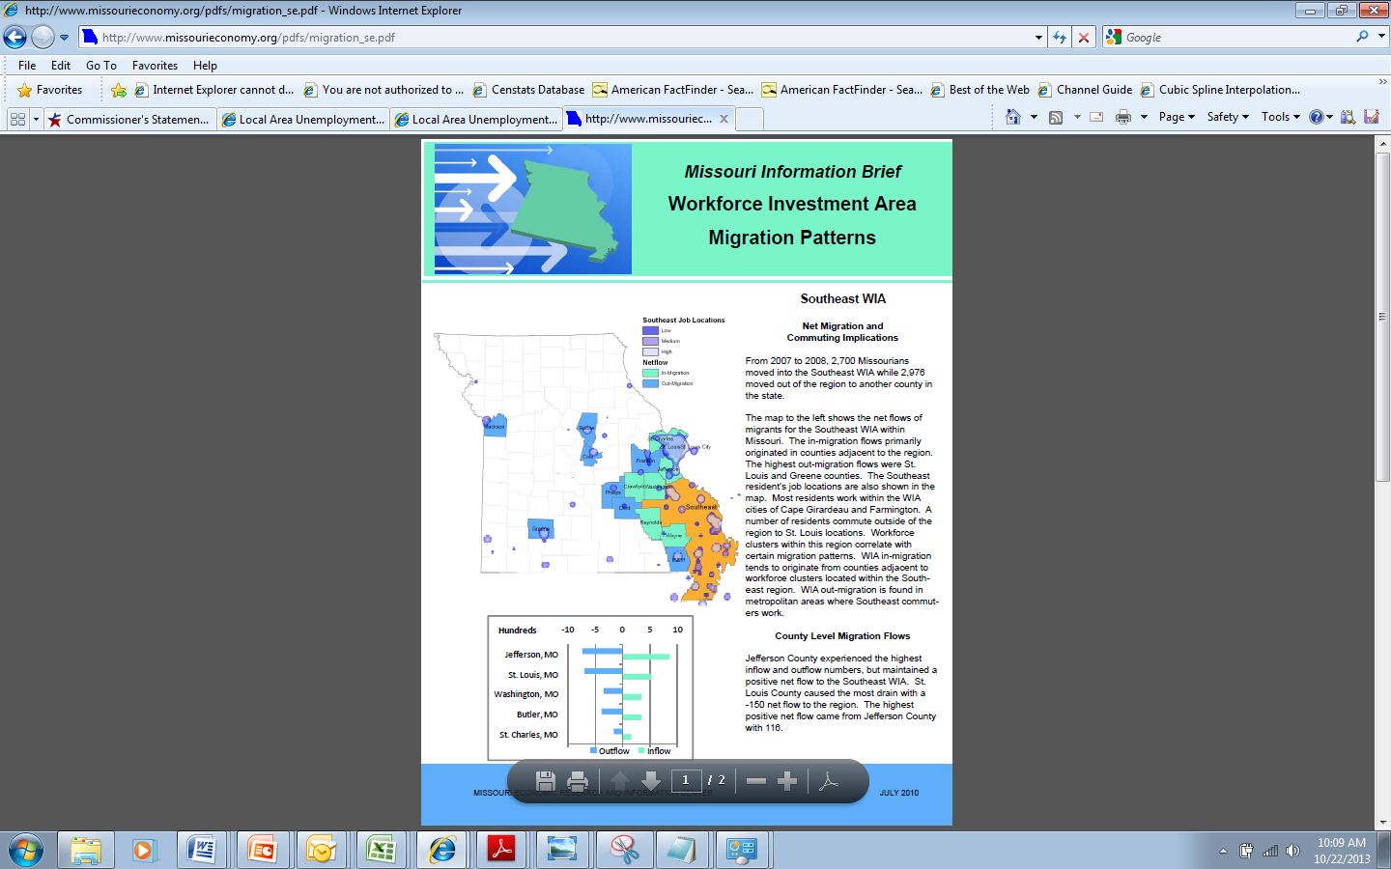
Notes:
This pages shows an example of use of migration data. These Migration Pattern reports are available on the MERIC website.
[CLICK]

Slide 23
Labor Force Data Website Links
Local Area Unemployment Statistics:
http://www.missourieconomy.org/indicators/laus/default.aspx
Regional Profiles:
http://www.missourieconomy.org/regional/index.stm
On the Map Commuting:
http://onthemap.ces.census.gov
Migration Patterns:
http://www.missourieconomy.org/regional/migration.stm
Notes:
Here is a list of the websites that we covered in Labor Force data. Please feel free to pause the webinar where you are now and practice retrieving data on your own. If you choose not to, please continue on with the Module lesson.
[CLICK]

Slide 24
Wage Data
…is closely tied to employment data AND labor force data.
Provided Data:
  Industry Averages
  Occupational Average
  Regional Breakouts
  Demographic Difference
Notes:
The third type of labor market information data is wage data.
It can tell you industrial and occupational wage averages, breakouts for wage data, and even differences in wages by demographics.
[CLICK]

Slide 25
Where to Find – Wage Data
http://www.missourieconomy.org/occupations/oeswage/
Occupational Employment Statistics (OES)
  Occupational Employment and Wages
MERIC Option
  Search by Region or Occupation
  Mean, Entry, Experienced and Median Wages
Example Question:
What is the entry-level hourly wage for a worker employed in the Ozark Region as a transportation supervisor?
Notes:
We’ve already seen wage data as a by-product of our QCEW and LEHD data tools. However, the most comprehensive and in-depth wage data tool is the Occupational Employment Statistics data. This survey tracks both employment and wages at a detailed occupational level and sums up the averages for occupational sectors.
The Occupational Employment Statistics tool allows you to sort by occupational sector or occupations alone for an area or across geographies for comparison. You can find data for the state, metropolitan area and WIA regions, but confidentiality restrictions usually prohibit producing data at the county level.
Let’s try to answer the example question in the orange box using the OES tool: What is the entry-level hourly wage for a worker employed in the Ozark region as a transportation supervisor?
[CLICK]

Slide 26
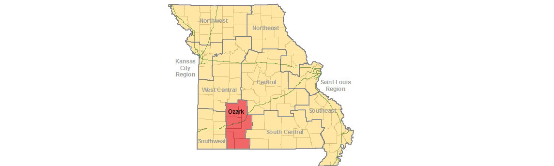
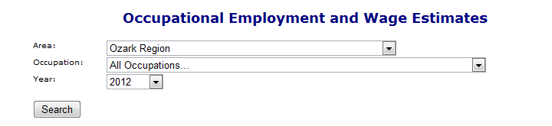
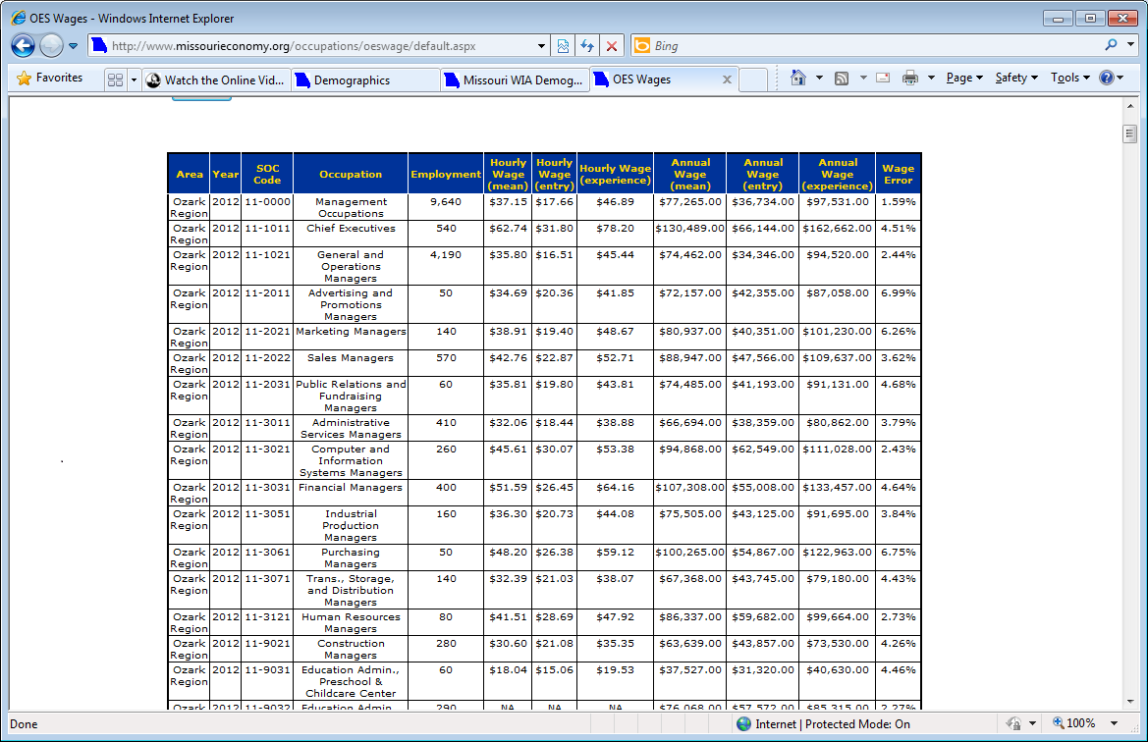
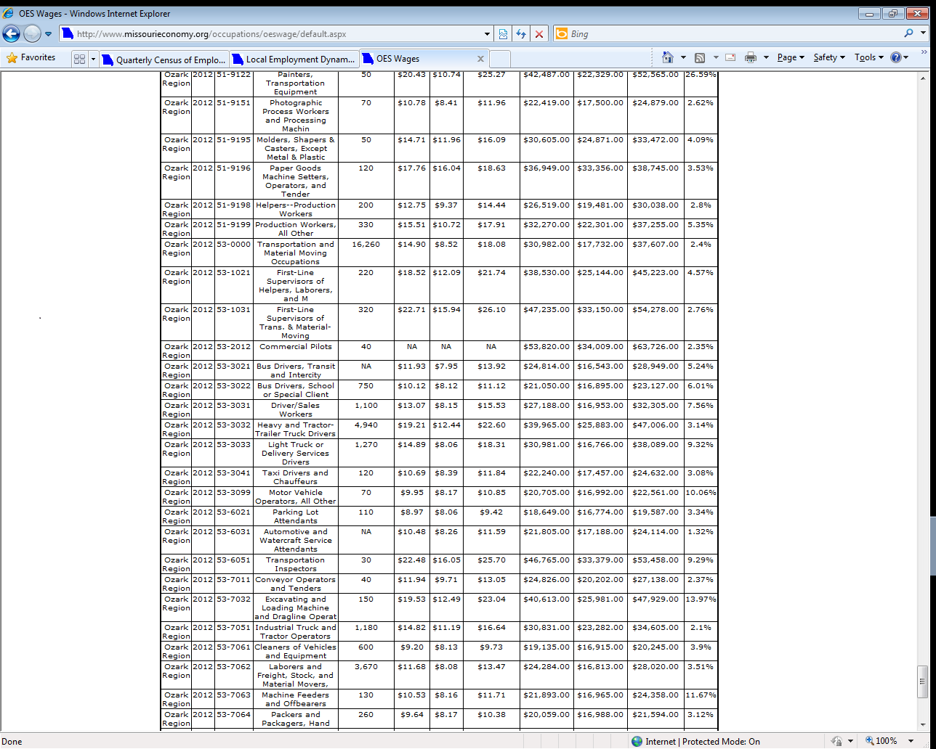
Notes:
You have the option of selecting the specific region on the map that you are interested in so you can view all occupations across sectors, or you can use the pull down menus to select the area and/or the occupation you wish to look at across all regions. We’ll look at the occupations within the [CLICK] Ozark region so we can see what the entry wage is going to be for an occupation matching the title of transportation supervisor.
When we scroll down, [CLICK] we find that the closest title for transportation supervisor is a first-line supervisor of transportation, and that the entry wage data for this occupation is $15.94 an hour or $33,150 annually. If we wanted to, we could now select that occupation from the drop-down list [CLICK] and see how these wage figures compare across the other regions in the state.
[CLICK]

Slide 27
Wage Data Website Links
Occupational Employment Statistics: http://www.missourieconomy.org/occupations/oeswage/
Notes:
Here is a list of the websites that we covered in the Wage Data. Please feel free to pause the webinar where you are now and practice retrieving data on your own. If you choose not to, please continue on with the Module lesson.
[CLICK]

Slide 28
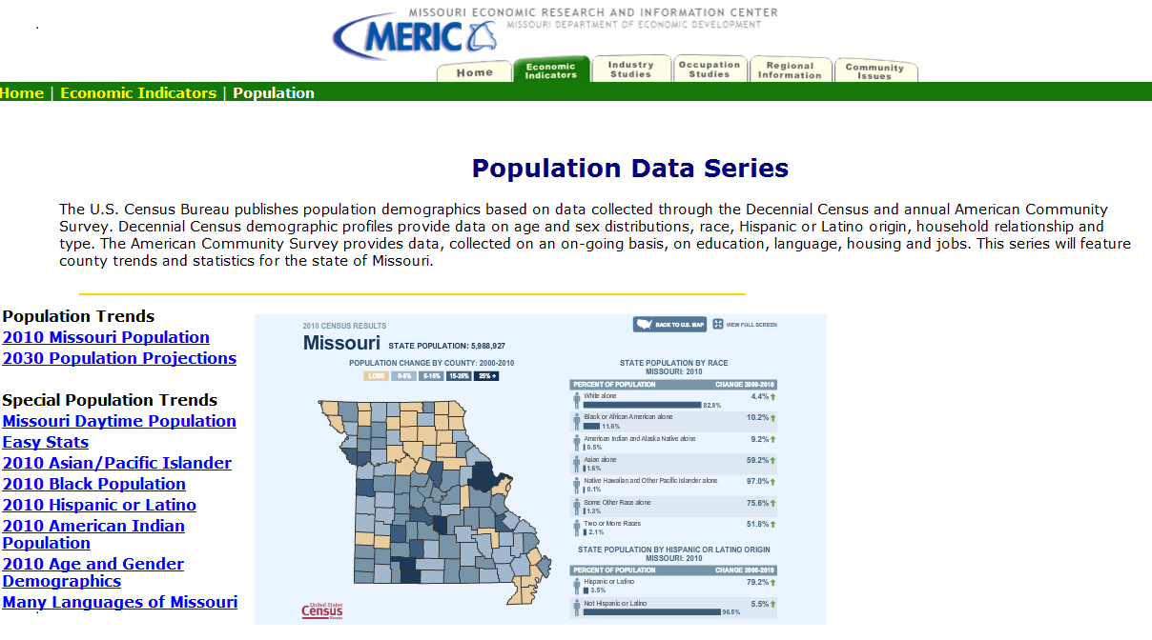
Demographic Data
…is about GENERAL POPULATION CHARACTERISTICS related to employment and workers. Some data can be found on the MERIC website…
Notes:
The fourth LMI data type is demographic data. Most of this data is collected and disseminated by the U.S. Census Bureau. A complete count of the population occurs every 10 years…the Decennial Census. Socioeconomic data, such as employment, education, and income, are no longer collected in the decennial census. The Census Bureau now uses the American Community Survey or ACS to collect those types of data. MERIC is able to provide some demographic data…
[CLICK]

Slide 29
Where to Find – Demographic Data
Most data come from US Census Bureau
  Complex tables to simple summaries
  Decennial Census (2000…2010…)
    Complete counts of the population
  American Community Survey (data published annually)
    Detailed socioeconomic characteristics
      Employment
      Income and poverty
      Education
      Disability
  Finite to state level geographies
  Complex tables to simple summaries
MERIC Option
  Regional Summary Reports
Example Question:
What is the number of Missourians (25 and over) who do not have a high school diploma? How many have a Bachelor’s degree or higher?
Notes:
but the majority of information comes from Census Bureau. We’ll go to the Census Bureau’s website to answer the following questions in the orange box: What is the number of Missourians (25 and over) who do not have a high school diploma? How many have a Bachelor’s degree or higher?
[CLICK]

Slide 30
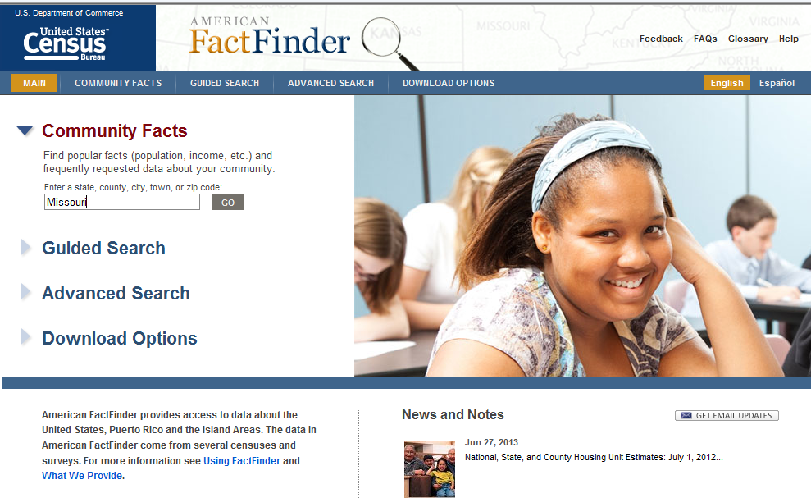
Notes:
Census data are available through the Bureau’s American Fact Finder Website.
Detailed data can be found using the “Guided Search” and “Advanced Search” options, but good summary information can be obtained using the Community Facts part of the page. Simply enter the area you are interested in, in this case Missouri. [CLICK]
[CLICK]

Slide 31
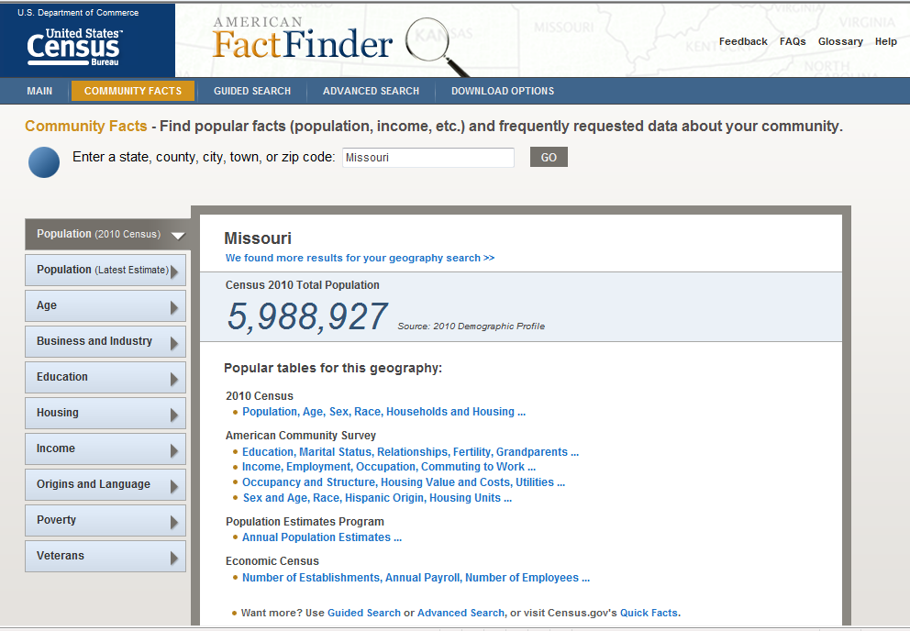
Notes:
We’ll click on the ACS table that contains education [CLICK]
[CLICK]

Slide 32
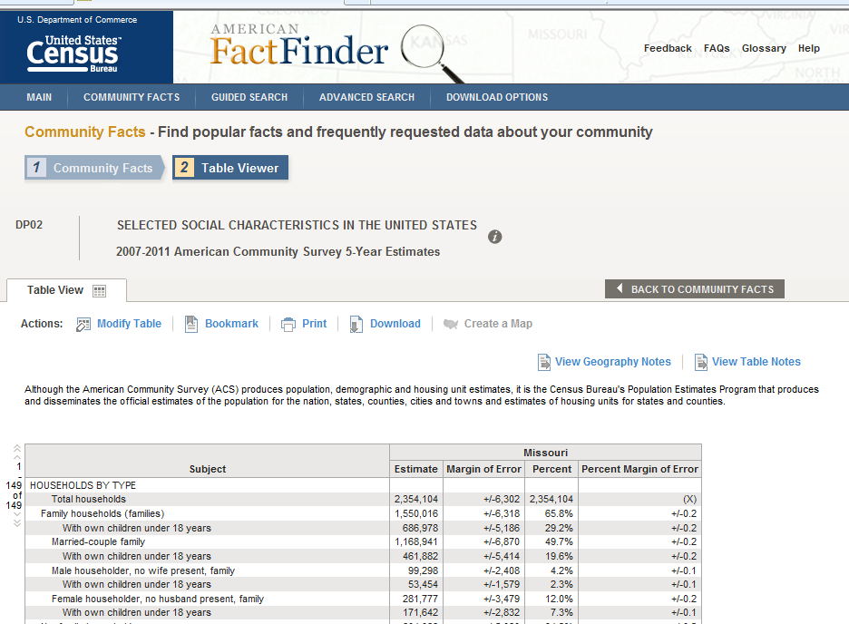
Notes:
Here’s the results page. By scrolling down…[CLICK]

Slide 33
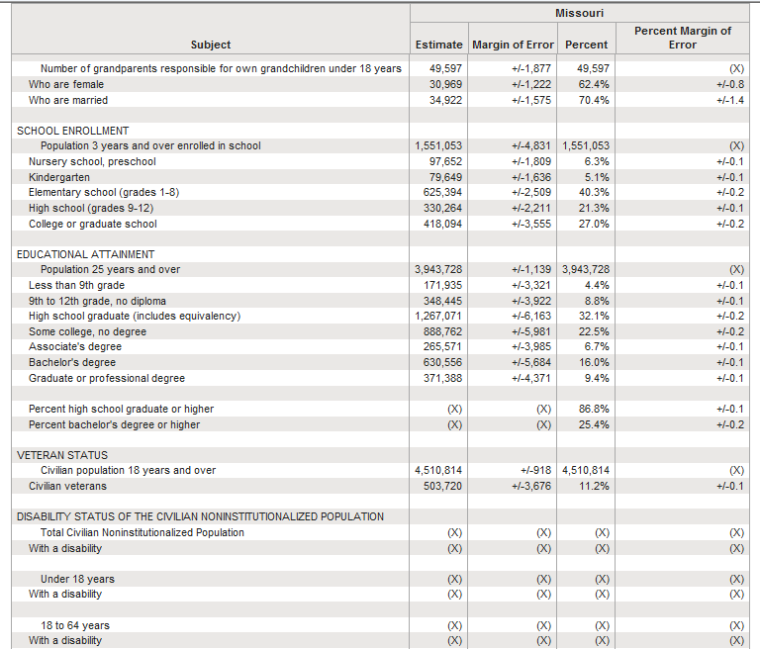
Notes:
…we are able to locate information about educational attainment. [CLICK]
We see that 13.2% of Missourians had less than a high school diploma, while 25.4% had a bachelor’s degree or higher in the time period covered by the report. Take a moment to look at some of the other types of data on this page. [CLICK] The ACS is full of good information for all areas of the state, but it takes some practice to be proficient in locating more detailed data. … [CLICK]

Slide 34
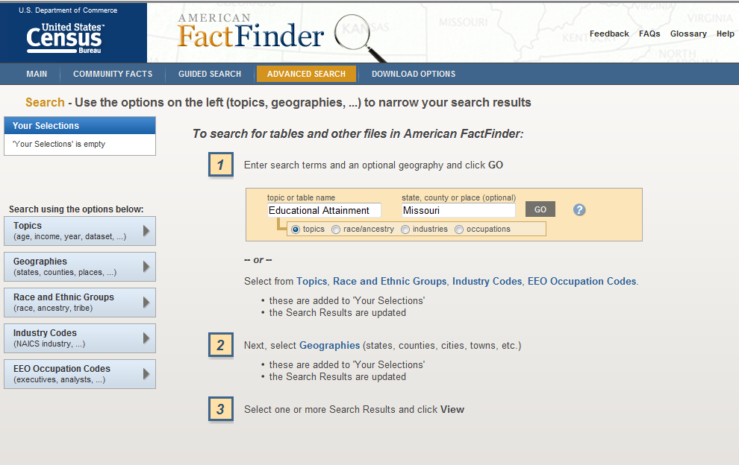
Notes:
Here’s an example of the ACS Advanced Search page, you can enter a subject and geography in the highlighted boxes to start the process of narrowing your request.
[CLICK]

Slide 35
Demographics Data Website Links
Census Bureau’s American FactFinder:
http://factfinder2.census.gov/faces/nav/jsf/pages/index.xhtml
MERIC Population Data: http://www.missourieconomy.org/indicators/population/index.stm
Notes:
Here is a list of the websites that we covered in Demographics Data. Please feel free to pause the webinar where you are now and practice retrieving data on your own. If you choose not to, please continue on with the Module lesson.
[CLICK]

Slide 36
Career Planning Information
…enables planning for future careers, both long-term & short-term.
Provides Data Regarding:
  Regional and State In-Demand Jobs
  Training Programs Available
  Wages for Major Occupations
Notes:
The final and most comprehensive data type of LMI is Career Planning Information. Most of the career planning information tools use at least some of the data we have already discussed throughout this lesson. The career planning information has to be all-encompassing and enable planning for both short-term and long-term career paths.
Career Planning Data provides answers to:
Regional and state in-demand occupations
Training programs required for certain occupations and where you can find them, as well as
Wage data for major occupations.
Since career planning information is complex and involves many sources, we’ll save a detailed exploration for the next lesson.
[CLICK]

Slide 37
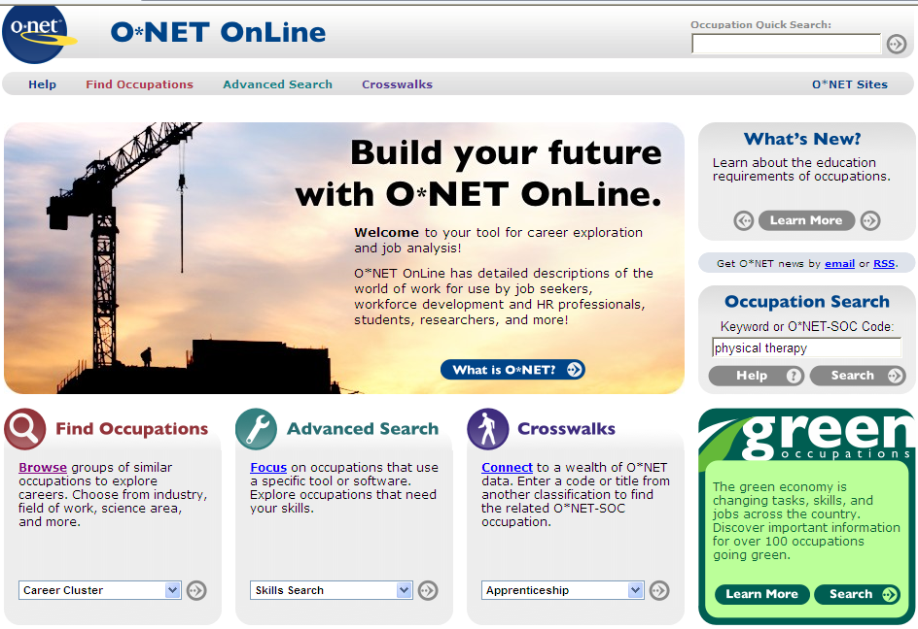
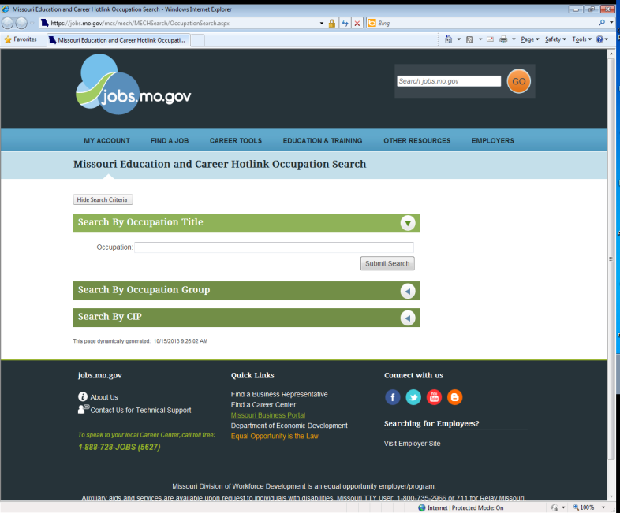
Where to Find – Career Planning Data
These tools and websites offer information describing over 800 occupations, their average wages, education and training requirements, and employment outlook.
O*Net Online
MERIC
  Education and Career Explorer Tool
  Missouri Employment Projections
Notes:
Career Planning data is nationally provided by the O*Net Online website. It allows you to look at information describing over 800 occupations including employment figures, average wages, typically required knowledge, skills, and abilities, and outlook for future employment.
Missouri has a similar tool in the Missouri Education and Career Exploration Tool. Much of the occupational information is actually supplied through O*Net Online, but employment figures and outlook, training requirements and programs, and job openings are Missouri supplied and specific.
Another useful career planning tool that Missouri produces is the Employment Projections.

Slide 38
Occupational Information Network (O*Net) Online
Assisting all types of job seekers and businesses
  Jobseekers can narrow career path searches
  Businesses can utilize for human resources
Constantly Updated
Notes:
Most economic developers in Missouri know and use O*Net Online. The website has resources that assist all varieties of job-seekers and businesses in Missouri…..
Jobseekers can use the skill profiler tools available within O*Net’s system to narrow their career search and find an occupation that better matches their wants and needs. Businesses can use O*Net online to create more accurate job descriptions when filling vacancies and can see what trainings are typically required for occupations so they can keep their staff up-to-date with new practices and technologies.
O*Net’s even been integrated into the Missouri CareerOneStop site and our ToolBox 2.0 function. O*Net is also constantly updated with new and emerging occupations and industries or new employment outlook figures to give jobseekers, businesses, and workforce developers the most up-to-date picture of employment.

Slide 39

Career Explorer
https://jobs.mo.gov/
Missouri-specific employment figures
O*Net data
Job Openings
WorkKeys filters
Notes:
The Missouri Education and Career Exploration Tool is very similar to O*Net Online. We work with O*Net to populate the occupation titles, descriptions, and necessary knowledge, skills, and abilities to make sure Missouri matches with national standards. However, the employment and outlook figures, as well as the training programs and licensing requirements for occupations are supplied by Missouri specific data. There’s even a function that populates current job openings in the region for matching occupations.
It’s currently being updated to be even more user-friendly and reliable with new features and reports available soon.

Slide 40
State Occupational Projections
Bureau of Labor Statistics
  QCEW
  NAICS Establishments
MERIC
  2 and 10-year
  Supplements non-farm data with self-employed, agriculture, religious organization, and railroad employment
Notes:
The state occupational employment projections are available on the MERIC website and within the Bureau of Labor Statistics. Employment projections are either short-term which covers a two year period and are produced annually for Missouri and the St. Louis and Kansas City WIAs, or long-term which covers a ten year period and are produced bi-annually for Missouri and all ten Workforce investment areas.
Industry employment data for Missouri is collected along with a series of other economic indicators and run through a series of regressions along with regional staffing patterns to create a best estimate of what employment will be doing in either the next two or ten years.
The occupational projections do not just show base and projected employment numbers, but also wage data, education and training requirements, growth, and number of total openings per occupation for the time frame.

Slide 41
Career Planning Data Website Links
O*Net Online:
http://www.onetonline.org/
Career Explorer:
www.jobs.mo.gov/
Missouri Occupational Projections: http://www.missourieconomy.org/occupations/occ_proj.stm
Notes:
Here is a list of the websites that we covered in the Career Planning Data. Please feel free to pause the webinar where you are now and practice retrieving data on your own. If you choose not to, please continue on with the Module lesson.

Slide 42
Real-time Labor Market Data
What is it?
  Emerging data source
  Aggregates online job postings into one database
  Gives comprehensive picture of current hiring
  Utilizes thousands of existing data sources
  Provides current analysis of hiring trends
Prominent vendors
  Burning Glass
  Wanted Analytics
Notes:
Occupational projections provide some indication about the medium- and longer-term occupational demand, but they are less effective for determining the kinds of workers that employers are seeking right now. In recent years, a new kind of data source has emerged that begins to address just that question. These data are known as ‘Real-Time’ Labor Market Information (LMI). Real time LMI is derived from an analysis of Internet-based job advertisements. Real-Time LMI providers use web-spidering technologies that pull down information from online job boards like Monster.com, online classified sections of newspapers, as well as company websites. These data are pulled together into an aggregated database after the web advertisements are organized and de-duplicated.

Slide 43
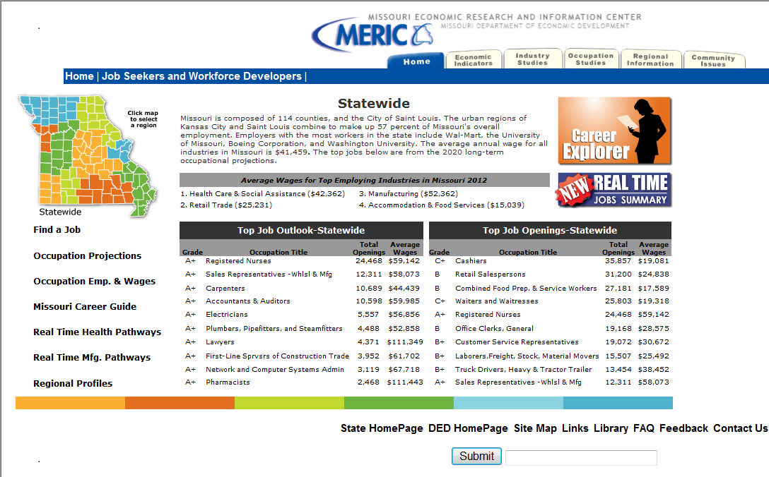
Know in Demand Jobs and Skills
Real Time Labor Market Summaries
Notes:
Using Real Time LMI data, MERIC produces real time Labor Market Summaries every 2 months. They show a summary of real time labor market analysis for the past 60 days. Summaries are produced for the state and for the 10 WIA regions.
By clicking your region on the map and then clicking the “Real Time Jobs Summary” button on the right side of page, it will take you to a regional real time labor market summary

Slide 44


Burning Glass Technologies, Labor/InsightTM
Real Time Labor Market Data
Available for Statewide and all 10 WIA regions
Notes:
Through a community college grant, MERIC now has the opportunity to use the Burning Glass Labor/insight Product. Burning Glass Labor/Insight is an interactive, report-generating application that delivers real-time access to a comprehensive database of real-time, job demand data. Burning Glass is able to collect job posting data from more than 17,000 sources on a national basis and is updated daily. It’s a unique source that gives insight on what’s happening right now in the labor market. It is powered by the job postings that employers express their need for workers across the spectrum of industries and occupations.

Slide 45
Burning Glass Technologies, Labor/InsightTM
Aggregates, mines and codes data from each job listing.
Skills
Skill Clusters
Education
Experience Levels
Certifications
Work Activities
Salary
Number of Job Openings
Notes:
Once the information is collected and aggregated, Burning Glass mines and codes detailed data from each job listing. It describes the specific skills, skill clusters, educational credentials, certifications, experience levels, and work activities required for that specific job. Also codes information about salary, number of openings, and job type.
With this information, we can discover: Which occupations are most in demand? What skills, certifications, and educational credentials are required? What industries are growing? Which employers are hiring and for what jobs?

Slide 46
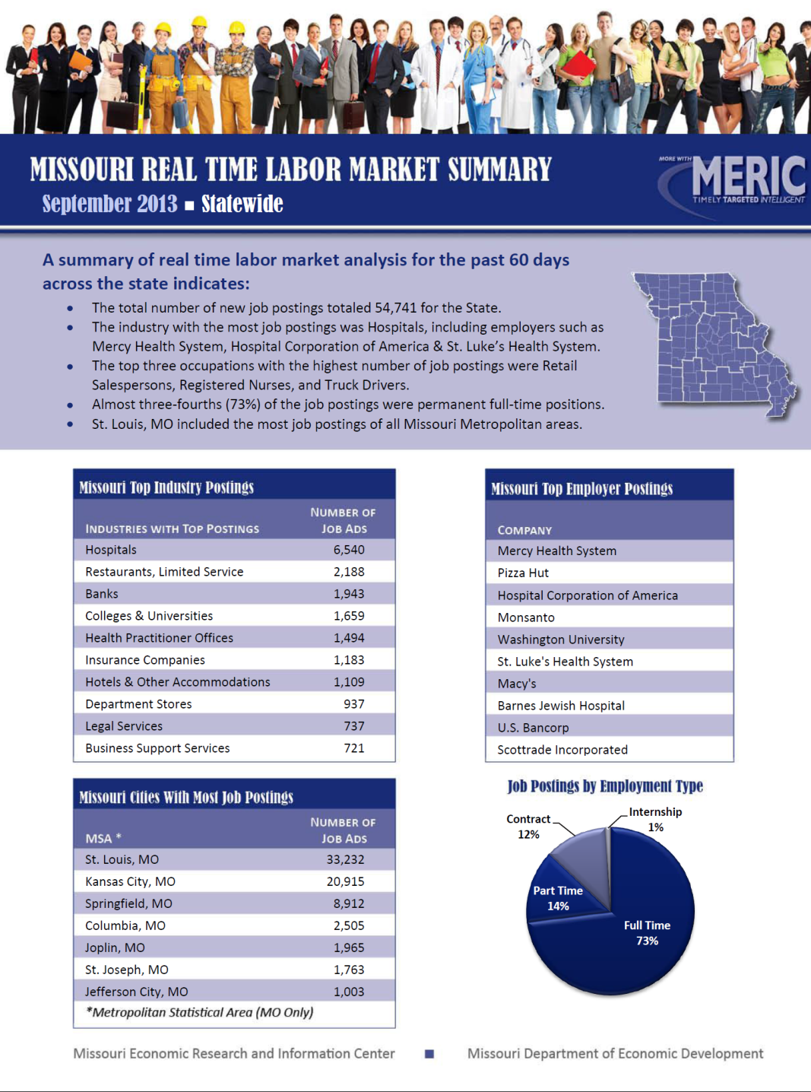
Real Time Labor Market Summaries
Notes:
Real Time Labor market Summaries show a summary of real time labor market analysis for the past 60 days. Summaries are produced for the state and for the 10 WIA regions.

Slide 47

Notes:
Information published includes the CLICK total number of new job postings by industry, city, and employer. CLICK It also shows Job postings by employment type-(full‐time, part‐time, or contract) CLICK

Slide 48
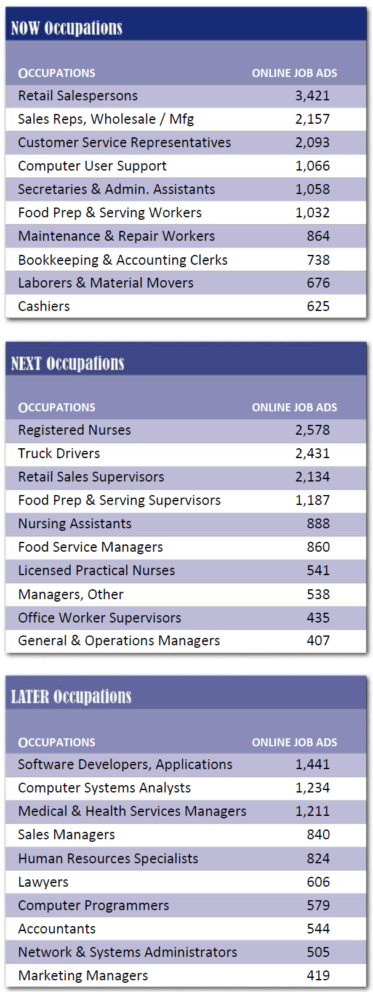
Jobs by Typ. Training Needed
NOW Jobs:
Retail Salesperson
Sales Reps. Wholesale/MFG
NEXT Jobs:
Registered Nurse
Truck Drivers
LATER Jobs:
Software Developers
Computer Systems Analysts
Notes:
The report also shows the occupations with the highest number of job postings in the region.
On our Real-time LMI report, occupations are divided into Now, Next, and Later categories. Now occupations usually require 1-12 months of on-the-job training. Next occupations typically require more then 1 year of on-the-job training and require an associate’s degree or vocational certificate. Later occupations usually require a bachelors or advanced degree.

Slide 49
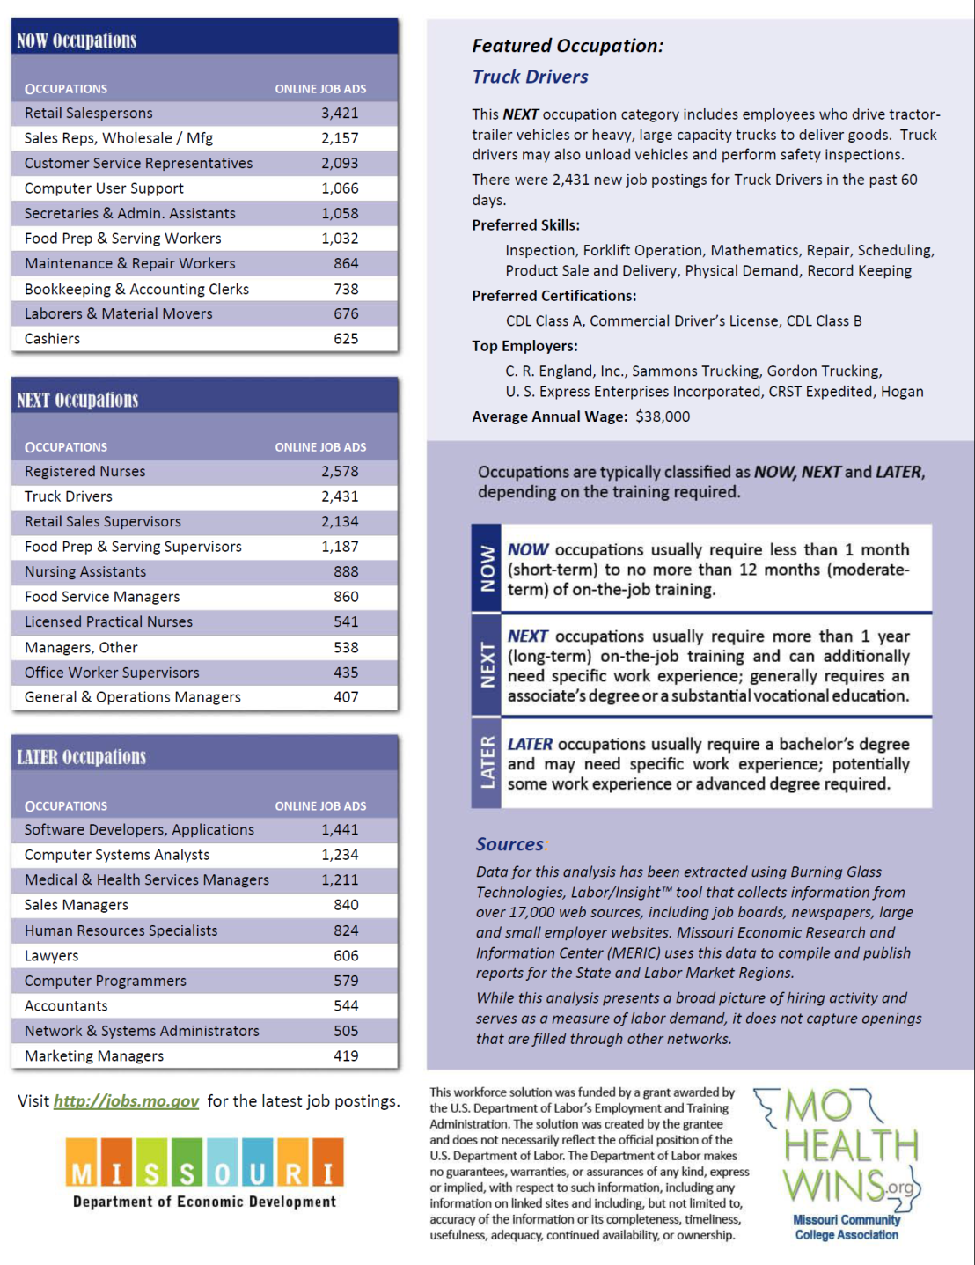
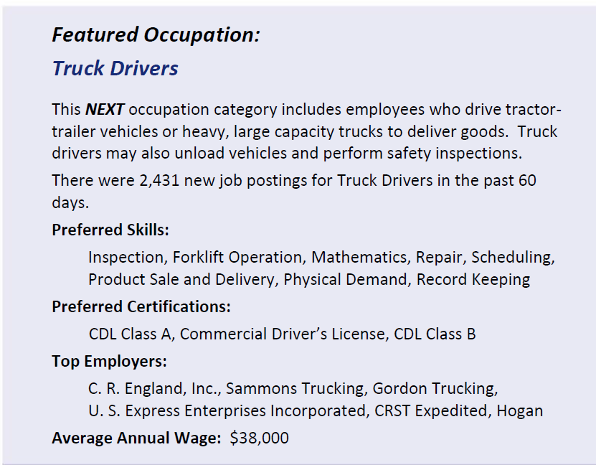
Real Time Labor Market Summaries
Notes:
MERIC also reports on a featured occupation in our real time labor market summaries. The featured occupation lists the top skills and certifications that are needed for that specific occupation.
Real time LMI summaries are a good source to see what type of occupations are available in our current labor market by region or state

Slide 50
Real Time Labor Market Data Website Links
Real Time Labor Market Summary:
http://www.missourieconomy.org/customer/statewide.stm
Notes:
Here is a list of the websites that we covered in the Real Time Labor Market Data. Please feel free to pause the webinar where you are now and practice retrieving data on your own. If you choose not to, please continue on with the Module lesson.

Slide 51
Module 1—What’s Next?
Module 1: Labor Market Information Fundamentals
    Lesson 1: LMI Fundamentals
    Lesson 2: LMI and Employment Fundamentals
Module 2: Using Skill Assessments & Career Pathway Planning
Module 3: Using Economic & Workforce Data to Drive Reemployment Strategy
Module 4: Guiding Businesses/Partners to Use Workforce System & LMI Resources to Support Human Resource Functions
Notes:
Congratulations! You have just finished lesson 1: LMI Fundamentals in the first module. You may now continue onto lesson 2: LMI and Employment fundamentals. This lesson will go more in-depth with some of the tools we discussed here today and prepare you more for the extensive practice.
[CLICK]

Slide 52

Thank you for your participation!
Contact us at:
mericdata@ded.mo.gov
Fax: (573) 751-7160
www.missourieconomy.org
Notes:
Thank you for participating in this LMI series of webinars. If you have any questions regarding this training or would like additional LMI data information, please feel free to contact by e-mail at mericdata@ded.mo.gov. You may also visit MERIC’s website at www.missourieconomy.org for additional resources and contact information for your assigned regional staff liaison.

Slide 53
Please take a moment to complete this survey, which is available online at the link below. Your input will assist us in making these webinars more effective and successful as we continue to make further improvements.
http://www.surveymonkey.com/s/M7BLRV9

