Slide 1



Module 1: Lesson 2
LMI and Employment fundamentals
U.S. Department of Labor—Employment & Training Administration| Missouri Economic Research and Information Center| Missouri Department of Economic Development
This project has been funded, either wholly or in part, with Federal funds from the Department of Labor, Employment & Training Administration under Task Order Number DOLJ061A20373; the mention of trade names, commercial products, or organizations does not imply endorsement of same by the U.S. Government.
Notes:
Welcome to Module 1: Lesson 2 of the Labor Market Information eLesson catalogue. This series of webinars is intended to increase the use of Labor Market Information in the full spectrum of workforce development.
Today’s lesson will focus on the types of LMI available to help Next Generation Career Center staff translate employment fundamentals to job seekers.
(Advance Slide)

Slide 2
Today’s Lesson
Module 1: Labor Market Information Fundamentals
  Lesson 1: LMI Fundamentals
  Lesson 2: Employment Fundamentals
Module 2: Using Skills Assessments & Career Pathway Planning
Module 3: Using Economic & Workforce Data to Drive Re-employment Strategy
Module 4: Guiding Businesses to Use LMI Resources to Support Human Resource Functions
✓
Notes:
Before this lesson begins, you must complete Lesson 1: LMI Fundamentals, as it is required of all workforce professionals participating in this catalogue of LMI eLessons.
If you have met the prerequisite for this lesson, please continue.
(Advance Slide)

Slide 3

What’s in it for me?
After participating in this lesson, you will be able to demonstrate to job seekers:
  The importance of basic skills,
  The value of education, and
  How to start exploring and designing a career path
Notes:
After participating in this lesson, you will be able to demonstrate to job seekers:
The importance of basic skills,
The value of education, and
How to start exploring and designing a career path.
Throughout this lesson you will be introduced to, and asked to explore, a variety of resources developed by the Workforce Research team at the Missouri Economic Research and Information Center (otherwise known as MERIC).
(Advance Slide)

Slide 4

Career Planning Information
…enables planning for future careers, both long-term & short-term.
Provides Information Regarding:
  Regional and State In-Demand
  Jobs
  Training Programs Available
  Wages for Major Occupations
Notes:
Let’s get started….
Today’s lesson will focus on career planning data, and how it can be used to discuss the fundamentals of professional employment with a job seeker. The goal of this lesson is to identify available resources that can be used by NGCC staff to help the computer novice job seeker start a search to explore potential career paths.
As you should remember from “LMI Fundamentals” career planning data…..
Career planning data is its own type of LMI but it also is a fusion of other types. For instance, Career planning data is often going to report wages for occupations and employment numbers for industries but it will do so in a context that may be more accessible to a job seeker than raw wage or employment data reportings would be.
(Advance Slide)

Slide 5

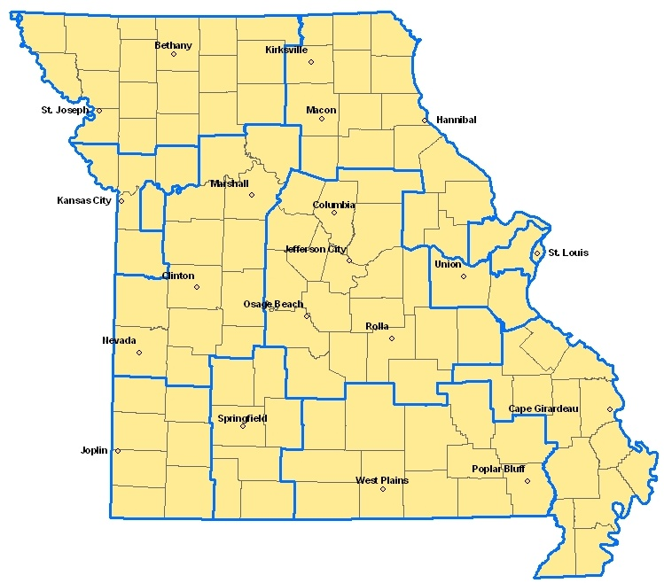
Missouri Economic Research
& Information Center
State LMI Shop
Original Research
  Workforce
  Economic
www.missourieconomy.org
Notes:
MERIC, under the state’s Department of Economic Development, is the state’s LMI collection agency. The MERIC team collects, vets and reports specific data. In addition to raw data reporting, the staff researchers contextualize LMI through regional, industry and occupation-specific reports. On the MERIC website, www.missourieconomy.org you can find portals to raw data numbers as well as original research reports regarding Missouri’s workforce and economy.
The full MERIC team is available to assist you with any number of data needs and we encourage you to navigate our constantly evolving website, to find dynamic information.
(Advance Slide)

Slide 6
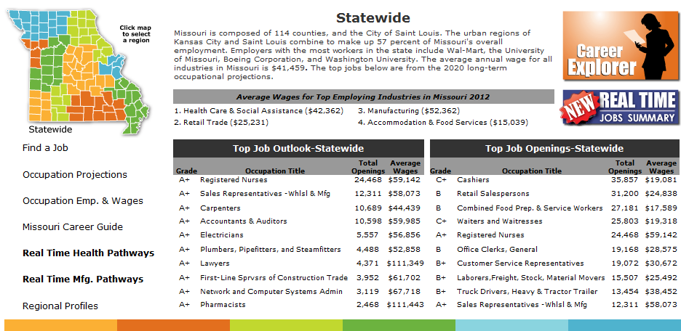
Missouri Regional Job Market
http://www.missourieconomy.org/customer/statewide.stm
Notes:
On the Missouri Economic Research and Information Centers’ website, there is a webpage that allows users to access LMI tools from a central location. This webpage contains the Education and Career Tool link, Real-Time LMI link, and also other data related to certain regions of the state.
You will learn more about the tools available throughout this catalogue of LMI elessons and will have an opportunity to extract data from them. For today, we are going to focus on a simple skills search to visually communicate the power of education.
(Advance Slide)

Slide 7
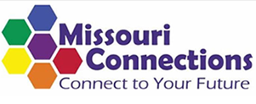
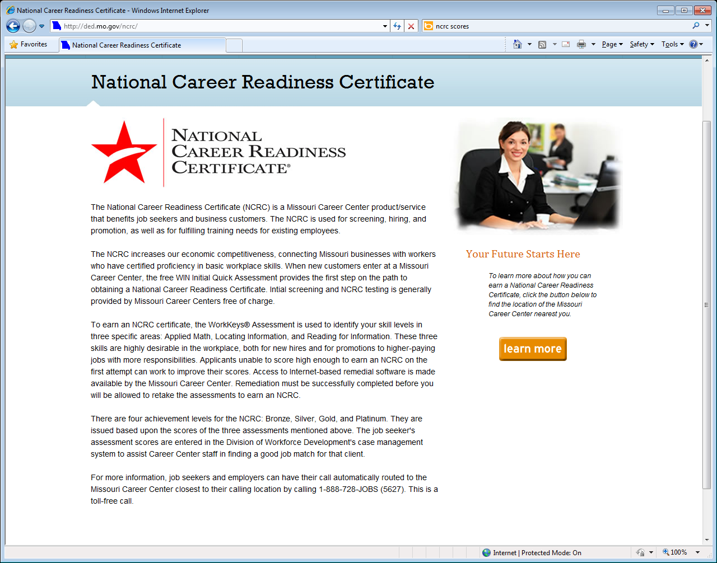

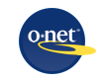
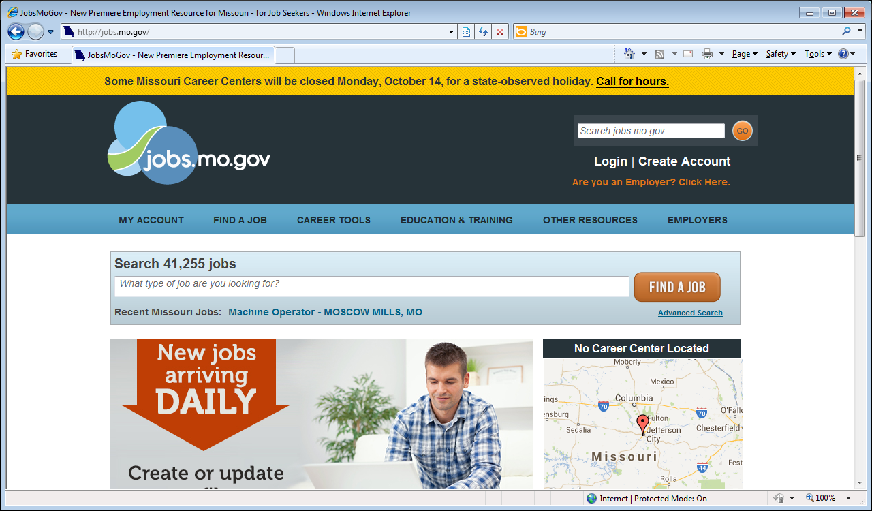
Where to Find – Career Planning Data
Notes:
There are a lot of portals to career planning data. Some of which may prove overwhelming to the computer novice? Or the job seeker with very low competencies? So today we will answer the question
How can career planning data be applied to empower such job seekers?
You will hear more detail about these and other websites throughout this catalogue of LMI eLessons, but for our purposes today there are a few particulars to note.
The first portal is the Missouri Connections webpage, it is useful to the full spectrum of job seekers who are trying to plan their career.
The next portal is the National Career Readiness Certificate, it is a Missouri Career Center service that benefits both job seekers and business customers. It is used to screen, hire, promote, and fulfill training needs for existing employees.
The third portal is the Missouri Career Grades, it is a simple tool that assists jobseekers and workforce professionals in choosing which careers have the best outlook in having good growth, large number of annual openings, and offers an above average wage for job seekers.
The fourth portal is the O* NET website, it is the most dense source of occupation information. While it has information relevant to a wide spectrum of job seekers, it may be overwhelming to the computer novice.
The fifth portal is the Missouri Education and Career Tool, it is a visually simple tool that allows jobseekers to use various filters to build a custom job search. The tool uses O*NET occupation language and Missouri wage and employment data. It is found on jobs.mo.gov website.
And finally, the last final portal to career planning data is the jobs.mo.gov website. This websites provides career planning and job training information.
(Advance Slide)

Slide 8
Explore Career Goals
Missouri Connections
Designed for first time career explorer
Career Planning Tools
Job Search Tools
http://www.missouriconnections.com/
NCRC
Missouri Career Grades
O*Net Online
Career Explorer
Notes:
Missouriconnections.org was designed for the younger (high school/college) job seeker. It is useful to the full spectrum of job seeker but because there are preliminary steps to establish a personal profile it may be discouraging to the computer novice or to the older worker who is just beginning to explore career planning information.
(Advance Slide)

Slide 9
Exploring Career Goals
    Develop a plan to achieve career goals
    Determine your skills and interests
    Explore Careers
    Create an education plan
    Search for colleges and training options
    Find a job
    http://www.missouriconnections.com/
Notes:
These tools are to help develop a plan to achieve career goals, determine your skills and interests, explore the different careers, create an education plan, and to help search for colleges and training options that help find a job.
(Advance Slide)

Slide 10
Explore Career Goals
Missouri Connections
NCRC
Used for screening, hiring and promotion
Assess Training Needs
Provided by MO Career Centers for free
http://ded.mo.gov/ncrc/
Missouri Career Grades
O*Net Online
Career Explorer
Notes:
National Career Readiness Certificate helps assess the training needs of an individual for the workforce. This service is provided by Missouri Career Centers located throughout the state for free.
(Advance Slide)

Slide 11
Exploring Career Goals
Evaluate a job seeker’s skill levels in applied math, reading and locating information.
Used by business customers for screening, hiring and promotion
The job seeker’s assessment scores are entered in the Division of Workforce Development’s case management system to assist Career Center staff in finding a good job match for the client
http://ded.mo.gov/ncrc/
Notes:
The service evaluates a job seekers skill levels in applied math, reading and locating information. Business customers use it for screening, hiring, promoting, and fulfilling job training needs. Assessment scores from job seeker’s are entered into the Division of Workforce Development’s case management system to assist Career Center staff in finding a good job match for the client.
(Advance Slide)

Slide 12
Exploring Career Options
Missouri Connections
NCRC
Missouri Career Grades
Projects future outlook of occupations
Identifies training and educational needs
Lists top occupations in specific regions
http://www.missourieconomy.org/pdfs/abcs10-20grades.pdf
O*Net Online
Career Explorer
Notes:
Missouri Career Grades projects the future outlook of occupations, indentifies training and educational needs and lists top occupations in specific regions.
(Advance Slide)

Slide 13
Exploring Career Goals
Grades A, B, C, D and F are used to help compare the future outlook of the 800 plus occupations
Three variables are used to determine the grade: job openings, percent growth and average wages of an occupation
Career Grades are available for Missouri and the 10 Workforce Investment Areas (WIA’s)
Due to regional differences, grades may be higher or lower in different areas of the state
Occupations are grouped by the education and training levels associated with those occupations
http://www.missourieconomy.org/pdfs/abcs1020grades.pdf
Notes:
Career Grades help compare the future outlook of the 800 plus occupations by assigned grading. Grades range from A, B, C, D and F. To determine grading, three variables are utilized: job openings, percent growth and average wages of an occupation.
Career Grades are available for Missouri and the 10 Workforce Investment Areas (WIA’s). Occupations are grouped by the education and training levels associated with those occupations.
(Advance Slide)

Slide 14
Exploring Careers Options
Missouri Connections
NCRC
Missouri Career Grades
O*Net Online
Source for occupational information
User friendly Career Exploration Tools
Targets full spectrum of job seekers
http://www.onetonline.org/
Career Explorer
Notes:
O*NET Online is a source for occupational information. It contains user friendly Career Exploration Tools and targets the full spectrum of job seekers.
(Advance Slide)

Slide 15
Exploring Career Goals
Lists descriptions of different occupations and the basic and specialized skills associated with those occupations.
Provides an Interest Profiler to help find careers jobseekers may want to explore
Search career path by keywords or by industry
Businesses can utilize for human resources
http://www.onetonline.org/
Notes:
O*NET lists descriptions of different occupations and the basic and specialized skills associated with those occupations. The website provides an Interest Profiler to help find careers that jobseekers may want to explore. You can also search career paths by keywords or by industry. It is a good source for businesses, they can utilize occupational information for human resources.
(Advance Slide)

Slide 16
Exploring Careers Options
Missouri Connections
NCRC
Missouri Career Grades
O*Net Online
Jobs.Mo.Gov
Education and Career Tool
Education & Training
Job Search Assistance
Employer /Employee Link
http://Jobs.mo.gov
Notes:
Jobs.mo.gov provides job listings, career tools and education & training resources.
(Advance Slide)

Slide 17
Exploring Career Goals
Job Search Tool
  Locate Career Centers
  Job Search Assistance
Education & Training Resources
  Education & training provider search
  Resources for entrepreneurs
  Workshops
  Training Assistance
Career Tools
  Skills Assessment
  Resume Writing
  Education and Career Tool: https://jobs.mo.gov/mcs/mech/MECHSearch/OccupationSearch.aspx
    Search for available jobs by occupation, occupation group, or Classification of Instructional Program (CIP).
Notes:
Job.mo.gov helps individuals find jobs and locate career centers. It also gives individuals access to career tools that assess jobseeker skills and give tips on how to create a resume. Jobseekers also can find ways to obtain education and training through: workshops and searching training providers. The Missouri Education and Career Tool allows jobseekers to search for available jobs by occupation, occupation group, or Classification of Instructional Program (CIP). The site is updated frequently to get the most up to date information. Job vacancies are posted by businesses and organizations.
(Advance Slide)

Slide 18
Communicating the Fundamentals
Employment Fundamentals
The Power of Education
Pursue a passion
  What are you good at?
  What do you enjoy doing?
Understand the professional fundamentals
  Personal Effectiveness
  Academic
  Workplace
Skills Assessments
  Skills Development
Occupational Training
  In Demand
  Bright Outlook
  Green Economy
Notes:
In closing, the fundamentals of successful employment include:
pursuing an interest or passion, (identified with the MO Career Guide)
respecting the professionalism of the workplace, (reported with the Competency Models) and
pursuing the education needed to open doors (demonstrated with the MCET).
MERIC and other career planning sources provide a variety of tools to help the expert or novice job seeker find lasting employment success. You will see more of these tools throughout this series.
(Advance Slide)

Slide 19
Website Links
Missouri Career Connections:
www.missouriconnections.org/
National Career Readiness Certification:
http://ded.mo.gov/ncrc/
Missouri Career Grades:
http://www.missourieconomy.org/pdfs/abcs10-20grades.pdf
O*net Online:
www.onetonline.org/
Career Explorer:
https://jobs.mo.gov/mcs/mech/MECHSearch/OccupationSearch.aspx
Missouri Jobs:
www.jobs.mo.gov
Notes:
Here is a list of the websites that we covered in Employment Fundamentals. Please feel free to pause the webinar where you are now and practice retrieving data on your own. If you choose not to, please continue on with the Module lesson.

Slide 20
Module 1: Complete
You should now be able to demonstrate to job seekers:
  The fundamentals of professionalism,
  The power of education, and
  How to start exploring and designing a career path.
Preview: Module 2
  Using Skills Assessments & Career Pathway Planning
Notes:
Congratulations! You have completed today’s lesson and the first module of this series.
(Advance Slide)

Slide 21
Thank you for your participation!
Contact us at:
mericdata@ded.mo.gov
Fax: (573) 751-7160
www.missourieconomy.org
Notes:
Thank you for participating in this LMI series of webinars. If you have any questions regarding this training or would like additional LMI data information, please feel free to contact by e-mail at mericdata@ded.mo.gov. You may also visit MERIC’s website at www.missourieconomy.org for additional resources and contact information for your assigned regional staff liaison.

Slide 22
Please take a moment to complete this survey, which is available online at the link below. Your input will assist us in making these webinars more effective and successful as we continue to make further improvements.
http://www.surveymonkey.com/s/M7BLRV9

